Slide 1
A Truckload of Financial Value
Russ Bonilla

Slide 2
Content
Playbook for FP&A Automation
Initial FP&A Plan
Reporting
Budget/Forecast Automation
12 Month Rolling Forecast
Introduction of AI
Cash Flow
What does it all mean?
Notes:
Presenter:
John
Backup:
Adam

Slide 4
FP&A Playbook
Development of Plan
Early Years
Initial FP&A Plan
Planful implemented but only 1 person knew the system
Exit Planful SME & New FP&A Lead doesn’t embrace Planful
Second New FP&A Lead joins in May of 2018
Planful reaches out for annual contract negotiation
System generated monthly Management reporting
Automated KPI reporting
Automated budgeting / forecasting
Additional subject matter experts
Was Planful the tool??

Slide 5
FP&A Playbook
Initial Contract Negotiation
Reviewed Merchants’ FP&A goals
Discussed Planful’s suite of products
Determined there was a match
Signed a 3-year contract & included a “Train the Trainer” package
Notes:
The best relationships are built with empathy

Slide 6
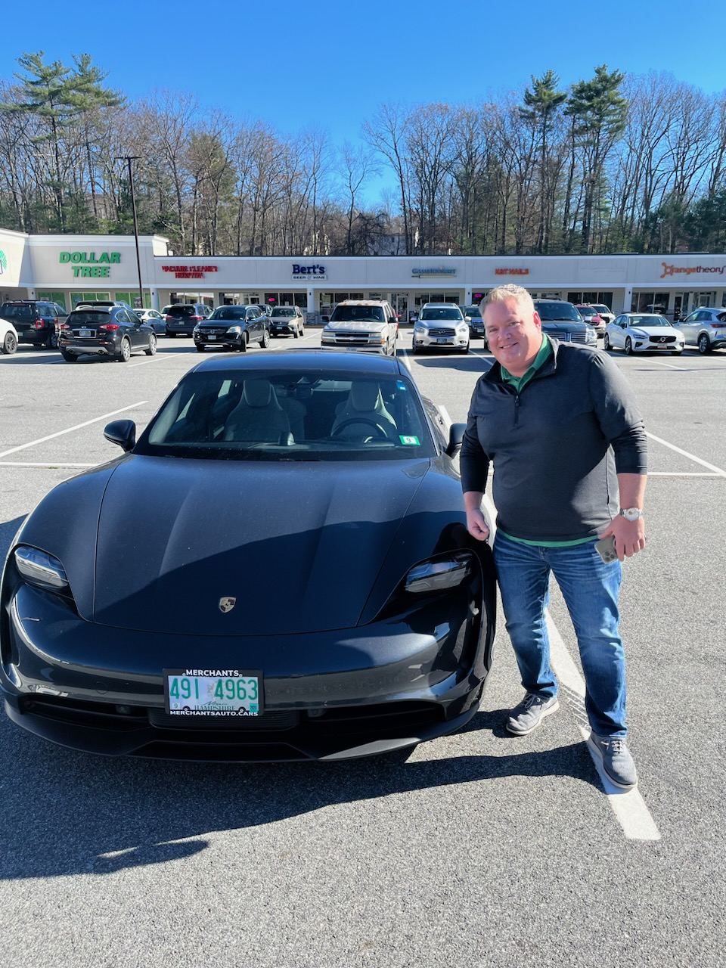
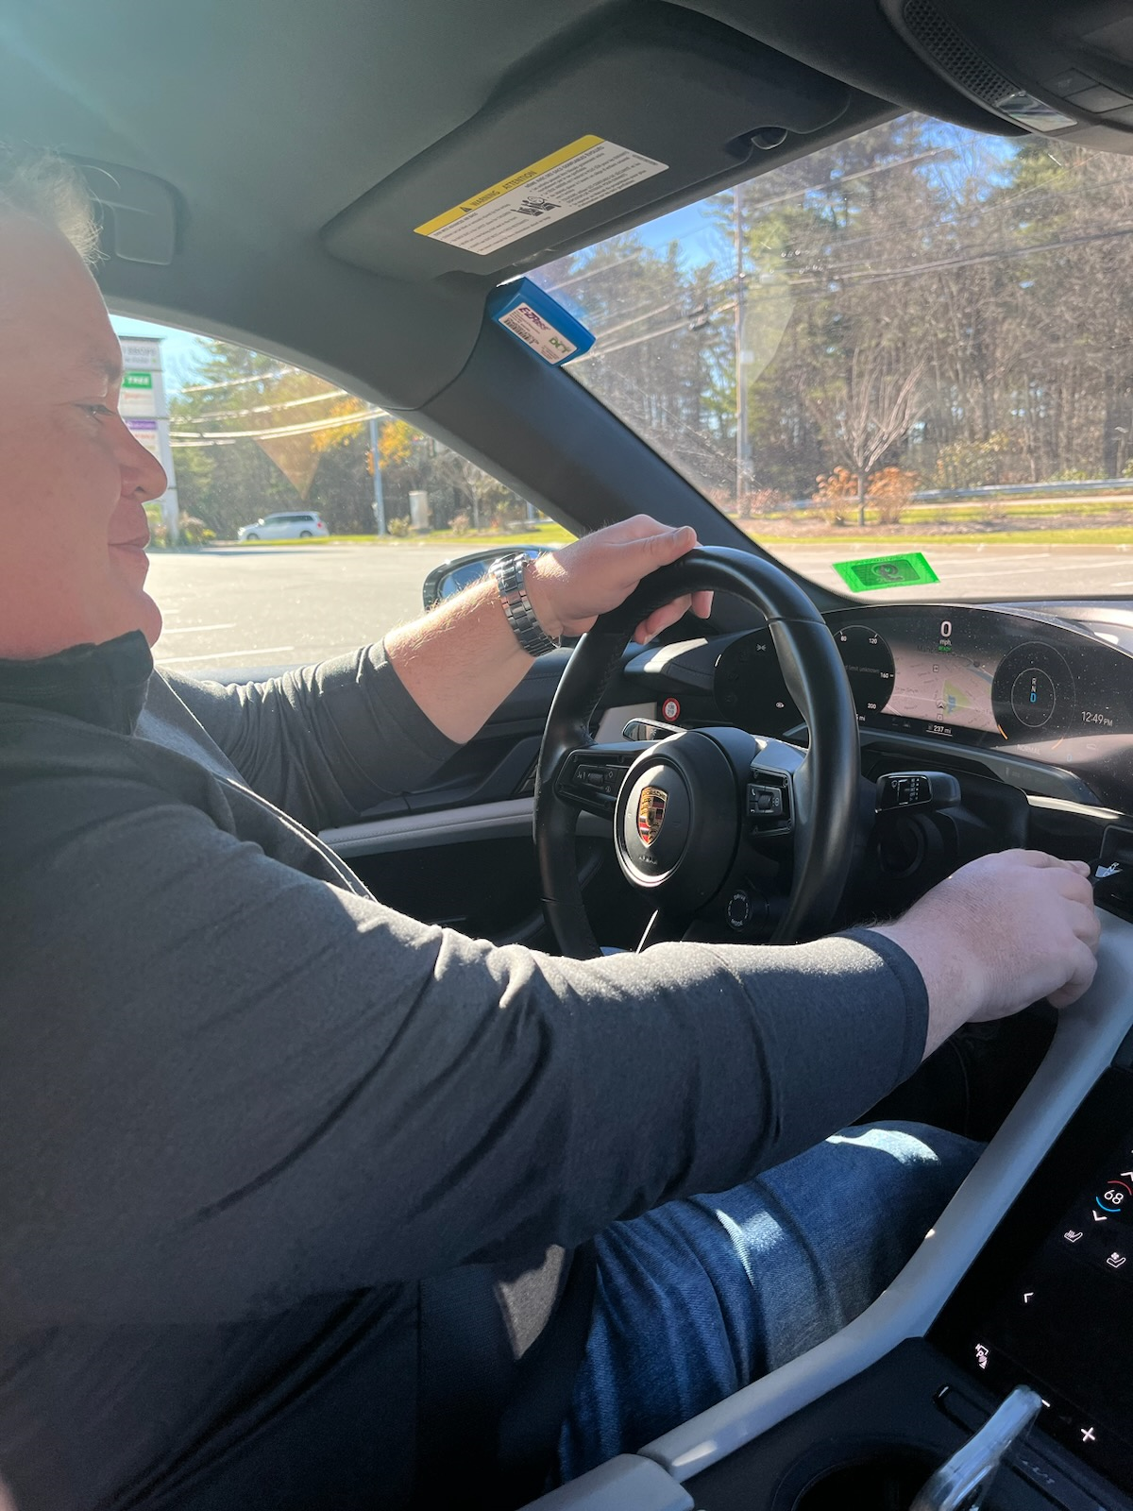
FP&A Playbook
Meet the Trainer

Slide 7
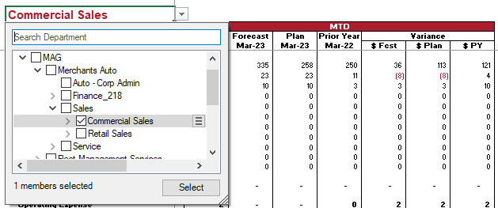
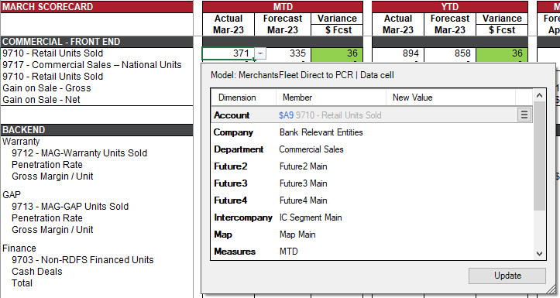
FP&A Playbook
Phase 1 – Report Automation
Spotlight Reporting
Management report to start
Scorecard second
Budget / Forecast
Balance Sheet
Adhoc KPI analysis
Savings of 12 hours

Slide 8
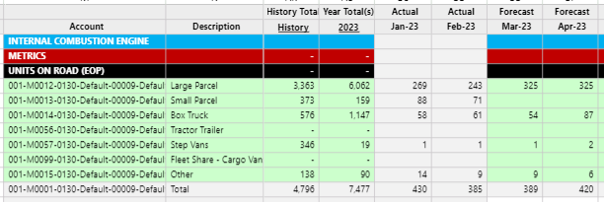
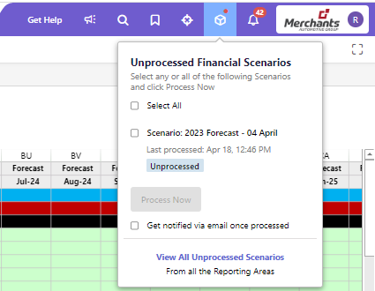
FP&A Playbook
Phase 2 – Budget / Forecasting Automation
Templates
1 Hour/week of training with Ron
Moved 16 P&L & Balance Sheet templates into Planful
Linking & roll-up fears removed
3-month budget process down to 6 weeks (280 Hours)
2 week forecast process down to 1 week (40 Hours)

Slide 9
FP&A Playbook
Phase 3 – Rolling 12 Month Forecasting
Covid Shuts Down the World
Rolling Forecast Stays
Changing KPI’s & customer financial situation
Forced to review full-year financial outlook weekly
Weekly forecasting allowed Executive Team to make timely & accurate decisions
Merchants had best year EVAH!
Merchants now does a rolling 12 month forecast every month
The majority of changes are key KPI’s
Huge growth from a company that forecasted 2 times a year
FP&A > FPAC

Slide 10
FPAC Playbook
Phase 4 – Introduction of AI
Signals
Reduced training time with new associates
Drill in capability takes the Finance Business Partner right to the template to research
Pings FP&A team members to review line items when numbers are outside the set parameters

Slide 11
FPAC Playbook
Phase 5 – Cash Flow Automation
Signals
Currently using spotlight to generate the Cash Flow statement
Few KPI’s and cash items are loaded monthly in stat accounts
Allows for monthly cash flow reporting & forecasting

Slide 12
FPAC Playbook
Time Repurposed
332 hours/person
4 people = 1,288 total hour
What does this all mean?
Time Savings & increased Productivity
Notes:
Additional time used as consultants for the business

Slide 13
My Roles Evolution
Long Range Forecast
Strategic partner in the direction of the company
Helping raise capital
My Teams Evolution
No single point of failure
In 2022 FPAC saved $2.2 million in efficiency gains (ROI on Train the Trainer)
Work life balance
FPAC Playbook
Move from Reporters to Consultants
Time Repurposed

Slide 14
FPAC Playbook
Phase 1:
Report Automation
Phase 2:
Budget / Forecasting Automation
Phase 3:
Rolling 12 Month Forecasting
Phase 4:
Introduction of AI
Phase 5:
Cash Flow Automation
Notes:
The best relationships are built with empathy

Slide 15
Questions?
Q&A with your speaker

