Slide 1
Transforming Accounting: Comprehensive solution from reconciliation to consolidation to external reporting
Jordan Akers & Chris Howard, Planful

Slide 2
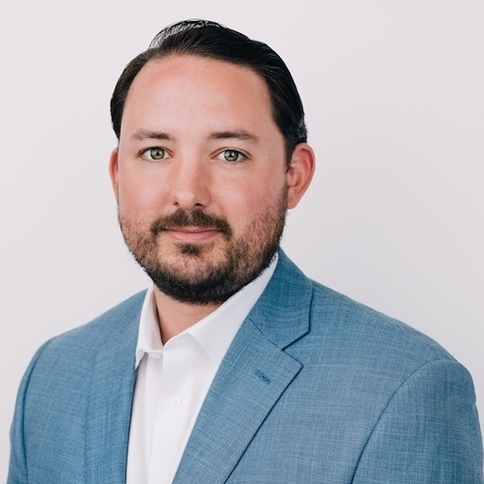
Jordan Akers
Senior Solution Consultant, Planful
Picture
Chris Howard
Senior Director
Global Partnerships, Planful
Picture

Slide 3
In-Person Event Attendees | CPE Information
Scan your badge/complete the sign-in sheet for each CPE-eligible session you attend.
Don’t leave your session early! You must say in the session for the whole duration.
CPE Certificates will be sent to your event registration email shortly after the event.
CPE Provided By:

Slide 4
Virtual Event Attendees | CPE Information
Respond to at least 3 polls/check-ins for each CPE-eligible session you attend.
Don’t leave your session early! You must say in the session for the whole duration.
CPE Certificates will be sent to your event registration email shortly after the event.
CPE Provided By:

Slide 5
Strategic Partners & Customers
Partnered together since 2017
2018 Tech Alliance Partner of the Year
Joined Planful as a customer in 2020
2022 Planful Strategic Partne of the Year
Developed direct integration between Planful & Workvia
Joined Planful as a customer in 2020
Announced our strategic partnership in 2021
2021 Trintech announced as Planful’s Strategic Partner of the year
$1 million dollar business
Notes:
The power of partnerships
Countless hours of joint collaboration, hard work all geared to creating a modern solution for today’s modern CFO, finance and accounting professionals

Slide 6
The Great Disconnect
Notes:
Speaker: Chris
In our opinion finance has been an underserved and overlooked area within many organizations, historically faced with responsibility for manual, tedious and time consuming tasks

Slide 7
Why are we still closing the books this way?
Multiple data sources merged together
Finance validates multiple data sets
Data emailed to stakeholders for review
Finance documents variances
Data compiled for reporting
Reporting emailed for review
Final reports created
Reporting manually created in word

Slide 8
Why are we still planning this way?
Finance validates multiple data sets
Update and build models with stale data
Email & collaborate for review
Clean up report for exec approval
Cycle repeats
Multiple data sources merged together
Reports made “board ready”
Reports provided to leadership
Reports approved
Plan submitted back to system

Slide 9
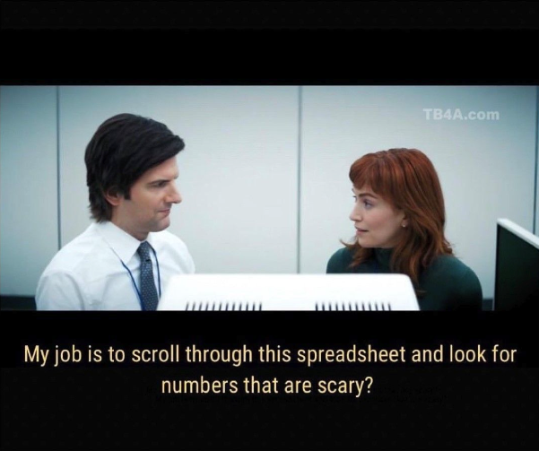
Notes:
Speaker: Chris
TV Show Severance

Slide 10
The Finance and Accounting Disconnect
Varying Priorities and Disconnected Systems
VP of Accounting
VP of Finance
Slowly closing the books
Disconnected
Hesitancy in reporting
Reactive
Scattered financial plans
Disconnected
Slow Processes
Reactive

Slide 11
The Modern CFO Tech Stack

Slide 12
Strategic Partnerships
For Modern CAOs and CFOs
Notes:
CHRIS: Have everyone give a 30-60 overview of their organization.
Planful is a financial performance management tool designed to support core financial planning

Slide 13
The Modern Close Management Process
Data Source
GL Data
Reconciliations
Consolidations
Report Creation
Report Automation
Books Close
Actual’s are ready for reporting
ERP Data
GL Data – Chart of Account, Trial Balance Transactions, Currency Data
GL balances
Reconciliations
Consolidations Engine
Drag-drop Reports
Trial balance
Account Reconciliations
Balance Amounts Requiring Adjustments determined
Top Side Journal Entries
Financial Statements
Variance Analysis
Forward Looking Statements
Final Mile of Reporting
Linking and collaborative capabilities automate final reports in spreadsheets, documents, and slide decks
Transactions

Slide 14
Common Motivators
Similar challenges our customers faced before transformation takes place
Insufficient technology & resources
Mandated by leadership
Pressured to reduce risk
Increased regulatory standards
Pressured to meet a changing environment
How are your current tools and processes serving you?

Slide 15
Poll time!
Can you think of processes still being done in Excel today?

Slide 16
Poll time!
Who here feels like they still spend too much time on non value added work?

Slide 17
Poll time!
Would getting actuals finalized faster speed up your process and allow you to add more value?

Slide 18
Questions?
Q&A with your speaker

