Slide 1
Product Highlights: Mastering Financial Consolidations and Overcoming Financial Complexity Across Your Business
Jordan Akers, Planful
Ben Page, Planful

Slide 2
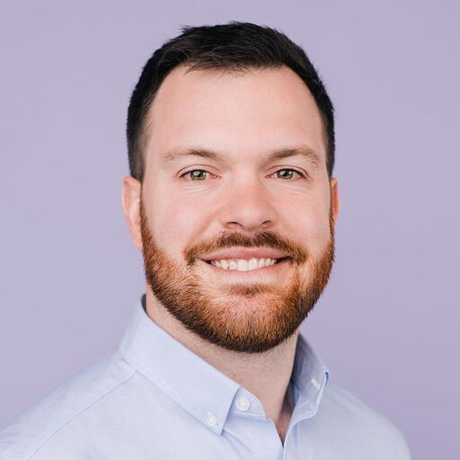
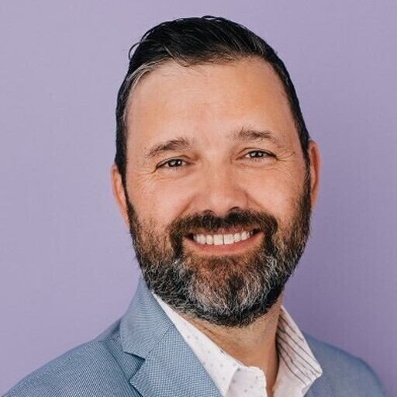
Jordan Akers
Senior Solution Consultant, Planful
Picture
Ben Page
VP Solution Consulting, Planful
Picture

Slide 3
In-Person Event Attendees | CPE Information
Scan your badge/complete the sign-in sheet for each CPE-eligible session you attend.
Don’t leave your session early! You must say in the session for the whole duration.
CPE Certificates will be sent to your event registration email shortly after the event.
CPE Provided By:

Slide 4
Virtual Event Attendees | CPE Information
Respond to at least 3 polls/check-ins for each CPE-eligible session you attend.
Don’t leave your session early! You must say in the session for the whole duration.
CPE Certificates will be sent to your event registration email shortly after the event.
CPE Provided By:

Slide 5
Agenda
The Monthly Close
Demo
Q&A

Slide 6
Poll time!
How long does your consolidations take?

Slide 7
Poll time!
How many currencies do you operate in today?

Slide 8
Poll time!
How many legal entities do you have today?

Slide 9
The Monthly Close Process
Does not begin and end with Consolidations
PLANFUL
TRINTECH
WORKIVA
Currency Translation
Eliminations
Adjustments / Reclassifications
Rollforwards
Reporting and Analysis
Process Management
Account Reconciliation
Transaction Matching
Close Analytics
Disclosures
K’s and Q’s
GRC
ESG

Slide 10
Demo

Slide 11
Questions?
Q&A with your speaker

Slide 12
Up Next
Increasing User Adoption Through Advanced Reporting
Thank you!
Michael Zambetti National DCP

