Slide 1
The Role of a Money Manager & How Finance Supports Them
Jennie Rush, Kiewit

Slide 2
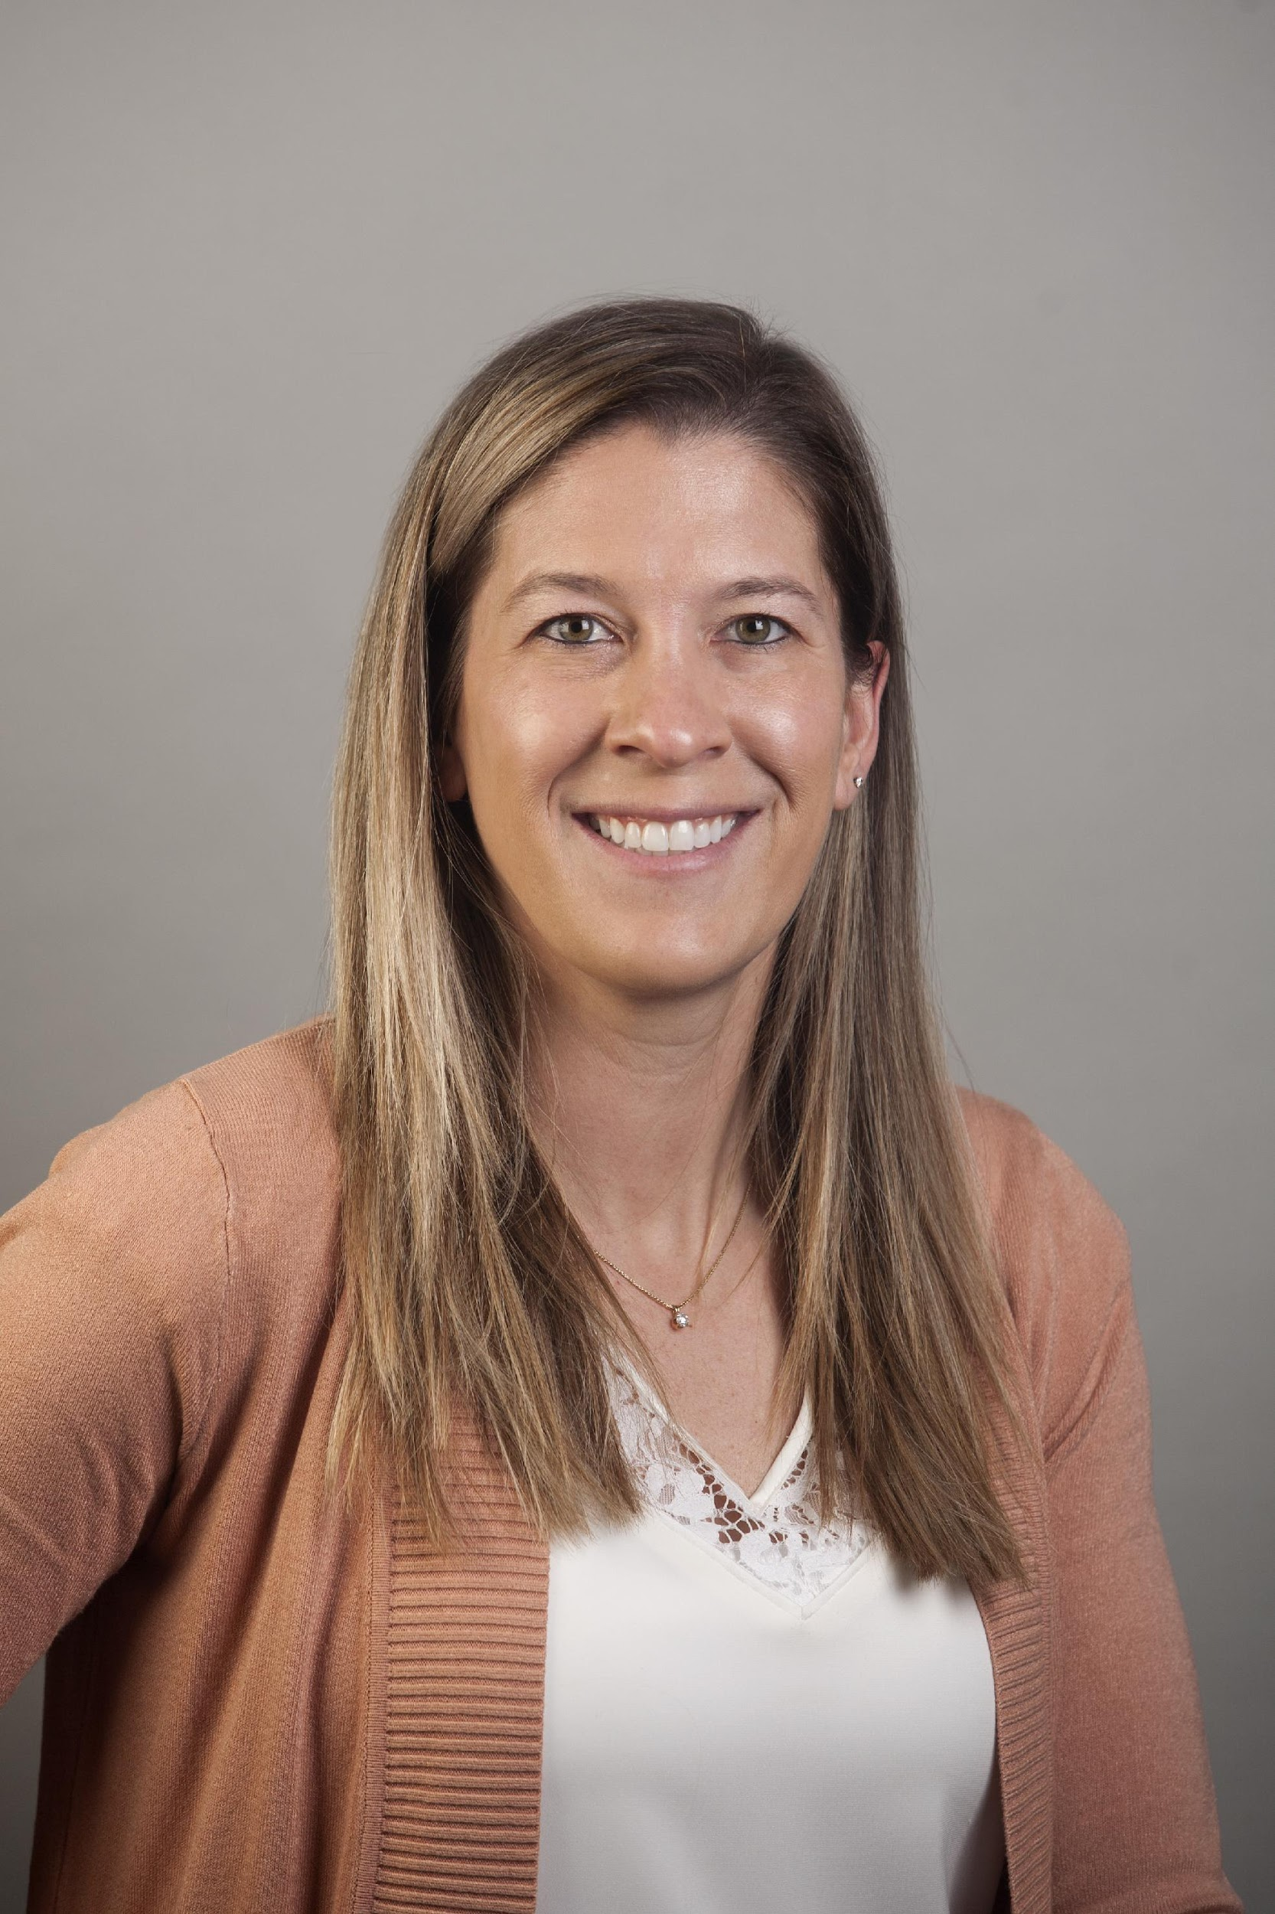
Jennie Rush
Finance Supervisor, Kiewit
Jennie Rush is a Finance Supervisor at Kiewit Corporation, where she supports the Kiewit Technology Group (KTG) as part of the Financial Management team. She has a strong passion for workforce finance and enjoys working with KTG Money Managers and Human Resources. She started with Kiewit Technology Group during its Planful implementation in 2017 and has since developed improvements to the Department’s financial planning processes by working smarter, not harder. She consistently analyzes process data and is continuously pursuing methods to create efficiencies within the organization.

Slide 3
Who is Kiewit
Kiewit is one of North America’s largest and most respected engineering and construction organizations. Our construction and design engineering professionals work on some of the industry’s most complex, challenging and rewarding projects – whether it’s boring tunnels through mountains, turning rivers into energy, or building bridges that connect communities.
Kiewit people tackle important projects of every size, in any market. Our 7 markets are: Building, Industrial, Mining, Oil, Gas & Chemical, Power, Transportation, and Water.
Kiewit’s commitment to safety, quality and environmental stewardship are ingrained in everything we do.
Notes:
Kiewit is one of North America’s largest and most respected engineering and construction organizations. Our construction and design engineering professionals work on some of the industry’s most complex, challenging and rewarding projects – whether it’s boring tunnels through mountains, turning rivers into energy, or building bridges that connect communities.
Kiewit people tackle important projects of every size, in any market. Our 7 markets are: Building, Industrial, Mining, Oil, Gas & Chemical, Power, Transportation, and Water.
Kiewit’s commitment to safety, quality and environmental stewardship are ingrained in everything we do.

Slide 4
Agenda
What is the Kiewit Technology Group (KTG)?
Money Manager Responsibilities
How does the Finance Team Support KTG?
What’s Next for KTG?
Notes:
Today we’ll talk about what makes up Kiewit Technology Group or our acronym KTG
What is a Money Manager
How our finance team supports Kiewit Technology Group
And what’s next for us

Slide 5
What Makes up Kiewit Technology Group (KTG)
130+
27
30
Cost Centers
Money Managers
Departments
Notes:
We are an overhead department that doesn’t generate revenue, but we still have a significant budget that we must adhere to. Kiewit Technology Group has 27 Money Managers that are responsible for their own financials. Those 27 money managers make up 30 different departments; those departments include: Architecture, Data Enablement, Network Services, and Software (to name a few). And of those 30 Departments, we currently have 130 cost centers, and that amount is ever changing.

Slide 6
Money Managers are Responsible for
Reviewing actuals for month-end and year-end
Compiling budget in fall for future year
Approving invoices for costs in their area
Forecasting monthly to stay under budget
Working with Finance to address Transfers/Terminations/Hires/Contractor Actions
Reviewing monthly variances with Finance
Notes:
A Money Manager is someone within KTG that manages a portion of our budget. Money managers are responsible for continuously reviewing their actuals and comparing to their budget and projections
-Compiling a budget for the upcoming year (which we usually begin in August and September and have it submitted by October or early November)
-Reviewing and approving invoices for cost in their areas
-Ensuring their forecasts are accurate monthly and that they are successfully tracking to their budget
-Managing all their workforce planning to include transfers, terminations, hires, & contractor actions with the Finance team (primarily myself). I work with the managers and HR to submit workforce changes in our ERP system and Planful.
And lastly, reviewing monthly variances with Finance. Money Managers are required to provide a comment for any variance that is 5% AND $25k over or under their projection

Slide 7
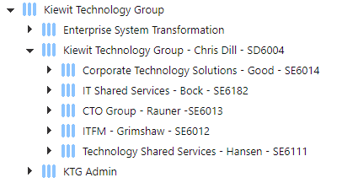
KTG Hierarchy
5 C-Level Executive areas
26 different company codes
3 countries with KTG employees
30 states with KTG employees
Notes:
Here are a few screenshots of our complex Hierarchy. This first screenshot shows our rolled-up level. We have 5 C-Level areas and then it breaks out to Departments/Money Managers.

Slide 8
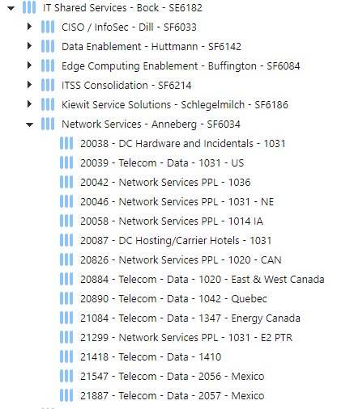
KTG Hierarchy
5 C-Level Executive areas
26 different company codes
3 countries with KTG employees
30 states with KTG employees
Notes:
As you can see in this screenshot, we have 6 Money Managers reporting to Bock. Anneberg’s area is quite complex with 14 different cost centers to manage. We have people working across the US/Canada/Mexico so we must make sure we have the correct company code/cost centers to account for peoples’ locations (especially for tax purposes). Our workforce changes a lot so sometimes if someone in one state moves from one Money Manager to another, we must create a new cost center in the new dept for that. It’s constantly changing.

Slide 9
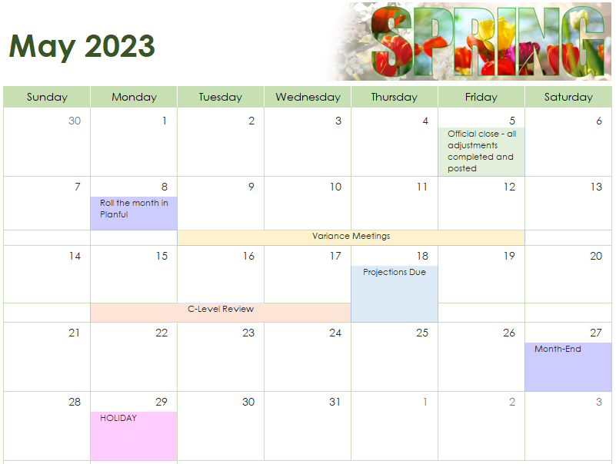
The KTG Financial Calendar
Notes:
The Finance team lives/breathes by these deadlines. We start off with Month End Close and then comes my To-do list. I Roll the Month in Planful (which changes April Forecast to April Actuals). Then I create the April Variance Report for my upcoming Variance Meetings with the Money Managers. It’s a busy week as variance meetings add 14 extra meetings to my calendar in one week. The following week, I have C-Level Review meetings. (I’ll touch on the details of both types of meetings later in my presentation). Our Money Managers must submit all Projections by End of Day May 18th. From there, we create a copy of our Current Forecast and then Title that our May Projection. All Money Mangers need to be able to forecast as best as they can until Month End of May 27th.
(In my Variance Meetings, I also walk through workforce changes (which I’ll touch on later in my presentation). I capture all requests from Money Managers and then I schedule meetings with our C-Levels to get their approval of the requested changes.

Slide 10
The KTG Variance Report
Notes:
Here is a screenshot of what our Variance report looks like in Planful. A variance is at least 5% AND $25,000 to the good/bad from what they projected vs their actuals. As you can see, we’ve added a Variance Check Column to pop that variance out and show managers lines that require a comment. When there are variances, I use Dynamic Commentary and assign a task to the Money Manager. Any variances in labor, I provide the details to the Money Managers. If actuals are less than projection, it’s usually open positions, Holidays or PTO. When people take pto or holidays, no cost hit so actuals will be lower. We see this a lot in summer months. If actuals are higher than projection, it could be that no one is taking PTO. I also check overtime for our hourly employees
Notes for me:
-A spot on Labor delta should be a -7% for attrition.
-May need to adjust b/c SAP actuals incorporate adjusted base wages (401K, FSA %, etc) and Planful doesn’t do that. So if people aren’t taking PTO this could play a factor in labor variances. Example: February 2020
40.45% which doesn’t include attrition & PTO Burden
-Just explain that along with attrition we estimate for PTO. We get charged 100% of our PTO up front every year. If people don't take it, they are going to be over budget. It is going to cause variance over the next few months, and we'll have to absorb it.
-The Company composite rates require us to budget 16.20% for PTO burden…that’s what we pay employees every week, that way when they take PTO (PTO Taken -12%) no cost hits our cost center.

Slide 11
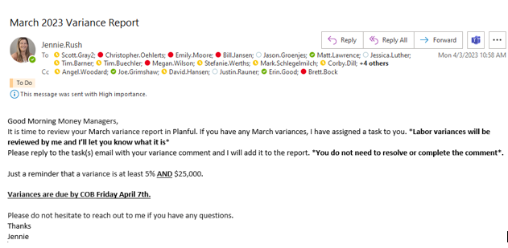
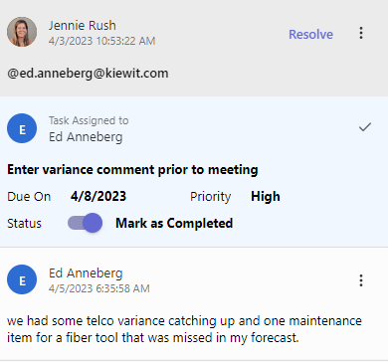
The KTG Variance Report
Notes:
Here’s an example of what the task looks like. I assign a deadline (which correlates with their variance meeting). The Money Managers then comment on their variance tasks. Once I have assigned out the variance tasks in Dynamic Commentary, I send an email to all Money managers. For most, it’s a reminder that it’s time to go into Planful and see what variances they have. For others, they already knew the variance was coming and are prepared to “speak to it”.

Slide 12
Agenda for Variance & C-Level Meetings
Updates from the Finance Team
Variances and Financials
Workforce Changes
Projection Reminder
New Features from Planful
Updates from the Finance Team
Labor Variances
Cost Moves
Unidentified Cost
Employee Transfers, New Hires, Terminations
Net Staff or Net Contractor Adds
Notes:
Here’s the agenda for our variance & C- Level meetings. First, we’ll talk financials. As I state earlier, anything labor, I find out what the variances is and share with the Money Managers.
Sometimes cost was associated with the wrong General Ledger account, so the finance team submits cost moves to fix that. Or other times, we find cost that hit their area incorrectly or they didn’t plan for it to hit that month. That happens a lot with the timing of when invoices are processed/paid.
Then, we talk workforce. Our dept is ever-changing so normally there’s always an HR update happening with each Money Manager. I compile a list of all changes and hang on to it until I meet with their respective C-Level the following week.
Lastly, I share updates from the Finance team (it could be as simple as a projection reminder). Or I’ll share with them a new feature Planful rolled out. In April, I showed them all the snapshot feature (which got them all very excited).
C-Level meetings are run much like the Variance Meetings. I go over each Money Managers’ financials and workforce changes. I get approval from the C-Levels to make any HR changes (even as simple as pushing a start date on an open position b/c they don’t have candidates yet). Any new positions to be added by a Money Manager must be approved by their C-Level. At this point, I can now go in and make all HR changes in Planful.

Slide 13
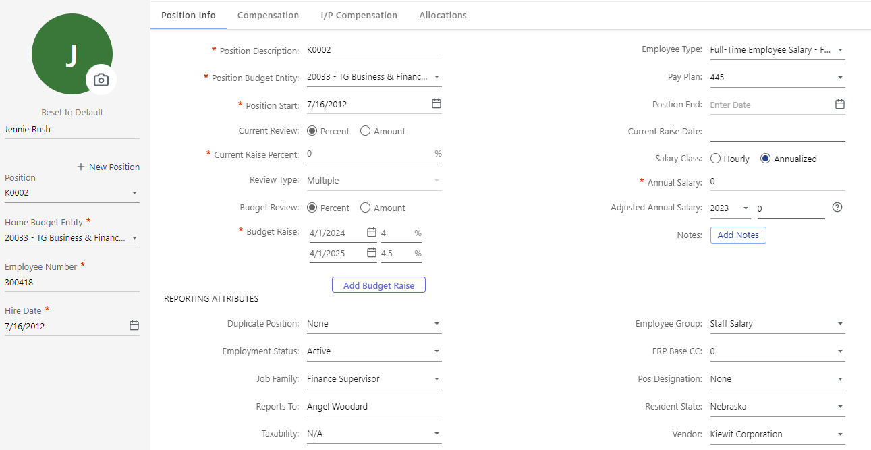
Workforce Attributes
Locked down to Administrators Only
Money Managers have View Only Access
We have unique fields in our HR template that aren’t in our ERP system
Notes:
Our HR templates can only be edited by Administrators. With 27 money managers, the data would never get updated consistently and accurately. And because we have approvals we require; it only makes sense to lock it down to Admins only. I pull a weekly report of all HR changes and adjust in Planful. Here’s all the attributes we’re currently using.

Slide 14
Workforce Attributes
Notes:
Our HR templates can only be edited by Administrators. With 27 money managers, the data would never get updated consistently and accurately. And because we have approvals we require; it only makes sense to lock it down to Admins only. I pull a weekly report of all HR changes and adjust in Planful. Here’s all the attributes we’re currently using.

Slide 15
WF Allocation Report: Proj vs Actuals with YTD
Notes:
One of our biggest accomplishments this year is reporting on Employee Allocations (Projected vs Actuals). We have a lot of employees that are 100% Project Allocated (which means they should be coding all their time to WBS elements supporting our field projects. Their cost should NOT hit their overhead cost center. As you can see above Billy Walker is 100% Project Allocated in his HR record. But then we look at our report. If it shows 100% under % KTG OH, that means they are 100% Overhead. If they are blank, that means they are 100% Project Allocated. You can see that Billy, Timmothy, and James all show Project Allocated, but had actuals hit their overhead cost center in March. Now our money managers can easily see this, and we can get time entry corrections doand hopefully eliminate rework in the future.

Slide 16
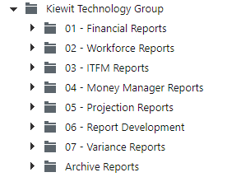
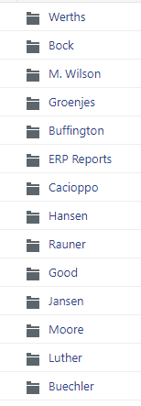
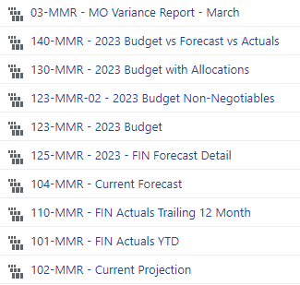
Ad-Hoc Reporting
Financial Reports
Workforce Reports
ITFM Reports
Money Manager Reports
Projection Reports
Report Development
Variance Reports
Notes:
Reporting is what matters most to our Money Managers. We have a good structure set up for our users that helps 1) find things easier and 2) ensure that we don’t have users creating random reports all over the place.
Our organization is a filing system, granting permissions to users as needed. We have a Financial Reports folder (which is used most & is my 2nd screenshot), a Workforce Reports folder (which is getting more use now that we use cost allocations at an employee level), an ITFM folder (where we house reports we use in our monthly Manager’s Meeting slide deck). The biggest help to us is the Money Manager reports. In the past, we created the reports sometimes weekly or monthly and had to send them via email in Excel. Now they request a report and if they confirm they would like to see that data again, we add it in their folder that only they have access to.

Slide 17
“Planful provides an easy to use and intuitive interface to perform all IT financial management activities. Trying to monitor expense management, forecasting, and budgeting activities with only SAP tooling would be extremely burdensome. Saves a significant amount of time by having Planful in place”
“Application is easy to use and modify needed views & reports”
“It gives me a good view of my financial standing in an interface that is easy to understand.”
“Everything is in one tool: Actuals, Planning, Forecasting. It’s ALL together”
“Our organization’s finance team has also been able to automate reports that I used to create via a complex process of downloading data, using pivot tables etc. saving me time to work on other business critical items.”
Notes:
Here’s a few quotes about what our Money Managers think about Planful. Now I’ll be honest, some of these quotes came from Money Managers that used to call the tool Painful instead of Planful. Now these same Money Managers heavily rely on the data that Planful provides at the click of a button. We’re finally getting to a point where side spreadsheet are diminishing and we’re trusting the tool to do the work for us.

Slide 18
What’s Next For Us
Continue working on Workforce Actuals
Revisit Workforce Automation
Explore Business User Experience (BUE) and how it can benefit our Money Managers

Slide 19
Questions?
Q&A with your speaker

