Slide 1
Accelerating Zero to Planful:
A Finance Evolution
James Muscat, Ten Lifestyle Group

Slide 2
James Muscat
Group Commercial Finance & FP&A Director
Notes:
To update
Brief background, Role, Company
PwC, Industries/Clients,

Slide 3
Agenda
About Me
About Ten
Digital Finance Transformation
Game changing Planful uses*
Consolidation
Reporting
Forecasting
What we’ve learned
*The numbers used in these slides are made up for presentational purposes

Slide 4
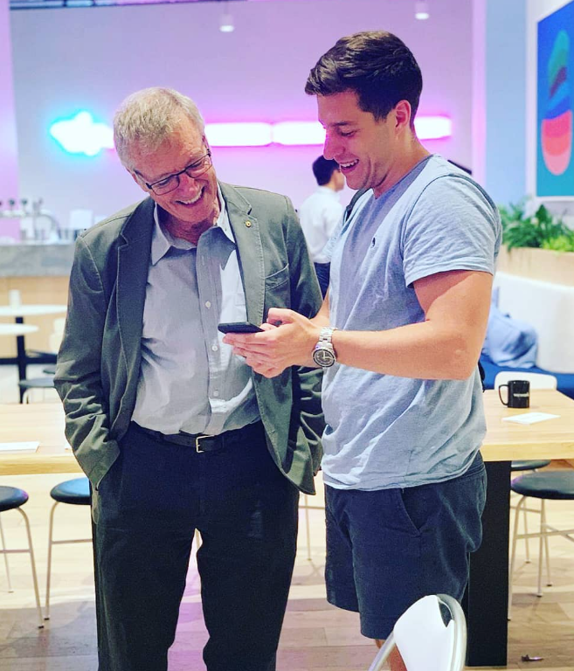
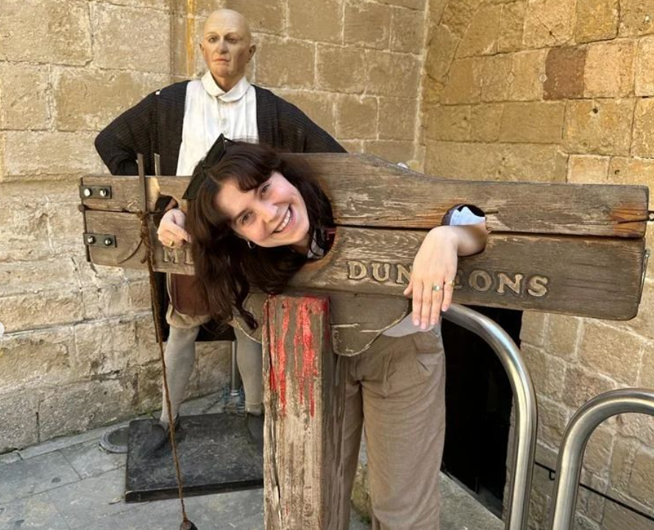
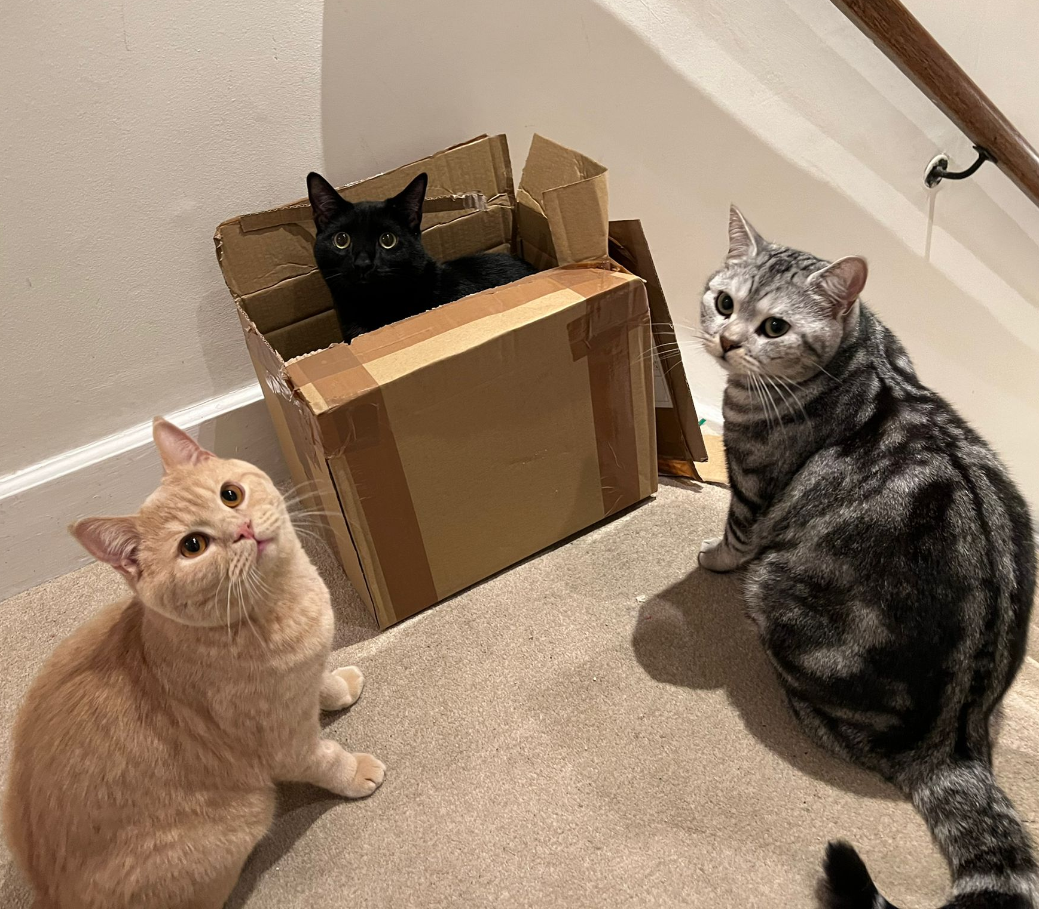
Notes:
PwC London - working mainly on FTSE listed clients
Easily swayed to get on a plane

Slide 5
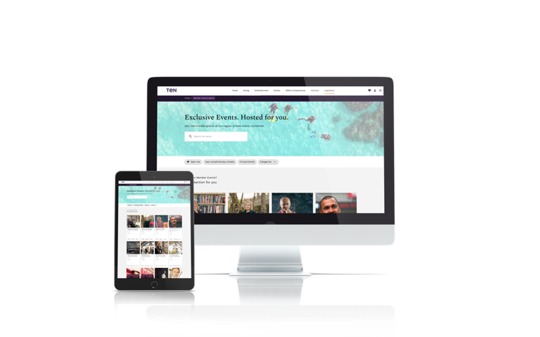
Our lifestyle and travel concierge service is offered to some of the most valuable customers of the world's leading private banks, premium financial services and luxury brands.
Headquartered London, UK
Employees 1,300
Corporate clients use Ten’s offline and online services to acquire, engage and retain affluent, high-net-worth customers and valued employees.
The service drives critical customer metrics, including Revenue growth and Net Promoter Score, and supports digital transformation initiatives.
Office Locations 22
Planful Users 8
Notes:
We help the customers of the world's leading private banks acquire and retain their affluent HNW customers using lifestyle and travel, concierge servics
Not only do we have local experts dealing with thousands of requests from our members every day through offline channels such as phonecalls, emails and whatsapps, we also have a fully transactional digital platform where you can self serve too.
Dining - worlds leading restaurants - held tables
Tickets - Because of our buying power we are given VIP allocations to sold out shows, and sports events.
Travel - global hotel collection - upgrades, in resort credit, late checkout
Content - inspiration - city guides featuring our members favourite restaurants / hotels / experiences etc, to dine, wine explore

Slide 6
Proposition for Members
Travel
Full Travel service IATA licensed
Exclusive benefits at 4000+ 4*/5* hotels
15% off at 650,000 hotels
Exclusively negotiated discounted flights and car hire with benefits
Tailormade holidays
Private Jets / Yachts
Dining
Held Tables, priority access and exclusive benefits at thousands of the world’s best restaurants
11,500+ restaurants
Industry insights and expertise
Exclusive hosted events
Entertainment
Access to the best seats, VIP packages and face value tickets, not available to the general public or sold out
Partnerships with the O2, Royal Opera House, Chase Centre San Francisco and more
Guaranteed inventory at desirable events in key cities
Luxury Retail
Personal shopping
Sourcing coveted products such as handbags, watches, jewelry
Exclusive offers on luxury lifestyle brands
Experiences & Events
Member events
Online Masterclass
Virtual Book Club – with top authors
Art club
Inspiration
In-depth City Guides
Articles and interviews with industry experts
Digital Magazines s - WINE, DINE, EXPLORE (travel), TREND (fashion)

Slide 7
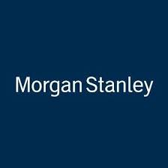
About Ten: Our Corporate Clients
Notes:
North America - Merrill lynch, Royal bank of canada, City national bank
UK - Coutts
HSBC
Run products for Amex, Visa and Mastercard in certain markets

Slide 8
Digital Financial Transformation
Getting out of Excel city

Slide 9
88
FP&A Before Digital Transformation
Undefined FP&A Function
Fragile & Complex Models driving reporting/ forecasting
Multiple Sources of Truth
Less effective Business Partnering
Sessions
Notes:
·We looked at how to segregate responsibilities accordingly rather than being jack of all trades.
Who business partners who? What do we want to provide?
·Struggling without one source of truth. Manipulating data pulled from our accounting system and data warehouse to create excel reporting. Lots of analysis and adjustments, done in separate places along the chain.
·Time wasted fixing links/errors. Corrupt files
·Little flexibility to model scenarios – i.e for example tweaking FX throughout 20 excels in a budget process was frustrating.
·Hard to build bespoke reporting for business partnering.

Slide 10
Multiple Sources of Truth & Fragile & Complex Models Driving Reporting/Forecasting
Group Finance
CFO
Trial Balance Review
Segmental Costs
Management Accounts
Board Deck
i.e management accounts
Segmental Revenues
FX rates linked at each stage
Adjustments in each file
Allocations
Complicated formulas and links, prone to breaking
Consolidation
Latest Forecast
Excel Files
Excel Files
PowerPoint
Notes:
Dimension Mapping in every file
Forecasting process - similar - 20+ files covering for every department

Slide 11
88
FP&A Before Digital Transformation
Undefined FP&A Function
Fragile & Complex Models driving reporting/ forecasting
Multiple Sources of Truth
Less effective Business Partnering
Sessions
Notes:
·We looked at how to segregate responsibilities accordingly rather than being jack of all trades.
·Struggling without one source of truth. Manipulating data pulled from our accounting system and data warehouse to create excel reporting. Lots of analysis and adjustments, done in separate places along the chain.
·Time wasted fixing links/errors. Corrupt files
·Little flexibility to model scenarios – i.e for example tweaking FX throughout 20 excels in a budget process was frustrating.
·Hard to build bespoke reporting for business partnering.

Slide 12
Digital Transformation in the Office of the CFO
Microsoft Business Central & Sharepoint
Power BI & Tableau
Finance IT Systems Manager
Planful & Adra
Yooz
Notes:
The office of the cfo
·Churn in the team over time – didn’t know how to use the accounting systems.
·and lack of SOP’s meant no one knew how to use the current old ERP to its full potential.
·Making use of Adra for Balancer, Task Manager for month end close / audit
·Making use of an invoice scanning software
•Power BI – ERP detailed analysis (i.e group debtor ledgers, underlying transaction detail)
•Planful – consolidation, dimensional reporting, forecasting
•Adra (recent) – month end close, tasker and balancer and audit
•Yooz (rolling out) – invoice and expense processing

Slide 13
Planful: Key Areas of Improvement
Consolidation
Reporting
Forecasting
Notes:
Hands up who uses each module?
Dynamic planning?

Slide 14
What Changed the Game
Key use cases in Planful

Slide 15
Consolidation
Automated connection between Microsoft ERP to Planful
20+ Entity level Currencies & Calculations
Dynamic journals for eliminations and FX reserve calculations
Utilization of standard and reclassification journals
Report Collections
Operational Data (?)
One source of truth
No human interaction
Manage the month end
The audit trail!
Notes:
Automated feed using power automate, automatically pushing our summary data into planful from business central every hour.
This has been very useful in areas where we are accounting during the month, rather than just at month end
Looking at how we can do this with Tableau for operational data.
We have 20+ ledger currencies, 30+ entities - one big excel file!
Our currency translation to consolidation currency is now automated - minimising human error, and linking back to having one source of truth for currency
Dynamic journals to ensure all the eliminations balance and the foreign exchange entries to the p&l and reserves are treated correctly
Standard and reclassification journals - a clean way of posting topside adjustments and managing adjustments with the local accountants at month end
Report collections - I will delve into this a little later on - but now we have a standard set of reports which have been set up to show the journey from local to consolidated currency, including bringing out adjustments. A great output to review and much cleaner for the auditors

Slide 16
Reporting
Report Collections
featuring;
Row & Column Sets
& Substitution Variables
Key uses

Slide 17
Key Dimensions
Ledger
Reporting Currency
Corporate Client
Nominal Account
Cost Center
Office
Suppliers
(Entity - Drives FX)
(LC or CC)
(Teams & Departments)
(New)
Notes:
Made it easier to look linkages in data, in which it was very hard to do before, without a reporting tool
If its in planful, and dimensionalised - you can report on it!!

Slide 18
Row & Column Sets
Value in multi-dimensional analysis in one currency
Procurement - Cost conscious Vendor spend by department or by headcount
Projects/ad hoc questions Office overhead spend by market
Performance - impact of sales and campaigns Revenue Stream by Corporate client by operating region
Performance - regional performance Contribution by market
Benchmarking of Pricing Revenue per request per market
Vs Budget, Forecast, Prior year
Balance of Year
MTD, YTD
Monthly, Quarterly, Annualized
Notes:
In the current climate, when we are cost conscious, looking at spend by supplier, in one place, in one currency has been key.
Ensure budget holders are spending in line with what they say they are spending
We have more eyes on the business, we implemented a strategy around hybrid working, and expected there to be office cost savings off the back of this
Looking at operational performance - we are constantly looking ways to add value to our corporate clients, and drive revenues in those area but at the same time we have had to manage the business target levels of contribution.
Maintain contribution per market, In this high inflationary environment, looking at current and estimated performance have had to compare inflation in our cost base vs changes in pricing

Slide 19
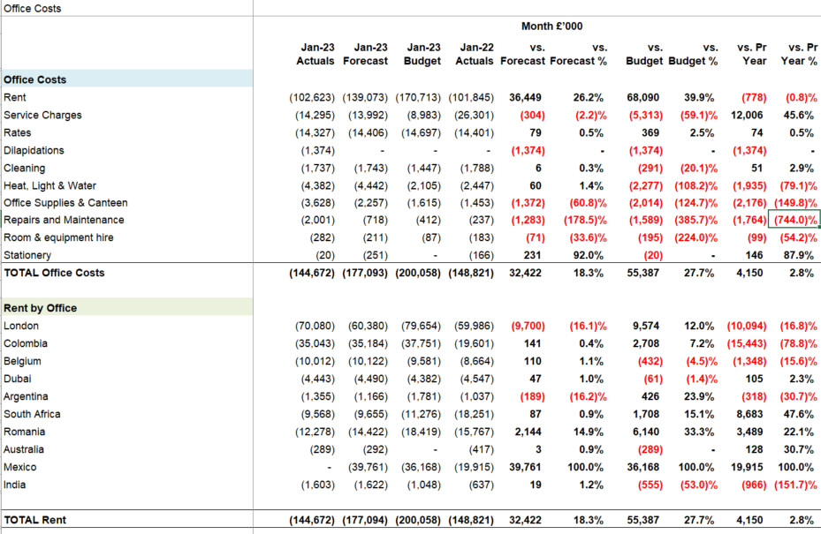
Report Collections
Business Partnering
Office P&L

Slide 20
Elimination of human error
Time saving
Accurate
Better decision making
More accountability in Business partnering
Greater trust

Slide 21
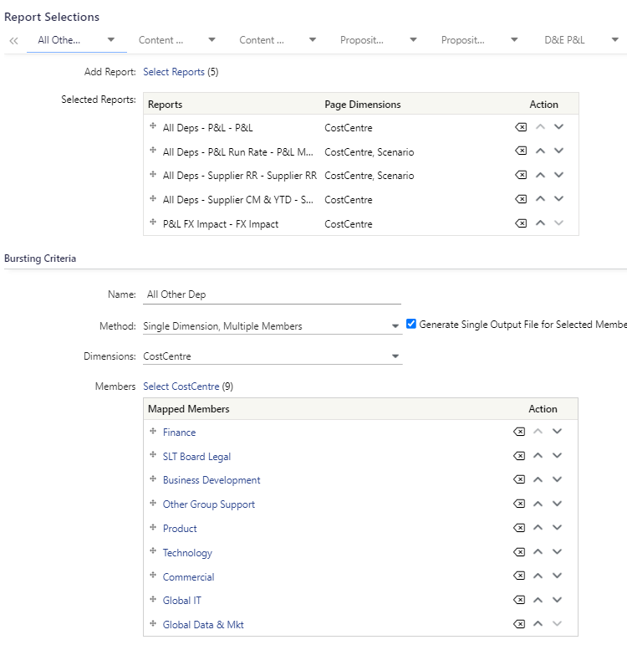
Report Collections
2
1
Better Business Partnering
Department P&L
2
Notes:
Select the reports
Select the appropriate members (Departments)
Behind each set of reports, set up email distribution lists with bespoke emails which automatically include parameters including month and department

Slide 22
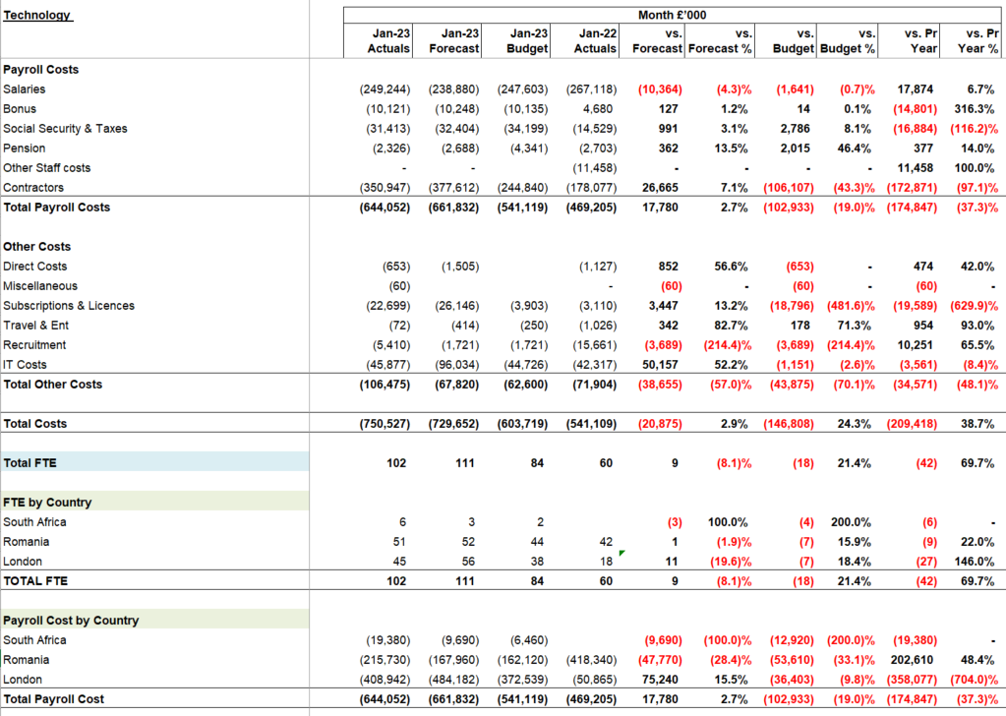
Report Collections
Example:
Technology Team
Notes:
Some more bespoke reporting

Slide 23
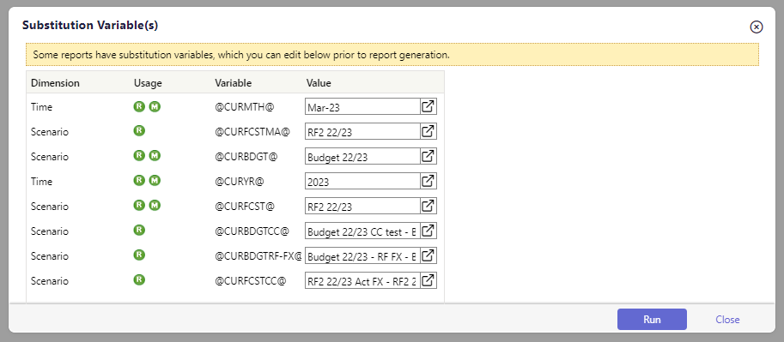
Substitution Variables
Change the period and comparative (scenario) parameters of your reports, quickly
1 Scenario
When a reforecast is in progress ensuring there is a SV Current forecast in progress vs the one currently being reported
1
2 Scenario
Bringing in Forecast scenarios retranslated at different FX rates
2
Notes:
This is a funny one - I wish someone shouted at me louder
We were originally building reports without substitution variables, and creating different reports for different months
We got creative with how we use sub variables - i.e bringing in forecast scenarios at different FX rates, ensuring we have a forecast variable for both the forecast in progress, and the current management accounting month, separately
Less bulky reports - if we want to go back, we can just tweak the substitution variable on one report- rather than dig through folders!

Slide 24
New tools to review month end

Slide 25
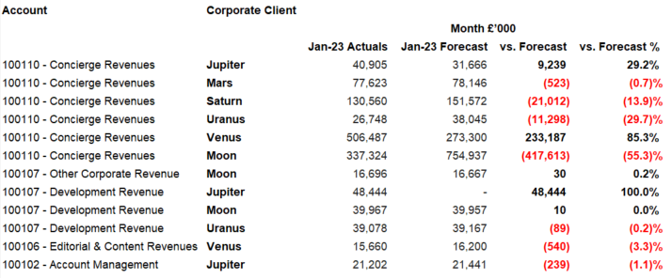
Report Collections
Quick and new tools to month end
i.e. revenue
Notes:
Reviewing Revenue
Venus and Moon - performance - can cross check this against non-financial reports with operating requests
Why is performance so good? Use other reports to look at performance of the number of requests we have serviced
Moon - Accrual missing or catastrophic performance?
Jupiter - Development revenue - release off the balance sheet?

Slide 26
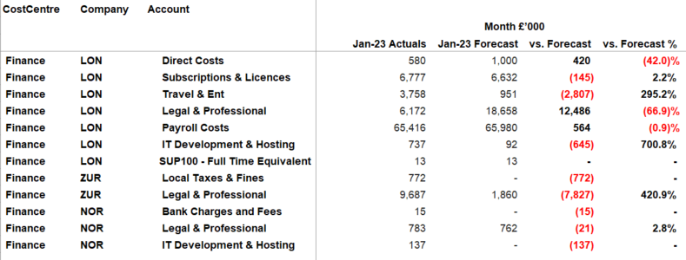
Report Collections
Quick and new tools to month end
i.e. cost

Slide 27
… or the forecast

Slide 28
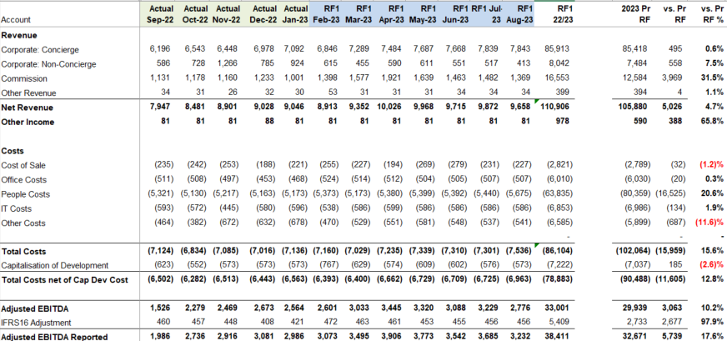
Report Collections
Validate the forecast at different levels
Can go down further i.e:
By Supplier, By Market, By Department

Slide 29
We can’t forget about the impact of foreign exchange

Slide 30
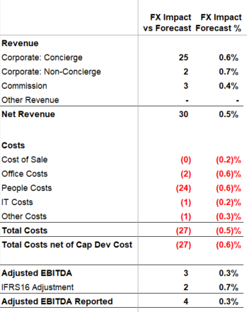
Reporting
Underlying performance / Impact of FX
Comparing the actual month, to the forecast month scenario, retranslated at today’s FX rates

Slide 31
Workforce planning…
75%+ of our cost is payroll
20+ countries

Slide 32
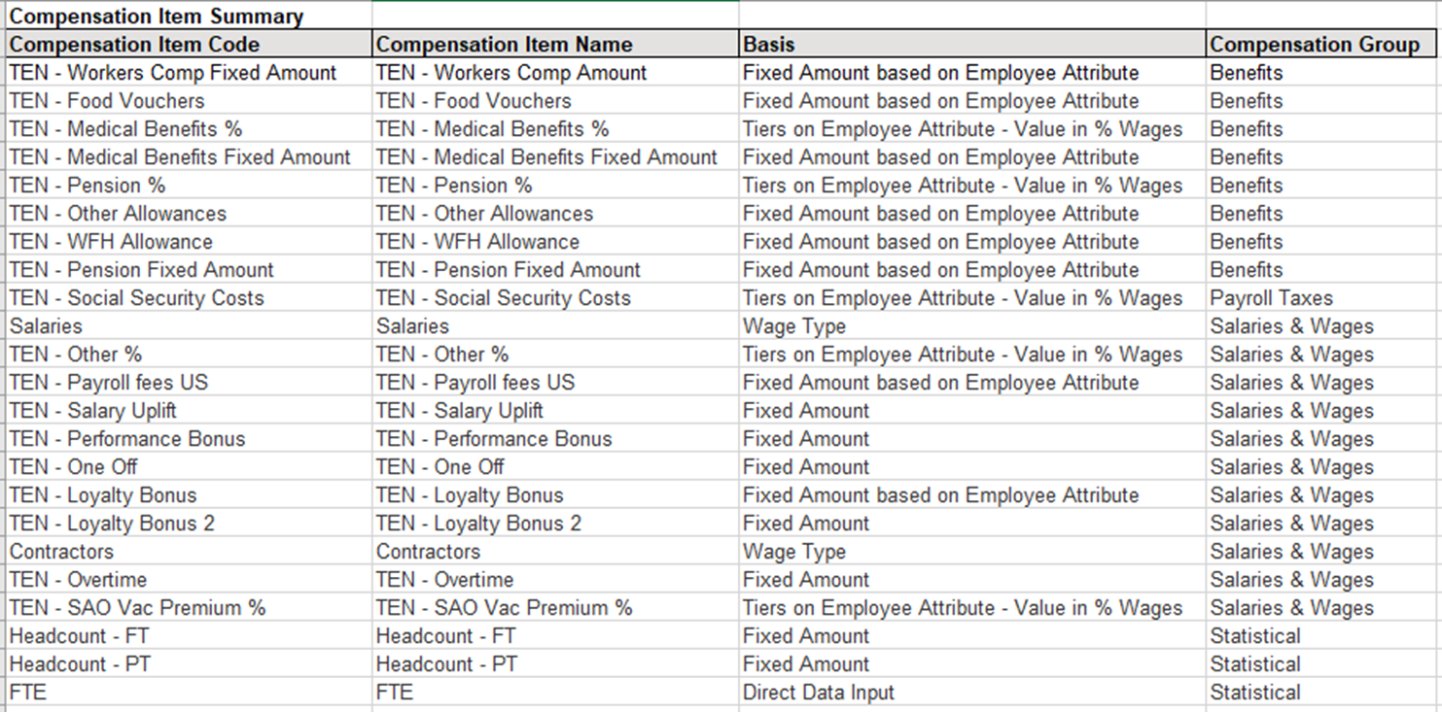
Forecasting: Workforce Planning
Salary data from HR in a prescribed format, marked with flags joiners, transfers and leavers.
Compensation Items

Slide 33
Structured planning...

Slide 34
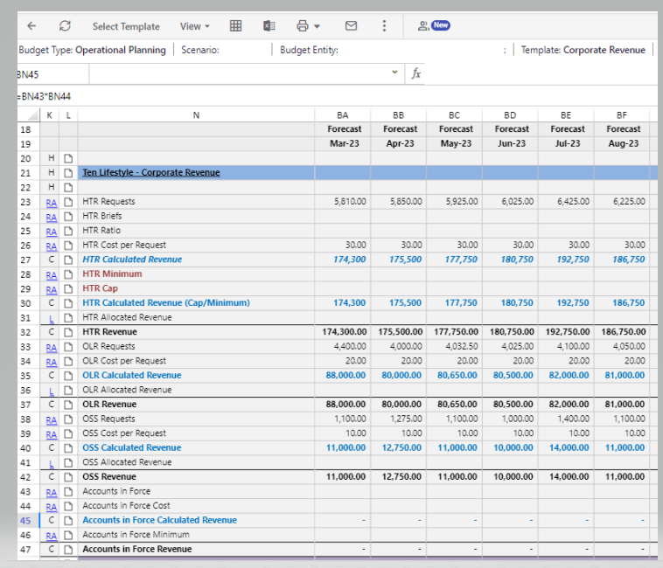
Forecasting: Templates
Revenue
Input non-financial forecasts, apply pricing & calculation
Notes:
Made up example
Input assumptions by DLR (pricing,number of jobs or cards for example_
Templates to cover different pricing mechanisms
Minimums, Caps

Slide 35
Impact
What we’ve learned

Slide 36
“Finance is now a strategic business partner”

Slide 37
Finance makes a bigger impact without growing the team
Consolidation
Reporting
Forecasting
Month end close from 10-15 working days to 5
Opened up time to analyze business partner add value with new reporting
Power in bringing in non-financial data across key dimensions
Bespoke reporting for different stakeholders
Standardized format
Currency calculations housed in Planful
Stronger and transparent processes around top level adjustments
More streamlined, detailed & reliable forecasting process
Workforce Planning – we can now analyze the detail behind our biggest cost – Payroll
Revenue calculations done in the system
New ways to verify the forecast
Less reliance on the pitfalls of relying heavily on Excel!

Slide 38
Lessons Learned
There is a vast opportunity to do more, and to do better
Good leaders are advocates for technology
Finance and IT are evolving
You don’t need to do everything all at once
Leverage resources: Engage, online guidance, support
Achieving greater transparency in forecasting & reporting hold finance and business partners more accountable
Creates more trust in finance
Embrace this change, and encourage building new skill sets
Finance Systems IT lead
Bring in Non-Financial data for stronger analysis

Slide 40
Questions?
Q&A with your speaker

Slide 41
Up Next
A Truckload of Financial Value: The Logistics of Moving from Excel to Automation at Merchants Fleet
Thank you!
Russ Bonilla Director Financial Planning & Analysis; Merchants Fleet

