Slide 1
From the GL Lines
to the Front Lines:
Meeting Leaders Where They Are
Grant Brooks, FIGS

Slide 2
Grant Brooks
Director of Corporate Finance, FIGS

Slide 3
We are a founder-led, direct-to-consumer healthcare apparel and lifestyle brand that seeks to celebrate, empower and serve current and future generations of healthcare professionals.
We are committed to helping this growing, global community of professionals, whom we refer to as Awesome Humans, look, feel and perform at their best—24/7, 365 days a year.
We create technically advanced apparel and products that feature an unmatched combination
of comfort, durability, function and style,
all at an affordable price.

Slide 4
“Do I have budget for this?”
̶ Every Leader
Notes:
Cam note: Ask for them to raise hands; by slide 3 anything else

Slide 5
“Which one is current?”
̶ Every Leader

Slide 6
“I didn’t know I overspent!”
̶ Every Leader

Slide 7
From the GL Lines
to the Front Lines
4 Cases Exploring Financial Reporting struggles
at various levels of the Finance funnel
Notes:
Cam note: Set the stage - acknowledge cases across finance funnel, different stages of a career, different needs as well “While I go through these examples, I want to you to imagine how you would feel”

Slide 8
Case 1: Business Development Analyst
ACTIONS:
Multiple inputs & users in planning system
Emailed budgets weekly
RESULTS:
Time consuming
Stale information
Inconsistent experience across 15 different analysts
Poor Decision-Making
Notes:
Genevieve note: it’s great to show your career journey aspect Cam note:

Slide 9
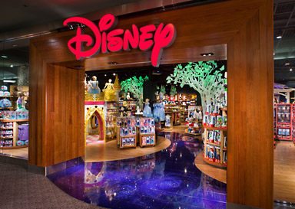
Case 2: Corporate Finance Manager supporting CFO
ACTIONS:
Excel submissions
Presentation 5 times a Year
RESULTS:
Infrequent / not on-demand
Inconsistent inputs
Time consuming
Confusion
Notes:
Gen note: an impact or a specific example to help ground the slide and feedback

Slide 10
Case 3: Finance Leader starting new segment/business reporting
ACTIONS:
Excel submissions
Excel deliverables 5 times a Year
Multiple presentations
RESULTS:
Inconsistent inputs
Time consuming
Scenario confusion
Inconsistent perspectives
Notes:
Gen note: it would be really cool to possibly dive into how the normalization occurred. Cam note: story is built in

Slide 11
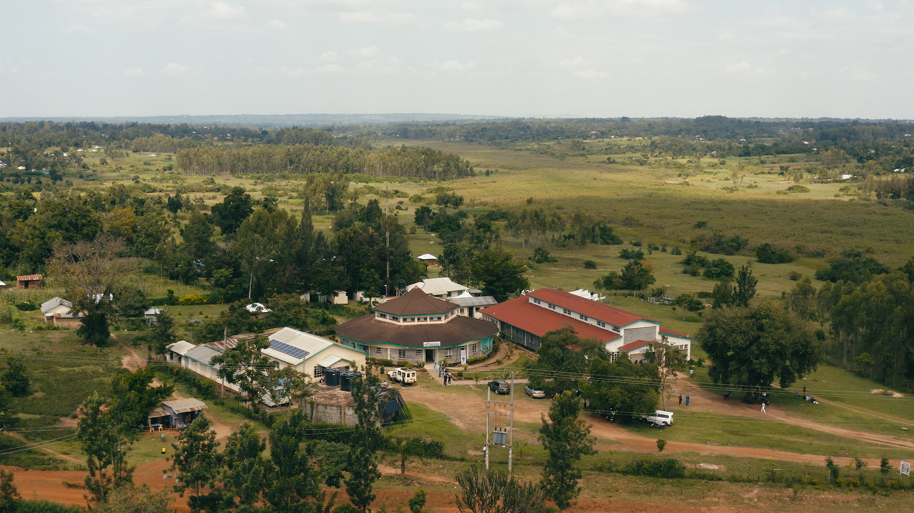
Case 4: Head of Corporate Finance for a high-growth, newly IPO’d company
ACTIONS:
4 Major Forecasts a Year
Monthly Dept Forecasting
RESULTS:
Dept Leaders only use Google Sheets
Time consuming (Planful > Excel > Google Sheets)
Transformation Mistakes

Slide 12
Trends Across Cases
Transformations can be time-consuming and introduce mistakes
Inconsistency of Experience Across Depts
Information can be stale by the time a leader uses it
Perception that relevant data is unavailable / inconvenient to review

Slide 13
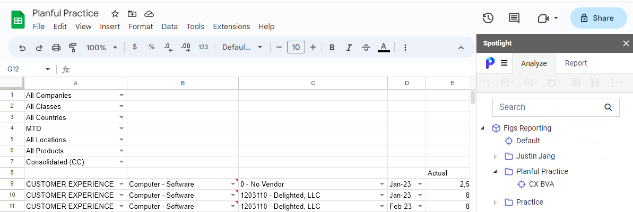
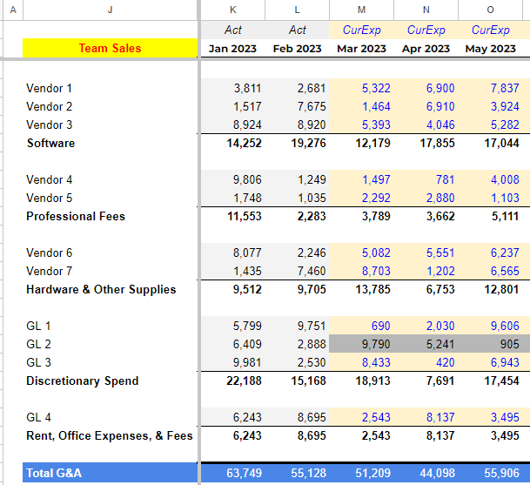
Introducing Spotlight for Google Sheets
ACTIONS:
Create a custom report via Dynamic Planning
Pull Natively in Google Sheets
RESULTS
Simple refresh updates sheet
Centralized control on reporting and what leaders should focus on
Eliminates majority of human error
Notes:
Albeit a simple solution, it is powerful

Slide 14
Excel visual that shows drop down spotlight menu and creation of report
Step 1:
Create a Dynamic Report
Main Points
Create a custom report via Spotlight Excel
Save Report
Pull via Google Sheets
Send Leader Google Sheet link (that will never change and they can favorite)
Google Sheet visual that shows drop down spotlight menu and pulling of report

Slide 15
Optional Step 2: Custom Transform for Leader
Main Points
Use pull via Google Sheets on Data tab
Transform on Summary tab (pivot, formula pull, etc)

Slide 16
Rework Data Transformations
# of Data Pulls
# of Data Requests
Confusion
Analysis
Data Relevancy
Convenience
Consistency
Happy Leaders
Organizational
Impact
ACTIONS:
Create a custom report via Dynamic Planning
Pull Natively in Google Sheets
RESULTS
Simple refresh updates sheet
Centralized control on reporting and what leaders should focus on
Eliminates majority of human error

Slide 17
“I use my favorite ‘Budget’ link all the time”
̶ Every Leader
Notes:
Cam note “how the conversations have changed”

Slide 18
“We need to transfer budget!”
̶ Every Leader

Slide 19
“I just reviewed my budget, and need to pivot. Have time?”
̶ Every Leader

Slide 20
Questions?

Slide 22
Outline
Who Am I: Overview of 13 Years of Experience [slide]
Who is FIGS? [slide]
What Problems have I faced at consolidating and providing data to business partners [slide x3]
Case 1: Bus Dev Analyst at Boeing (very bottom of finance food chain) [slide]
Case 2: Corp Manager supporting CFO at Disney (very top of finance food chain) [slide]
Case 3: Streaming & Global Entertainment Finance Leader building new business and reporting [slide]
Case 4: All of the above [slide]
What are the trends [slide]
How can Spotlight on Google Sheets be helpful and address the problems above [slide]
How we use Spotlight via Google Sheets at FIGS [slide]
How it addresses the problems stated above [slide]

