Slide 1
Financial Storytelling in a Volatile Economy
Erik Nakamura, CFO, Orange Comet

Slide 2
Erik Nakamura
CFO, Orange Comet, Inc.
Experienced C-Level Senior Executive that is a dynamic and inspiring leader known for a coaching and mentoring approach to building successful, cohesive teams with superior operational excellence. Expertise in growing Finance, HR, Legal, IT and Facilities teams from the ground up for public and private companies. Deep experience in equity and debt capital raising, securities offerings, FP&A, operational/technical accounting, treasury, internal controls and processes implemented.
Finance and Operations leader with over 22 years of broad and deep Financial, HR, Legal, IT and Facilities experience in Web3, Digital Asset, Blockchain, eCommerce, marketplaces, fin tech, prop tech, real estate, SaaS, medical device and manufacturing.
Notes:
OC Background and Historical Background

Slide 3
Notes:
OC is the leading next generation gaming and entertainment Company creating immersive Web3 games in partnership with the biggest entertainment properties in the world.

Slide 4
Key Takeaway:
Evolution of the Game
Notes:
Example: The NBA is in a different state than it was 20 years ago. Shaq on a recent documentary talked about the dominance of the “Big Man” era. But with shooters like Steph Curry, the tides have shifted to where teams need a strong perimeter game to keep up. What I’m here to tell you in business, is that the Office of the CFO has Evolved like the NBA. But it requires new plays to keep up. And the CFO add more value than compliance, reporting carding, etc.
I want to tell you my story on raising capital five years ago vs raising capital today. Same Game / New Plays
Handle objection: You may not raise capital for your company. But each and every one of you is a storyteller, and today I want to give you a framework for telling a compelling story when you have to present numbers.

Slide 5
Agenda
Financial Storytelling in a Volatile Economy (Serving a complete meal)
Value Prop = the Sizzle (Why)
Business Opportunity/Execution = Steak (How)
Financials, Data and KPIs = Potatoes/Rice (What-Supports Story and Execution)
Notes:
Pitching the story, building a meal. Digestible and succinct. Then get into it.
Prepping the story
Know thyself
Know the Game
Identify the patterns
Review your resources
Build a plan to increase strengths and weaknesses
Trust the Plan
Art & Science
Trust, Like and Respect
Who are we and what is our mission
Moral, good culture, drive to execution of value prop, stakeholder vision
Bus Opp
How has the game changed and how do we need to shift our messaging to address today’s market
Financials and KPI’s
CTA - Question Review in the context of raising capital
Knowing our unique value proposition, Empathy for the market
Effectively communicating the story behind the numbers takes a deep understanding of what's driving financial performance so you can articulate it in a way that resonates with your audience. Join Nakamura, CFO of Orange Comet, as he shares tips for developing a compelling narrative highlighting the company's strengths and opportunities without leaving plot holes for the potential challenges and risks. He'll also explain why building a compelling financial story is even more critical in our current era of volatility and uncertainty.

Slide 6
Value Prop:
Who are we and what is our mission?
Sizzle
Notes:
Value Prop definition:
The Company
The Problem
Why we solve it
Need to understand this really well and be able to pitch it
Build data, KPIs and metrics to support this value prop. All alignment
Opportunity, TAM, DNA, who we are and what are we solving. Definition of success. Make sure the entire org is aligned in who we are and our value prop. Make sure we are rowing in the right direction.

Slide 7
Value
Proposition
=

Slide 8
Identify
problem
Value
Proposition
=

Slide 9
Identify
problem
Value
Proposition
How we solve it better than anyone else
=
+
Notes:
Give OC Examples-TAM untapped vs TAM Tapped. Total Addressable Market.

Slide 10
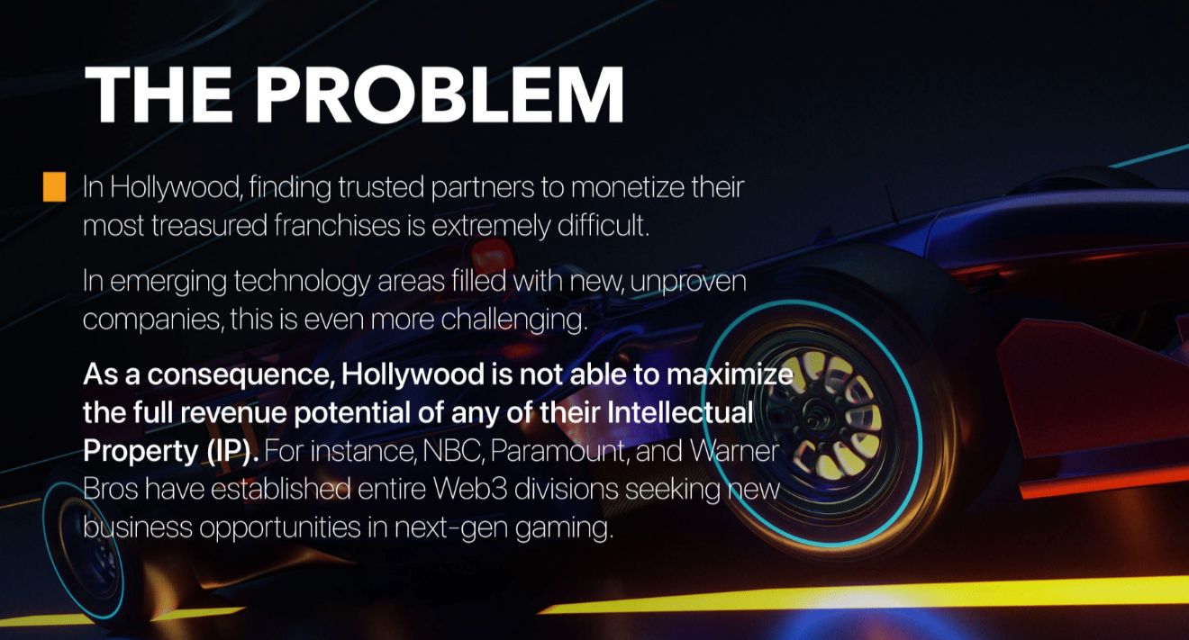
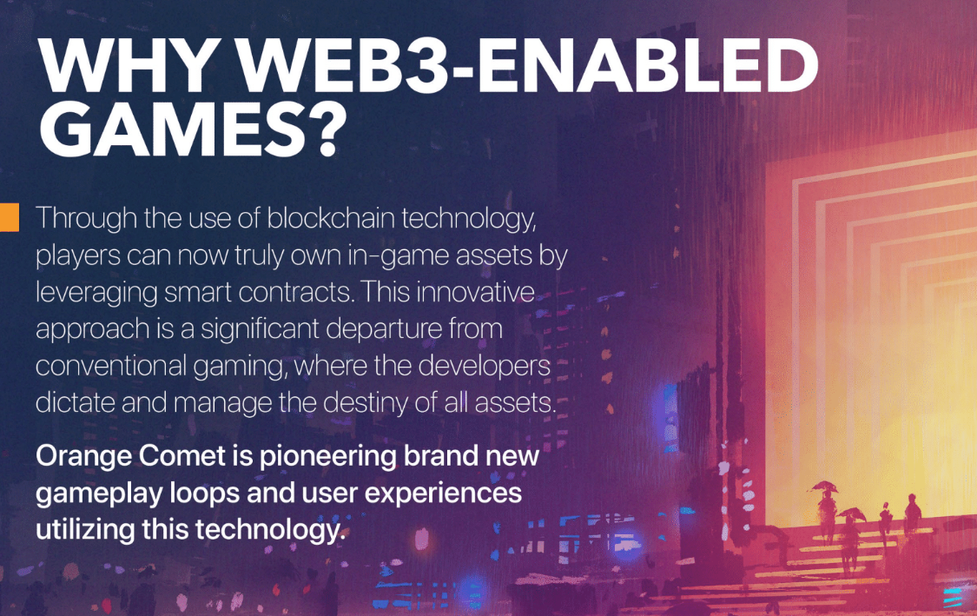
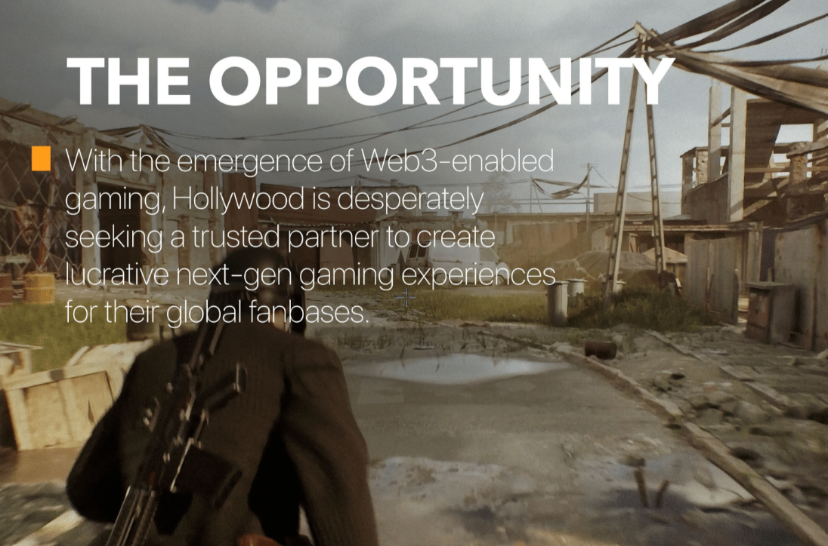
Notes:
TIP: Succinct Messaging - If you can’t state it back easily, neither can they when they have to relay the messaging to their boss. Need to have the company aligned on what the value prop is and the definition of success because that helps with the business opportunity, execution and metrics/KPIs.

Slide 11
Understanding the Value Proposition for Orange Comet
Short-Term
Mid-Term Plan
Long-Term Plan
Comet Lab Game Platform:
Digital Asset Based
Trading/Ticketing
Less investment in infrastructure
Revenue on the board now low volume
Shorter investment time to revenue
Roblox Game Platform:
Simulation gaming
Multiple player online
Investment timeframe 3-6 months
Revenue 1-2 qtrs out medium volume
Revenue on the board soon
High Fidelity Game Platform:
Simulation gaming
Multiple player online
Immersive Web3 worlds
Investment timeframe 18-36 months
Revenue 1-3 years out high volume
Revenue planning
Notes:
Walk through OC examples. This is key to understand so that that you can use data, KPIs and metrics to support this value prop. Volatility plays a role on the revenue.

Slide 12
Business Opportunity/Execution
Steak

Slide 13
Execution into that Business Opportunity/TAM
Do we have the right:
People
Process
Technology
Notes:
Do we have the right people, processes, and technology in place to backup the value proposition?
People = the team, backgrounds, experience, focus, scale, successes
Processes = How does this scale, unit economics, differentiation, adding value, the know how, secret sauce
Technology = Scaling, working smarter not harder, don’t just throw headcount after it, AI?
TAM = New, how do you attack it? And how do you trailblaze and disrupt?
TAM = Previously established, how do you take market share? What is your moat?
Understand volatility

Slide 14
Execution of the Business Opportunity
Understand your TAM and how you execute into which should take volatility into account
Must build volatility risk into the execution plan
Understand the risk of execution and address it, take it head on and do not avoid it
Understand your audience and let them know you understand volatility risk
Part of your value prop can be volatility risk mitigation:
Example: Orange Comet leaning into gaming, gaming is risk resistant
Build credibility by having a great executable business plan that understands the market and risks
Which leads to the data, KPIs and metrics that support
Notes:
TIP: Understand your audience

Slide 15
Financials, Data and KPIs = Support the Story and Execution
Potatoes/Rice

Slide 16
Supporting Evidence
Financials, Data and KPIs
Ask yourself this question:
Definitions of success met?
Aligned with the overall goals of the Company?
When reviewing the financials data, and KPIs/Metrics, does this support the value prop and execution?
Does it tell who we are through numbers?
Can any holes be poked in this?
Understand that quant or financial analysts types will review so understand your audience

Slide 17
Where We’ve Been and Where Are We Going?
Process
Technology
People
Outcomes = Scale
Notes:
Conservatism and reasonable assumptions (Address volatility)

Slide 18
Value Proposition
People + Process + Technology
Supporting Evidence
Notes:
Like Simon Sinek says, rather than starting with What >>> How >>> Why.
Start with WHY >>> HOW >>>> WHAT

Slide 19
Questions?
Q&A with your speaker

Slide 20
Up Next
A Truckload of Financial Value: The Logistics of Moving from Excel to Automation at Merchants Fleet
Thank you!
Russ Bonilla Director Financial Planning & Analysis; Merchants Fleet

