Slide 1
Debunking vendor level planning & demystifying strategic organizational hierarchies
Talyon Perry, TogetherWork, Sowmya Acharya , Cogenics & Jonathan Li, Cogenics
Notes:
(1 Mins) (Elapsed 1)
Jon:
Welcome everyone, my name is Jonathan Li, I am a former Planful employee, recovering accountant / auditor now turned Sr. Manager of Solutions leading the Planful practice at Cogenics one of Planful’s premier partners.
Today’s forum will be a discussion covering what “Debunking Vendor Level planning” looks like & the “demystification of strategic organizational hierarchies.”
Before I begin, I’d love to introduce the panelist who’ve come to join me. Next Slide

Slide 2
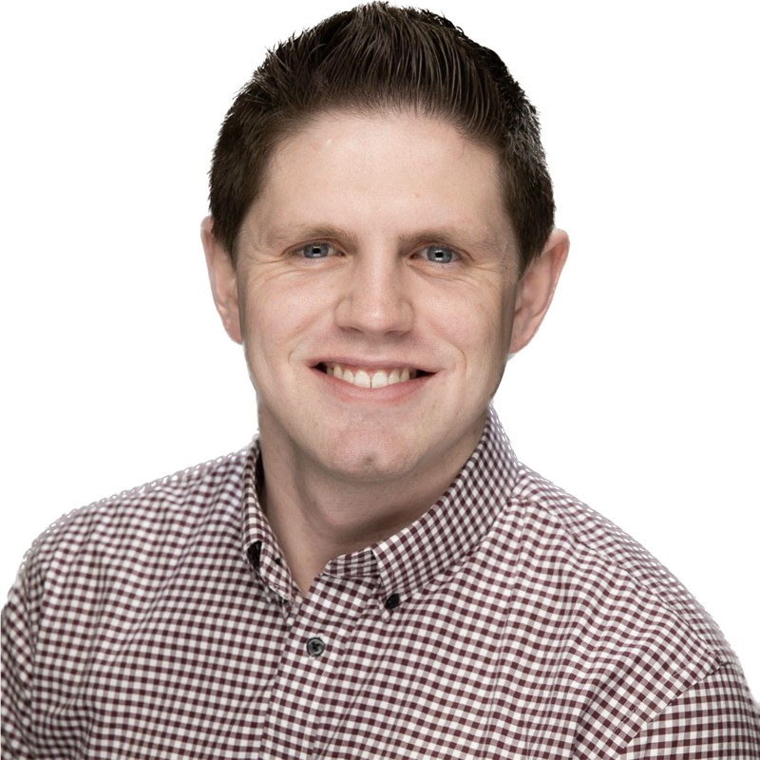
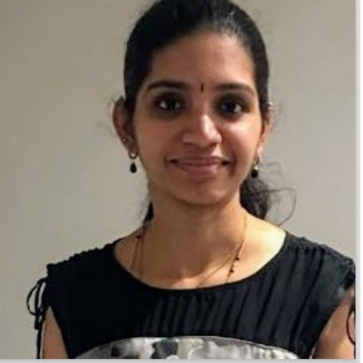
Talyon Perry
Sowmya Acharya
Jonathan Li
Notes:
(1 Mins) (Elapsed 2)
Jon:
In the middle we have Sowmya Acharya who is Cogenics lead Solution Architect with over 10 years of experience in the EPM space. She brings a large breadth and depth of expertise in financial planning, operational planning and legal consolidations for different industries including, but not limited to renewables, professional services, saas, manufacturing, retail, fintech and CP&G. Please welcome Sowmya! On the left, I have the distinct honor of introducing Talyon Perry, Senior FP&A Analyst for TogetherWork. He manages over $100M of budget across Technology, Operations, Marketing for his organization and took the lead in the implementation, administration, and on-going management of the Planful solution. Please welcome Talyon! Before we kick off our agenda, I’d love our audience to get a little bit of context as to who TogetherWork is and of course who Cogenics is.

Slide 3
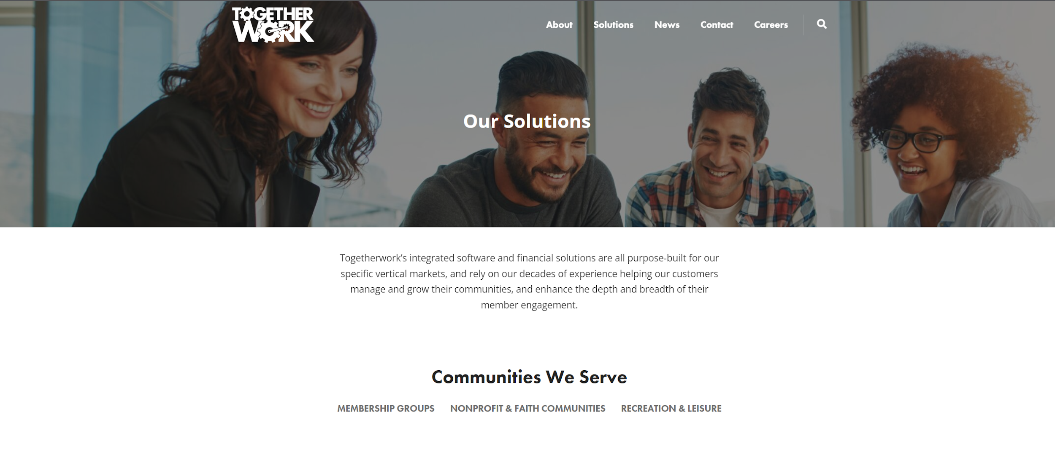
TogetherWork
Notes:
(2 Mins) (Elapsed 4)
Jon: So lets talk a little bit about TogetherWork! I’m going to hand the floor to Talyon! Talyon: Togetherwork is a provider of SaaS based Community management tools. We operate as approx. 25 product lines providing anywhere from customized solutions for Non-profit organizations to off the shelf solutions for Small and medium businesses. We are primarily based in the US, with a couple product lines in Canada and Europe. We are also highly acquisitive, which we'll dive into how that drove many of the ways we set up our Planful instance

Slide 4
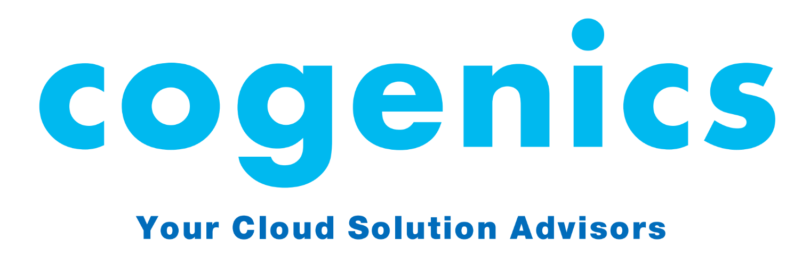
Leading Integration’s consultancy company in the SF Bay area
International presence with overseas offices across the world
300+ Projects delivered to date
1200+ Connectors built and delivered
Our teams are a combination of experts in both technology and function coming from a finance and accounting background
We are a requirements 1st organization
Notes:
(1 Mins) (Elapsed 5)
Jon:
Thanks Talyon! We wouldn’t be here today without the support of great clients like Talyon who have spearheaded this project from the bottom and have taken such great ownership of the solution.
To give a quick and brief introduction of why we’re here today, Cogenics is one of Planful’s Premier partner with over 300+ Planful Projects delivered to date with just shy of a decade of Planful experience. Our team is composed of both previous directors of finance, CFOs, and consultants but the one thing that I believe is a core tenant to our success is our requirements 1st type mentality when it comes to working with our clients.

Slide 5
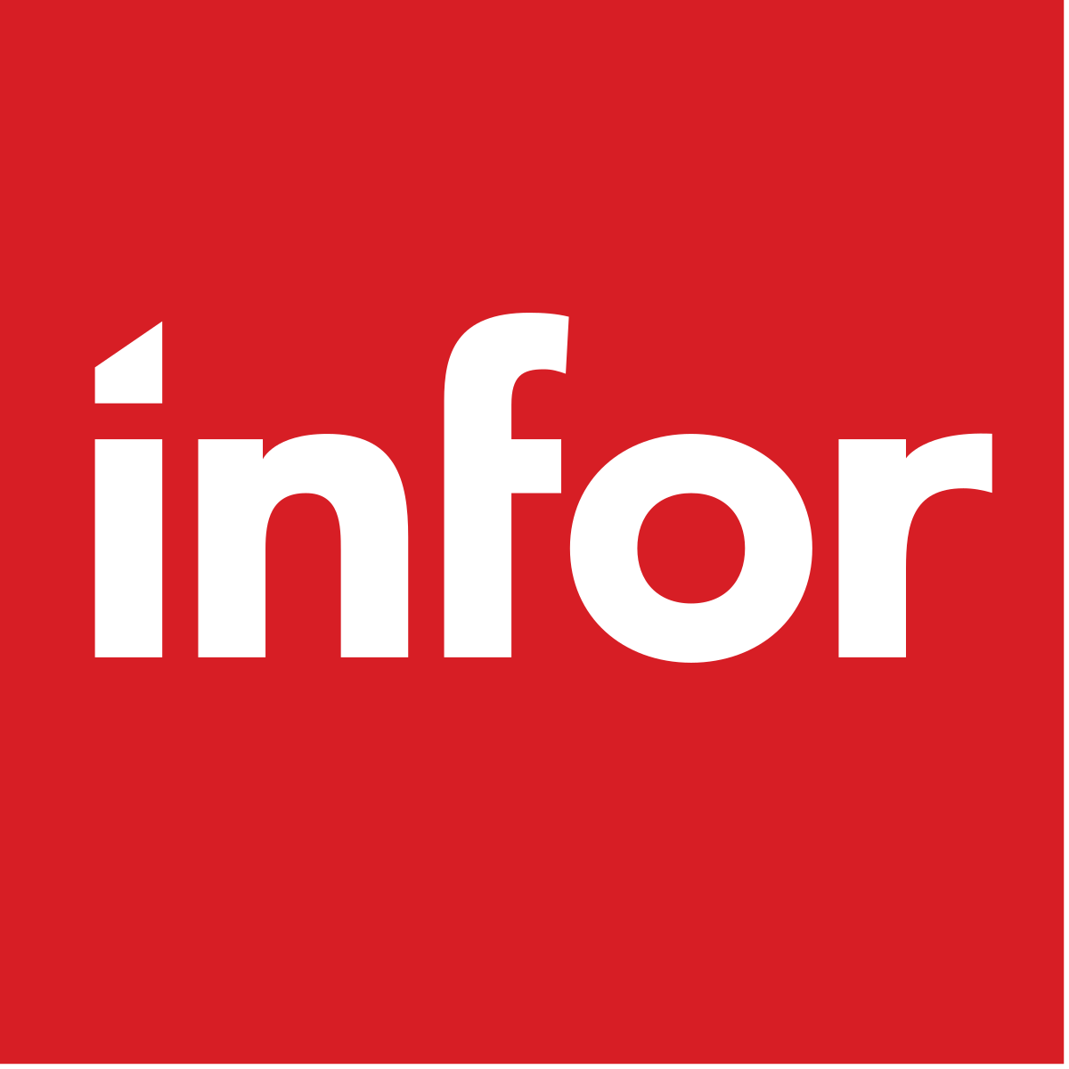
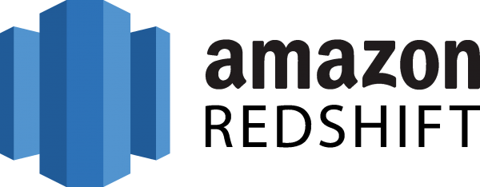
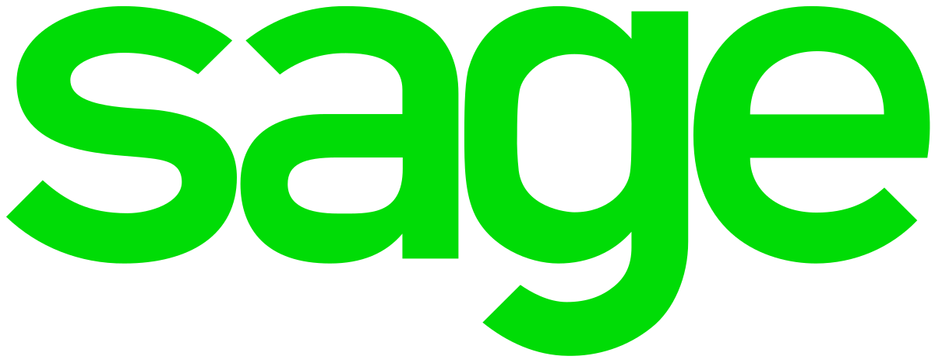
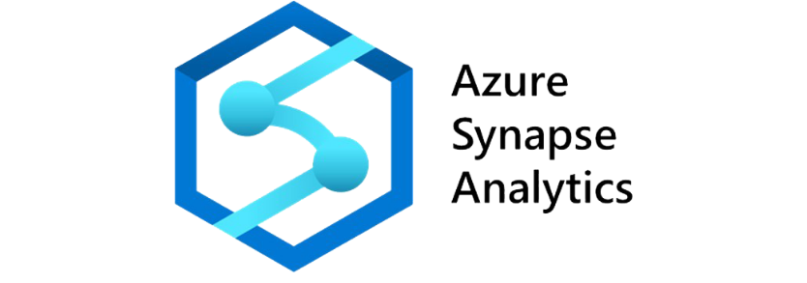
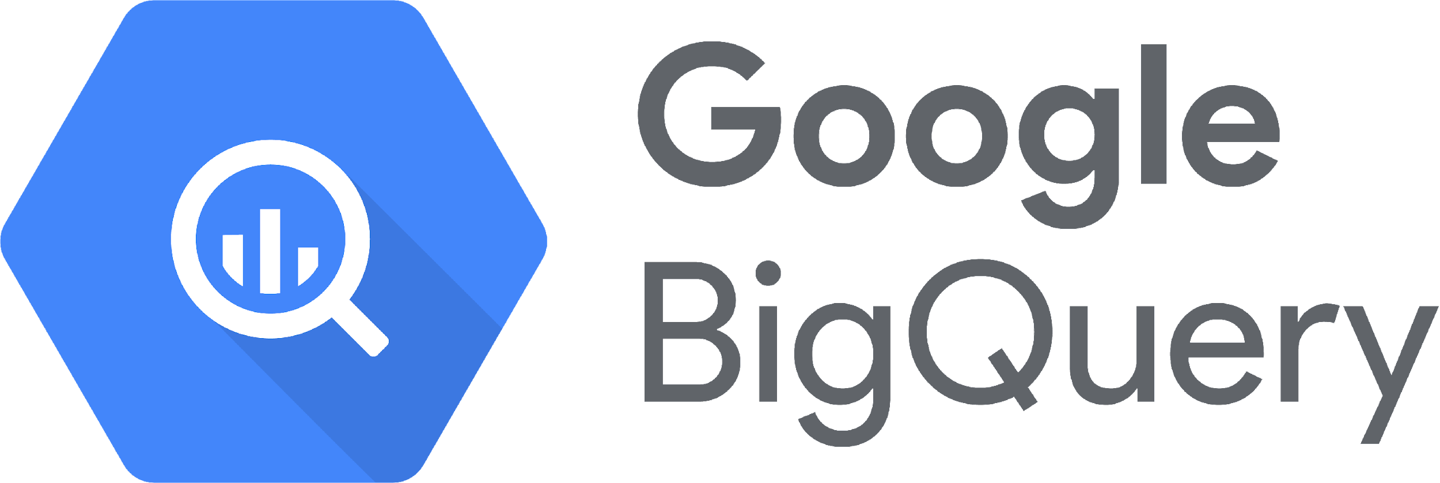
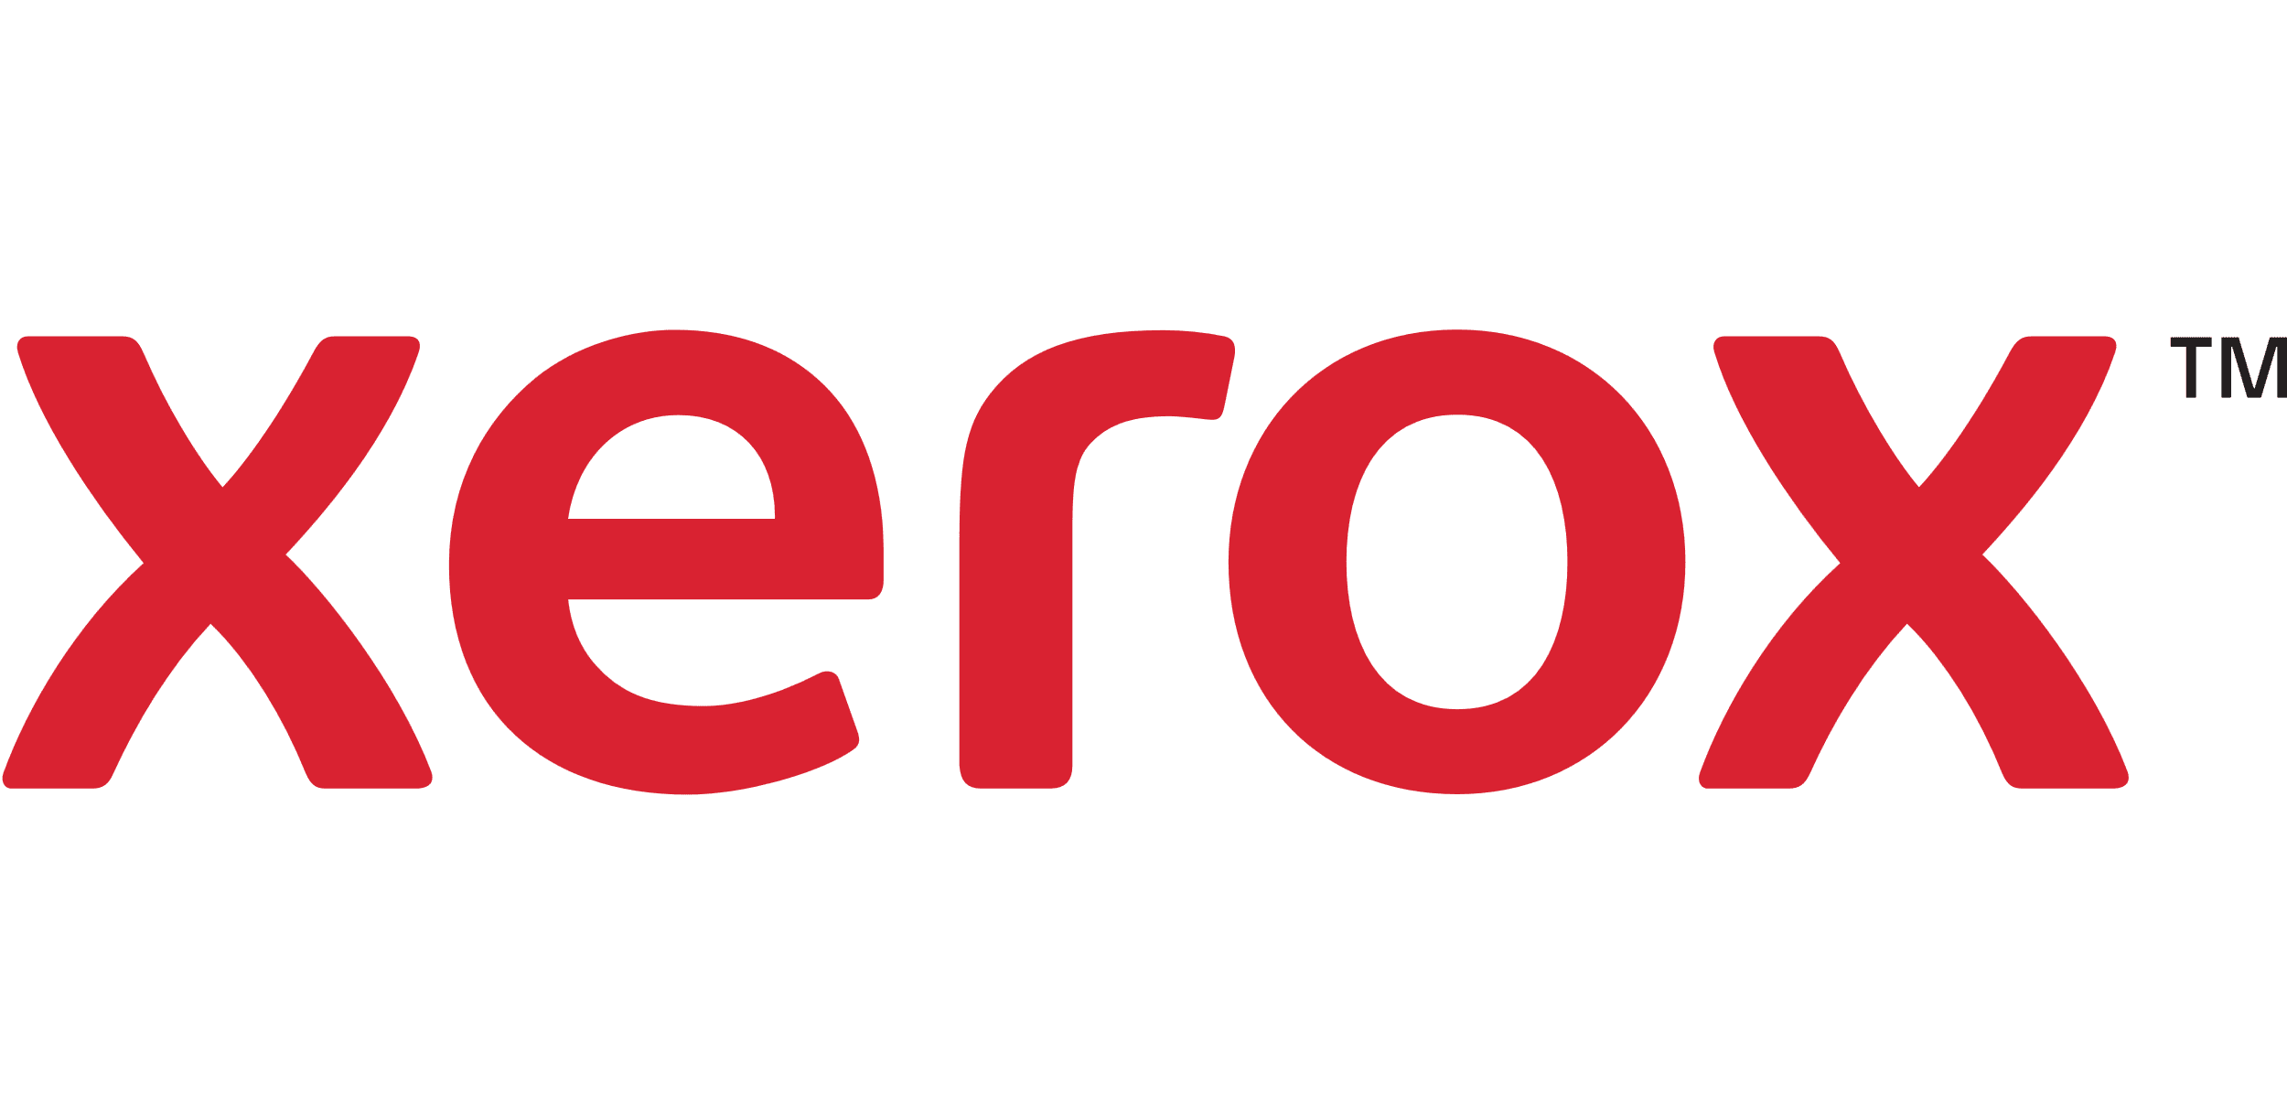
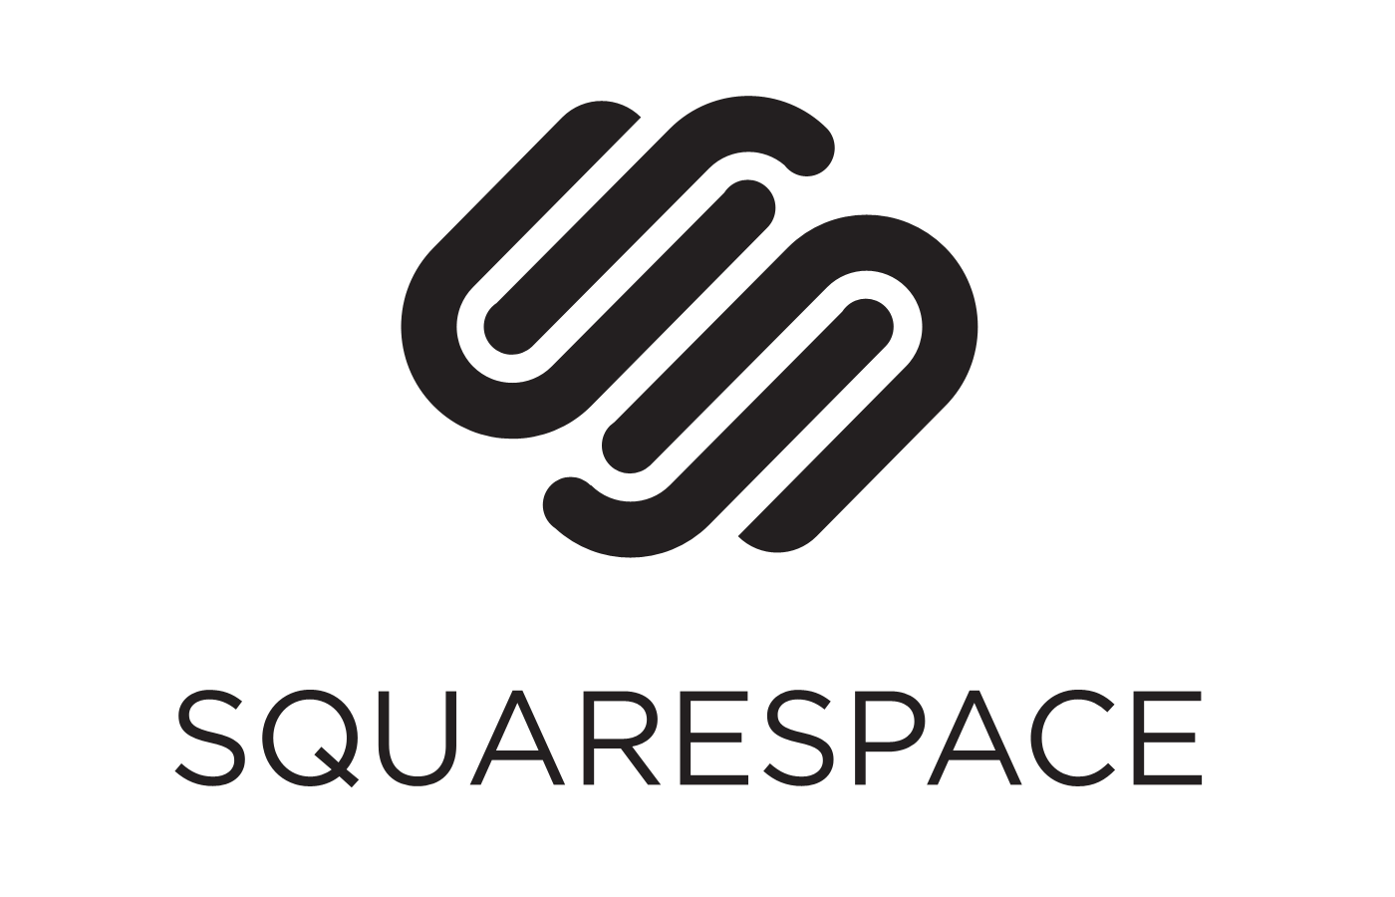
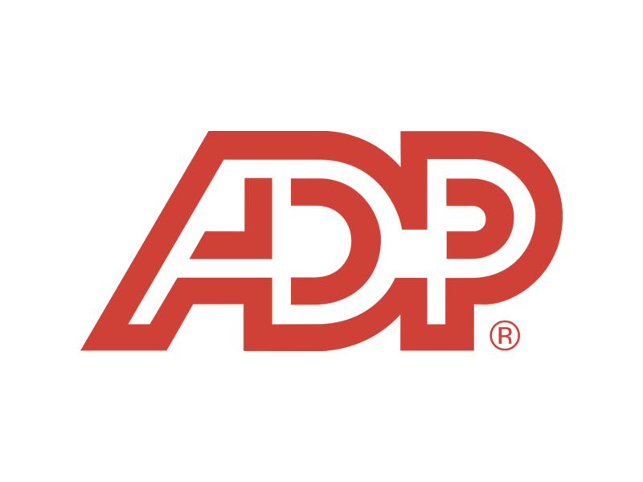
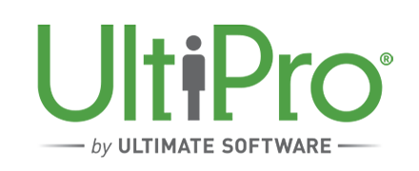
Our vision
ERP
Other
Transform and deliver an organizational solution that leverages ERP, CPM, Reporting, and other technologies to streamline your financial technology.
CRM
HRIS
Notes:
(1 Mins) (Elapsed 6)
Jon: With that said, I’d love for Sowmya, whose seen the landscape of both Planful change over the last decade along with the growth of Cogenics, to share just a brief word on our vision. Sowmya: Thanks Jon. Over the years, Cogenics has really grown its practice but the one constant has been the desire to transform and deliver an organizational solution that not only scales up with the company but also leverages other technologies. We’re not new in the space and recognize that more and more technologies are flooding the market, and the vision is to be able to seamlessly bring on your data and connect them into one report engine much like Planful to reduce clutter, increase accuracy, and encourage confidence in the data you work with when making such strategic decisions for your organization.

Slide 6
Agenda
Debunking vendor level planning
Why do consultants typically discourage vendor level planning in SP? The do’s and don’ts & why?
Demystifying organizational hierarchies
Understanding the ability to do top down forecasting with a bottoms up department hierarchy structure
The “X-Factor”
What made this project successful? What were the biggest challenges and learnings?
Results
What is TogetherWorks ROI with Planful with the help of Cogenics?
Notes:
(1 Mins) (Elapsed 7)
Jon:
So why are we here today! Let’s break down some of the topics that we’ll be covering! Starting with Debunking vendor level planning. A lot of us may have thought about it, perhaps are even doing it today in excel, or maybe have asked the consulting teams you’ve worked with in the past and they’ve either discouraged it and/or shy’ed away from it. I’ve brought on my colleague Sowmya who will tell you the in’s and out’s and why this may have been the case! Next we’ll talk a little bit of what strategic organization hierarchies mean. Some of you in the room perhaps already leverage attribute, alternative hierarchies, but what this really means is to be able to report in ways that you perhaps have not been able to do! Finally, we’ll touch on the X-Factors, why this was indeed successful projects, challenges that were faced, and of course the results of what this looks like today with TogetherWorks!

Slide 7
Debunking vendor level planning
Why do consultants typically discourage vendor level planning in SP?
The do’s and don’ts & why?
Notes:
(.5 Mins) (Elapsed 7.5)
Jon:
So let’s dive right in!

Slide 8
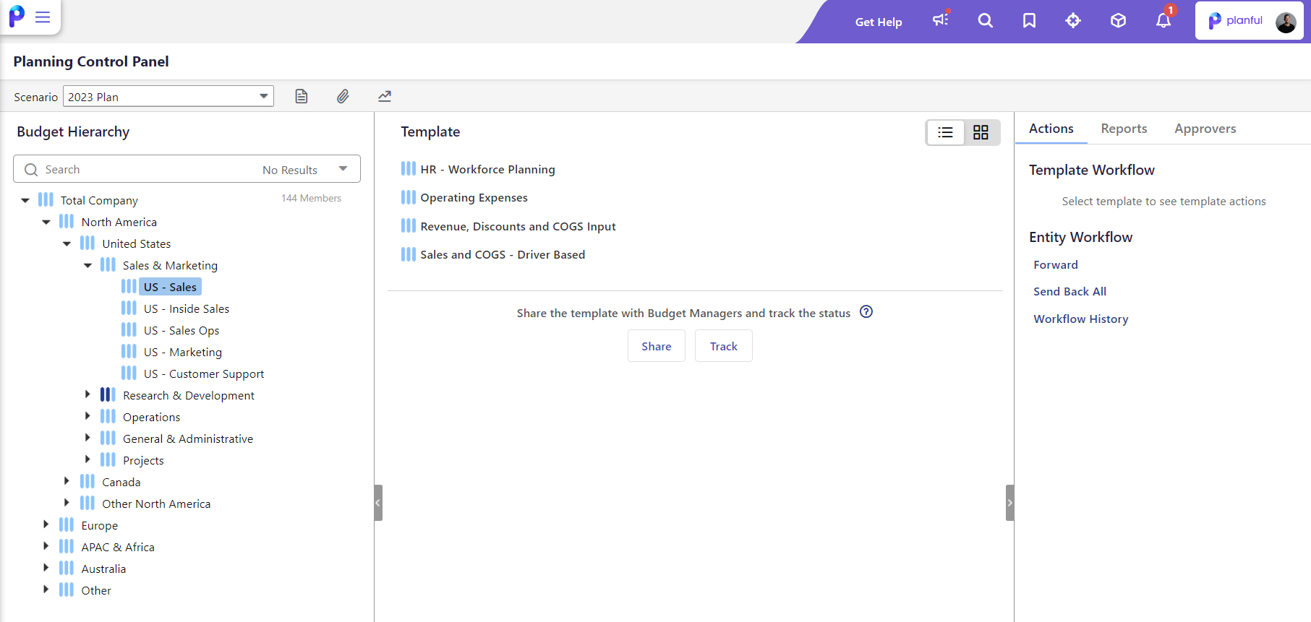
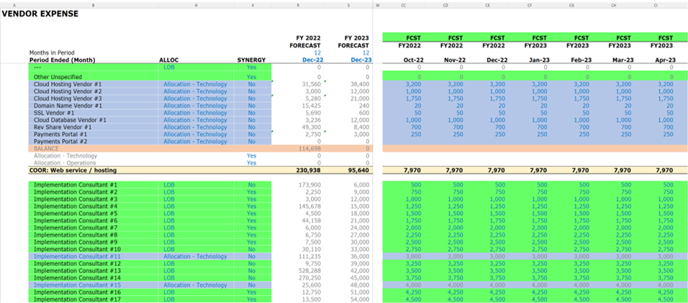
Why Vendor Level?
Notes:
(8.5 Mins) (Elapsed 16)
Jon, Talyon, Sowmya:
Jon: So Talyon, tell us before we dive in, the nature of TogetherWork and why vendor level planning was a non-negotiable when looking at your planning process?
Talyon: There are a few main factors for why vendor level forecasting was a non-negotiable for us. First, when people are managing their budgets they think in terms of the tool they are using or the tools they are planning on using, so we have to have an element of vendor level forecasting to ensure we have all of our bases covered. Second, from a reporting standpoint by combining vendor level forecasts and vendor tags from our accounting system we can easily discover the driver of variances on a monthly or quarterly basis. Lastly, we are a highly acquisitive company and when we acquire a company there is always an integration element where we transition their existing vendors to our vendors of choice or we are able to re-negotiate our contracts. Vendor level forecasting helps us to properly identify and plan those activities.
Jon: Sowmya, when you heard this. What were your first thoughts? And why is this typically “Taboo”? Sowmya: My first response was to try to talk Talyon and team out of it. Even if you have a great process in place and forecasting experts on your payroll, your forecasts will never be 100 % accurate especially in times of a crisis. Vendor level forecasting is time consuming and resource intensive and as a solution architect I didn’t want to propose or design a solution that I myself wouldn’t want to maintain going forward. But as we went through multiple discovery and design sessions I gathered that vendor forecasting was crucial for TW team to achieve the desired forecast accuracy,help plan next year’s relationship with each key vendor and reduce the risk of forgetting important expense items when not detailed out in the budget process.
Jon: Talyon, what were the largest perceived challenges on the onset of the implementation of this? Talyon: The biggest challenge was how do we possibly do this in a way that maximizes the amount of vendor level availability, without putting an unbearable burden on our FP&A team to maintain it
Jon: Were there any concessions?
Talyon: Yes, we had to be willing to make some concessions to make it work. The main concessions were utilizing an 80/20 principle to focus on the top vendors and to use global templates across our business. Looking back now though, "having" to use global templates turned out to be a blessing indisguise and we're able to use the sub-line feature for vendors we don’t have broken out. So I'd say we've been able to have minimal negative impact from these concessions.
Jon: Sowmya, how did you Iterate on this?
Sowmya: Talyon pretty much covered the best practices we applied to design a solution for TW. Even when you do a vendor forecast, I say forecasting for every vendor for every single GL account is bad practice. So first things first, focus on your key vendors or set a materiality threshold to filter the vendor list crucial for your business. GO TO SLIDE
Sowmya: …..
Sowmya: … this also leads to best practices (NEXT SLIDE)

Slide 9
Cogenics’ Best Practices
1
2
3
Identify the GL accounts that are most important and must be budgeted by vendor.
Setting a materiality threshold and applying the 80/20 rule to identify high priority vendors where focus and attention should be placed.
Recognizing that a one-size-fits-all templates may not always work. Instead, segmenting smaller sections for easier management and administration for scalability.
Notes:
(2 Mins) (Elapsed 18)
Sowyma: Best practices are… in your own words. (@sowmya, share why these are best practices)

Slide 10
Demystifying organizational hierarchies
Bottoms Up + Top Level Planning
Notes:
(.5 Mins) (Elapsed 25)
Well we talked a little bit around the vendor details, what about the organizational structure?

Slide 11
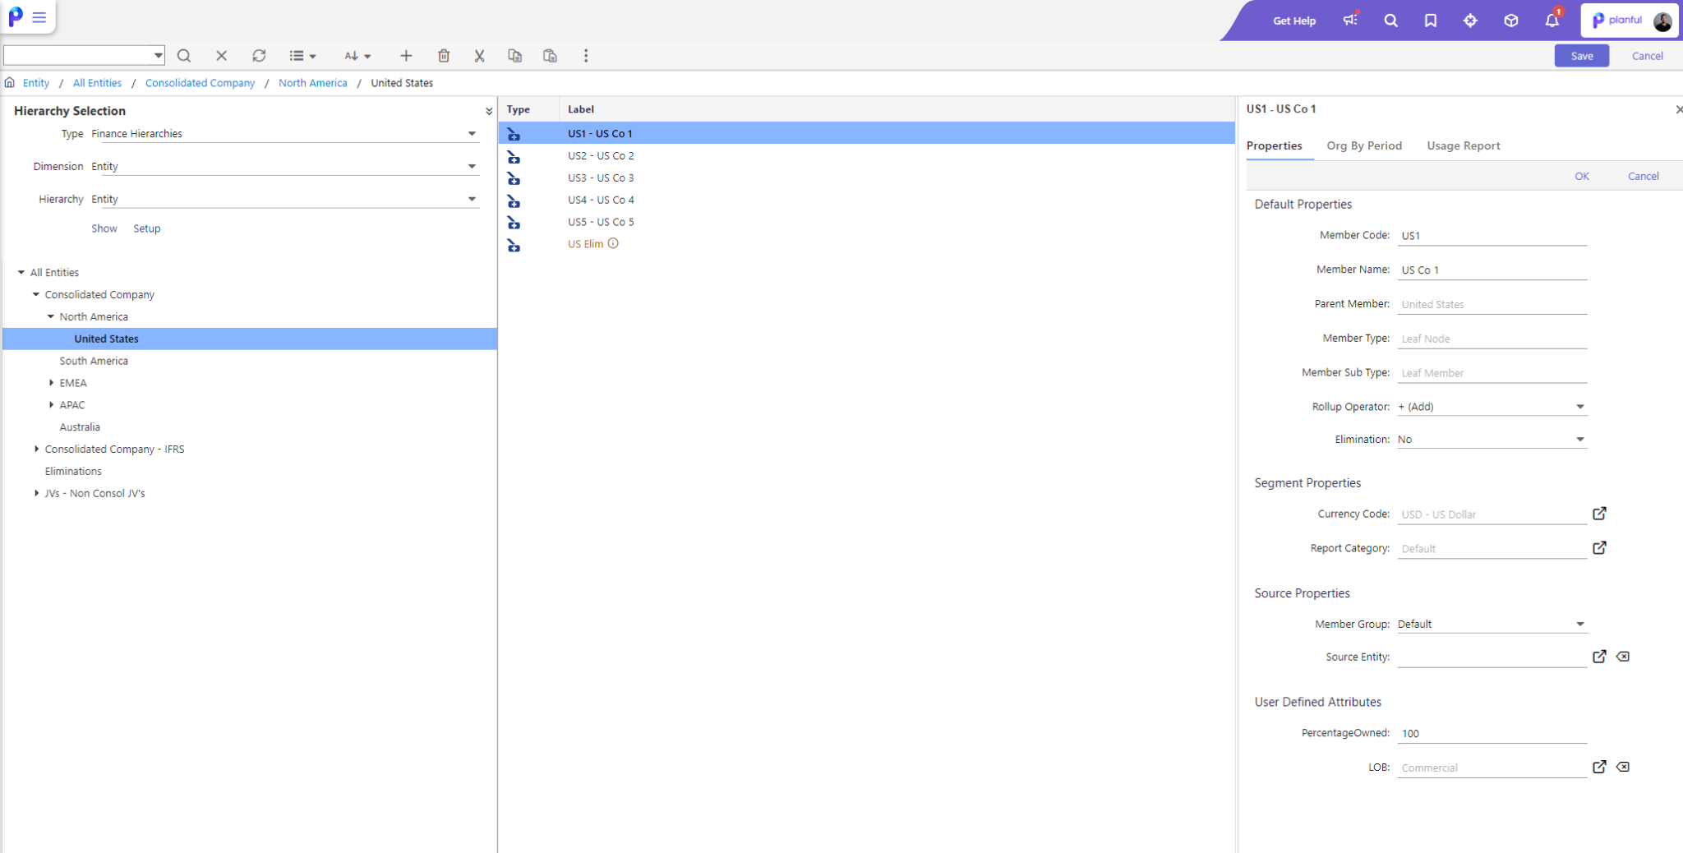
Why Vendor Level?
What is a tuck in acquisition?
What is the application of this?
What does this mean for different folks in the audience?
Notes:
(5 Mins) (Elapsed 30)
Jon, Talyon, Sowmya: Jon: Quick little poll for the folks in the room. How many people plan at the product level / line of business level? How many people want to?
Jon: Talyon, could you walk us through the complexity of TogetherWork and how tuck-in acquisitions work? Talyon: Yes, the complexity in our hierarchy structure comes from the fact that product-line level forecasting was a non-negotiable for us and sometimes our product lines don't follow a standard 1:1 relationship with the legal/accounting entity. This come about mainly from acquiring complementary businesses that we then operate as one consolidated product line. In these cases, we are combining historical and go forward revenue/expenses from two separate entities, but management is forecasting for these entities as one combined Product-line
Jon: Sowmya, for folks who perhaps don’t have tuck in acquisitions but may want to plan in similar fashion what are the implications of this? Sowmya: It’s the ability to have planning templates at the lowest level for certain departments, groups, or business units, but also to be able to budget at the consolidated/ aggregated level. One example I can think of is you could be a real estate company where you have multiple properties tied to a deal. While you may have actuals by individual property your budget input could be by the deals which is nothing but a group of properties. Jon: When you first explored this Sowmya, you told me that this was an “undiscovered benefit” from even the Planful success teams. Could you help me understand the implications for this? Sowmya: The Budget Entity is the level at which budget is submitted and more often than not it is at a leaf level department , business unit for a leaf level company. What TW wanted was to submit budget for a group of product lines/business units together you can use the attribute hierarchy to create a budget entity to submit plan or forecast for a group of departments or business units. Jon: Talyon, When you thinking about your reporting requirements. If you were to extrapolate this to the greater audience, what might this mean for them? Talyon: I think of it as a great example of how you can tailor your Planful use case to best mirror how the business is operated, which helps your non-finance business partners to be better able to do what they need to. I'd also say it's a vote of confidence for users that Planful will be adaptable to their ever changing business. For some of you this might come about through an acquisition and for others a spin-off or structural re-org. Either way, Planful can help you succeed.
Jon: From a management reporting view, how easy was this to accomplish compared to what you were doing before?
Talyon: well before we were doing lots of manual manipulations to have to string together values into these reporting segments. Now all that flows in and out automatically. Instantly, we can produce GAAP and Managerial reporting by Product and grouping. This saves us hours each month and quarter, while also significantly reducing error
Jon: Sowmya, before I let you take the floor, what would you say some of the best practices are when thinking about hierarchies?

Slide 12
Cogenics’ Takes on Hierarchy
Do not try to mimic budget entities with reporting hierarchies
Do not overcomplicate the levels of your budget entity
Notes:
(1 Mins) (Elapsed 31)
Sowmya: Some of the take aways are..
One of the common mistakes I have seen is trying to replicate bu
Do not try to mimic budget entity hierarchy with your reporting hierarchy. Remember their purpose is entirely different- Budget entity hierarchy should purely focus on how you submit your budgets – leaf level or group level.
Do not try to create too many levels in your budget entity hierarchy

Slide 13
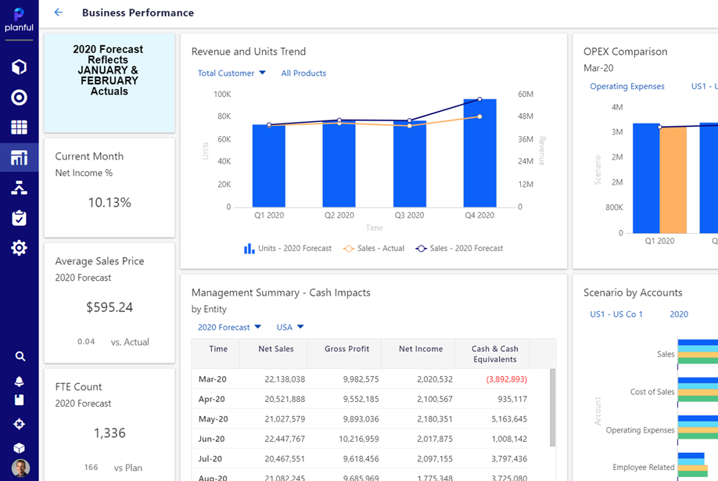
Hierarchy Structure
Notes:
(6.5 Mins) (Elapsed 24.5)
Sowyma: Now, we’re going to do a quick walkthrough of the structure of Togetherwork and how this was maintained. Talyon add color commentary

Slide 14
The X-Factor
What made this project successful?
Notes:
(.5 Mins) (Elapsed 31.5)

Slide 15
X-Factor
Ownership & Buy-In
Being a self starter, receptive to change management, and understanding complexity?
Notes:
(2.5 Mins) (Elapsed 33)
Jon: So when we think about x-factor we often times think about intangibles, things that really lead to the success of TogetherWorks’ use of a solution like Planful. Sowmya, in your mind what were some of the biggest factors you’ve seen for TogetherWorks success compared to other projects you’ve been a part of? Sowmya: .. The success was a function of Talyon champion the tool, but really ownership and buy-in of the solutions!
Being a self starter, receptive to change management, understanding complexity Jon: Talyon, what were the biggest challenges you originally anticipated, faced, and then of course over come?
Talyon: Knowing that they are a unique business, anticipation on how users will adopt this?
Jon: How are users adopting it today?

Slide 16
Results
What does ROI mean for you?
Notes:
(.5 Mins) (Elapsed 33.5)
Jon Everyone talks about ROI, but what does this truly mean for your organization?

Slide 17
Results
Take advantage of training resources, on-demand content, and practice
Don’t underestimate time savings
Educate, educate, educate
40+ hours saved per forecasting cycle
Notes:
(2 Mins) (Elapsed 35.5)
Jon: When we often times talk about results, we’re thinking ROI. What does ROI mean to you? What was some of the direct results of being able to budget and forecast the way your organization needs? Talyon: I'll highlight 2 main benefits. First, the time savings for the FP&A team is massive. Speaking for myself, I used to spend 2 days a month building manual vendor level budget vs actual reports that are all automated now and during our quarterly forecast periods I spent several days translating updates from leaders into our 25 models. Now, I can spend that time digging into the details and other strategic projects. Which, to step away from the quantitative benefits, has made my job so much more enjoyable. Second, the access that leadership now has to monthly and forecast reporting allows them to self-serve and truly own their numbers Jon: From an enablement standpoint. What allowed you to be successful? What advice would you give folks who have new team members? Or perhaps are new customers?
Talyon: I'd say dedicating my time to use the Planful academy trainings, practice building reports, and understand how the underlying hierarchies interconnect has helped me to be successful. The move you dive head first into it the move value you'll get out of it. At this point I can build a custom report faster than I could create on in Excel and its going to be living in perpetuity without additional effort and its going to contain access to the underlying data that excel just can't give you. That's where the value of a system like Planful really is
Jon: Last but not least, I think something that really impacted you was your ability to navigate, own, and manage the solution. I’d like to pass the floor for you to give a quick walk through of what this perhaps meant for you?
40ish hours per forecasting cycle
25+ models across different workbooks
3 days of Talyon’s own time (manually building vendor vs “actuals” / “Forecast” reports

Slide 18
Walk Report
Notes:
(5 Mins) (Elapsed 40.5)
Talyon to present 2-4 mins on his walk report.
The benefits he saw
Largest take aways

Slide 19
Questions?
Q&A with your speaker

