Slide 1
StackAdapt: Automating Reporting to Enable Value Add Analysis
Barry Cheung, StackAdapt

Slide 2
Automating Reporting to Enable Value Add Analysis
Intro
Meet Barry
About StackAdapt
State of FP&A team
Pain points of old process
How StackAdapt leveraged Planful
Integrations
Dynamic Reporting
Report Collections
Q&A
Contents

Slide 3
Barry Cheung
Manager of FP&A, StackAdapt
Based in Toronto, Canada, Barry started his career in a traditional accounting role before moving into FP&A in various sectors including Financial Institutions, Cannabis and Technology. Today he is with StackAdapt, and Ad-Tech company where Planful was was newly implemented. Outside of work Barry is a die hard Toronto Raptors fan and spends plenty of time with his 2-year old Sheepadoodle

Slide 4
About StackAdapt StackAdapt is a self-serve programmatic advertising platform used by the most exceptional digital marketers. This state-of-the-art platform is where some of the most progressive work in machine learning meets cutting-edge user experience. Ad buyers plan, execute, and manage data-driven digital advertising campaigns across all devices, inventory, and publisher partners.
FP & A Team Team formed in late 2021 with just 2 headcount and tasked with establishing a best in class FP&A team

Slide 5
The Why
Manual reporting with a small team meant hours are wasted every month when FP&A could have been spending more time analyzing the underlying data to deliver actionable insights to business partners

Slide 6
Old FP&A Process Reporting at consolidated level. Manual processes for:
KPI Reporting
Variance Reporting
Board Decks
Investor Reports
Rolling Forecasts
Time consuming processes meant hours during the critical quarter end periods were spent on report maintenance rather than analysis
Pull Financial Budget information from Tool
Pull KPI Budget information from Tool
Retrieve Actual results from ERP
Consolidate into single spreadsheet
Do checks & balances

Slide 7
The How
Through combination of services integration, dynamic report building and report collections in Planful, we’re able to unlock valuable capacity by automating many of the tedious processes

Slide 8
Integrations Through integration services StackAdapt is able to have a direct connection to our key systems, creating a single space for our budget and actual information
ERP
GL Balances
Transaction level Detail
HRIS
Workforce Data

Slide 9
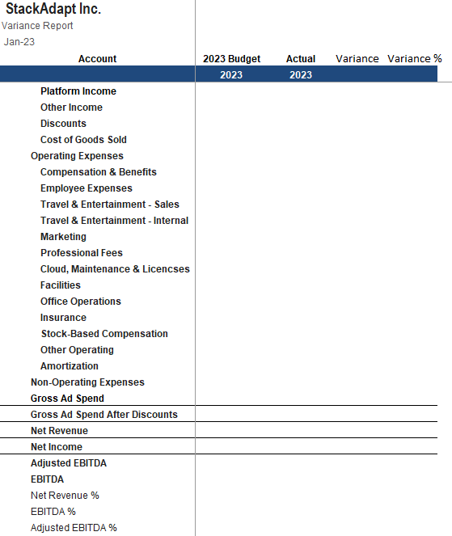
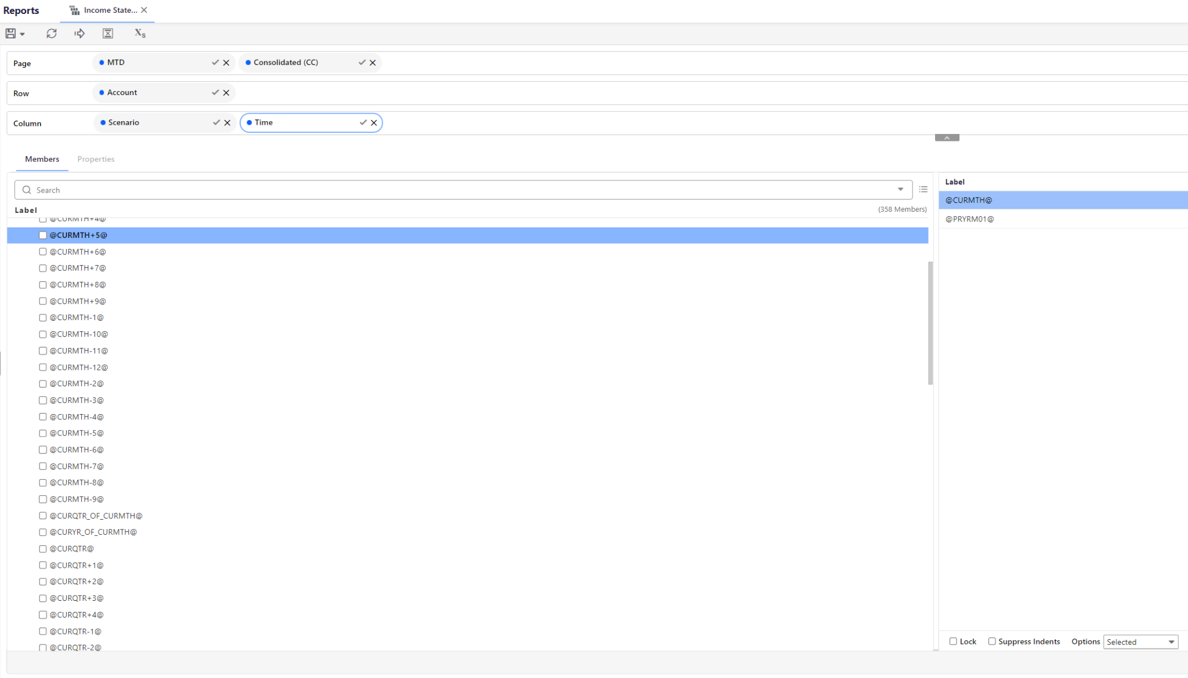
Dynamic Report Build
Leverage substitution variables to quickly update monthly & quarterly reports
TIP Use report sets to create a standard reporting row set
TIP 2 Substitution variables help reduce manual effort in regular reporting
Notes:
Tips and tricks “Don’t forget to:” leverage report sets, sub variables. Text below.
Left image would be good for report set discussions
Right is already on variables.

Slide 10
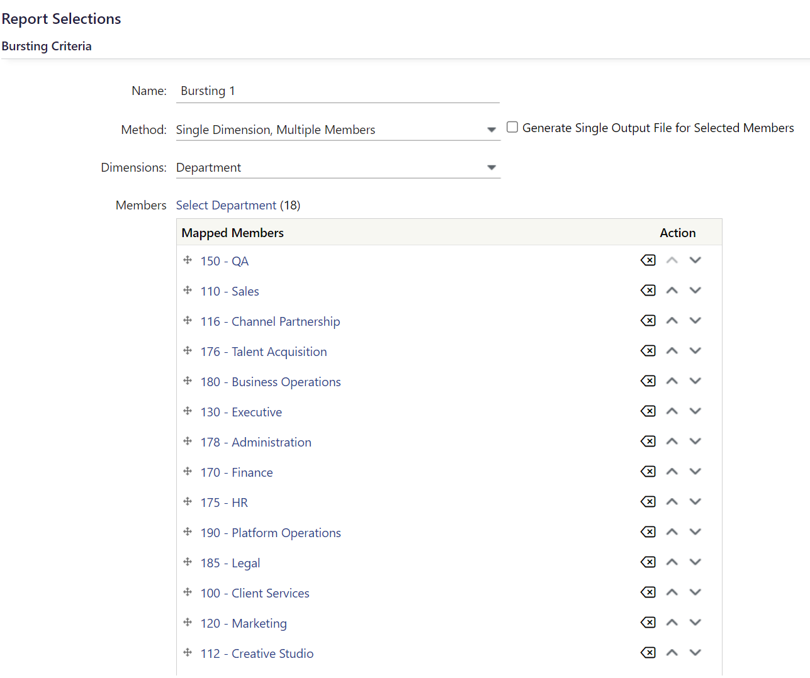
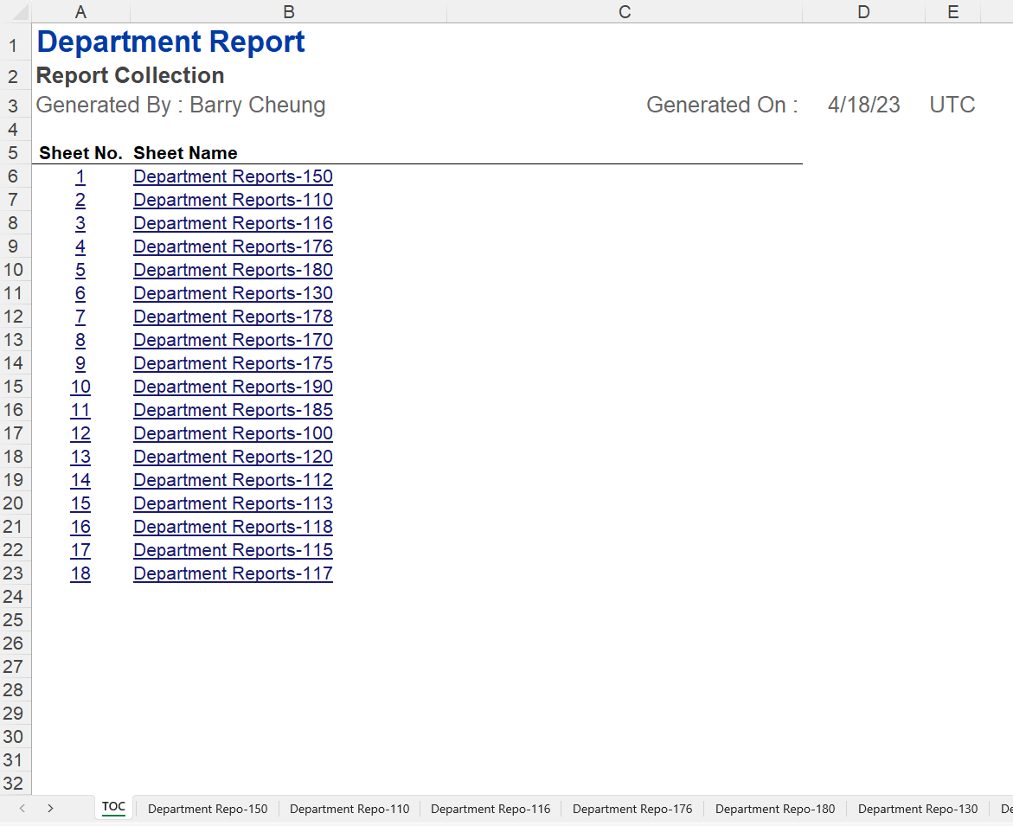
Report Collections
Use report collections to run the same dynamic report with varying dimensions. StackAdapt leverages this to create department specific variance reports with the click of a button.
Notes:
Note that the output report can either be consolidated for those who need a view into everything, or individual reports for easy distribution to single department owners

Slide 11
The Result
Significantly reduced time spent collecting data and manually compiling reports - saving over 1-2 business days during the critical month and quarter end processes. Team has been able shift the team’s focus into analyzing the output of the reports to create actionable insights for business partners

Slide 12
Questions?
Q&A with your speaker

