Slide 1
Supercharge your integrations: Boomi tips and tricks for Planful administrators
Bill Rausch, Bright Point

Slide 2
Bill Rausch
Managing Director

Slide 3
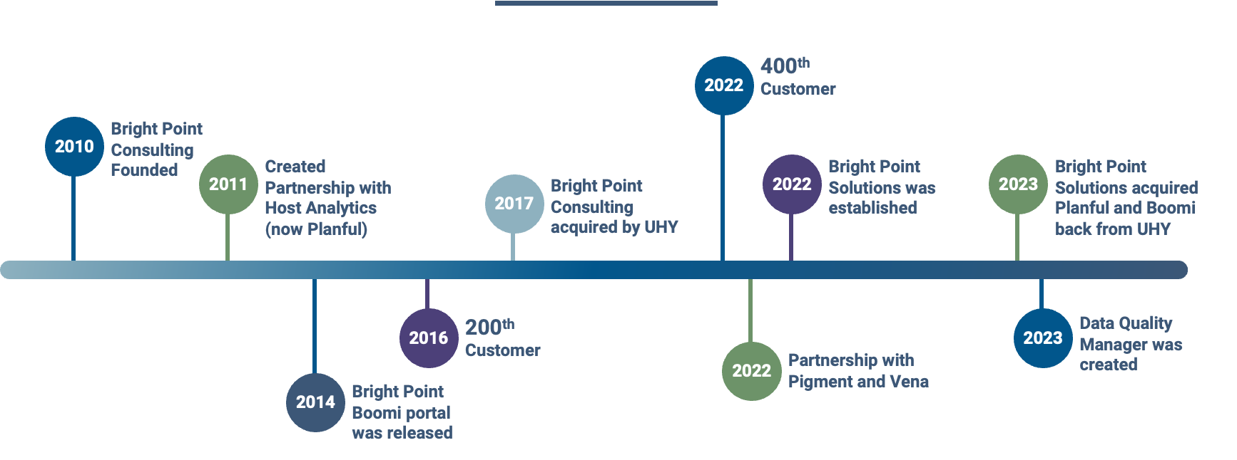
Bright Point History
13 year Partnership and 400+ clients

Slide 4
Agenda
What’s Boomi Anyway?
Expose what’s happening in Boomi
Use ChatGPT to Fix Dirty Vendor and Client Lists

Slide 5
What Is Boomi?

Slide 6
Automated Data Model
Extract
Transform the Data
Load
Flow of Data (generally)

Slide 7
Boomi: Moves Data from Point A to Point B
aka Extract, Transform and Load
Connections & Contracts: Builds connections to source and target systems; how do we log into these tools and request data or push new data in
Extracts and Loads: use either API calls or Queries (SQL) to extract or load data
Transformations: maps columns or rows from one format to another

Slide 8
Connections & Contracts
Address & Security (i.e., phone number and secret code)
On-Premise Systems: typically requires IT professionals for systems that are hosted in-house
Cloud Systems: requires system administrators for cloud systems (ex. NetSuite, Rippling, Salesforce)

Slide 9
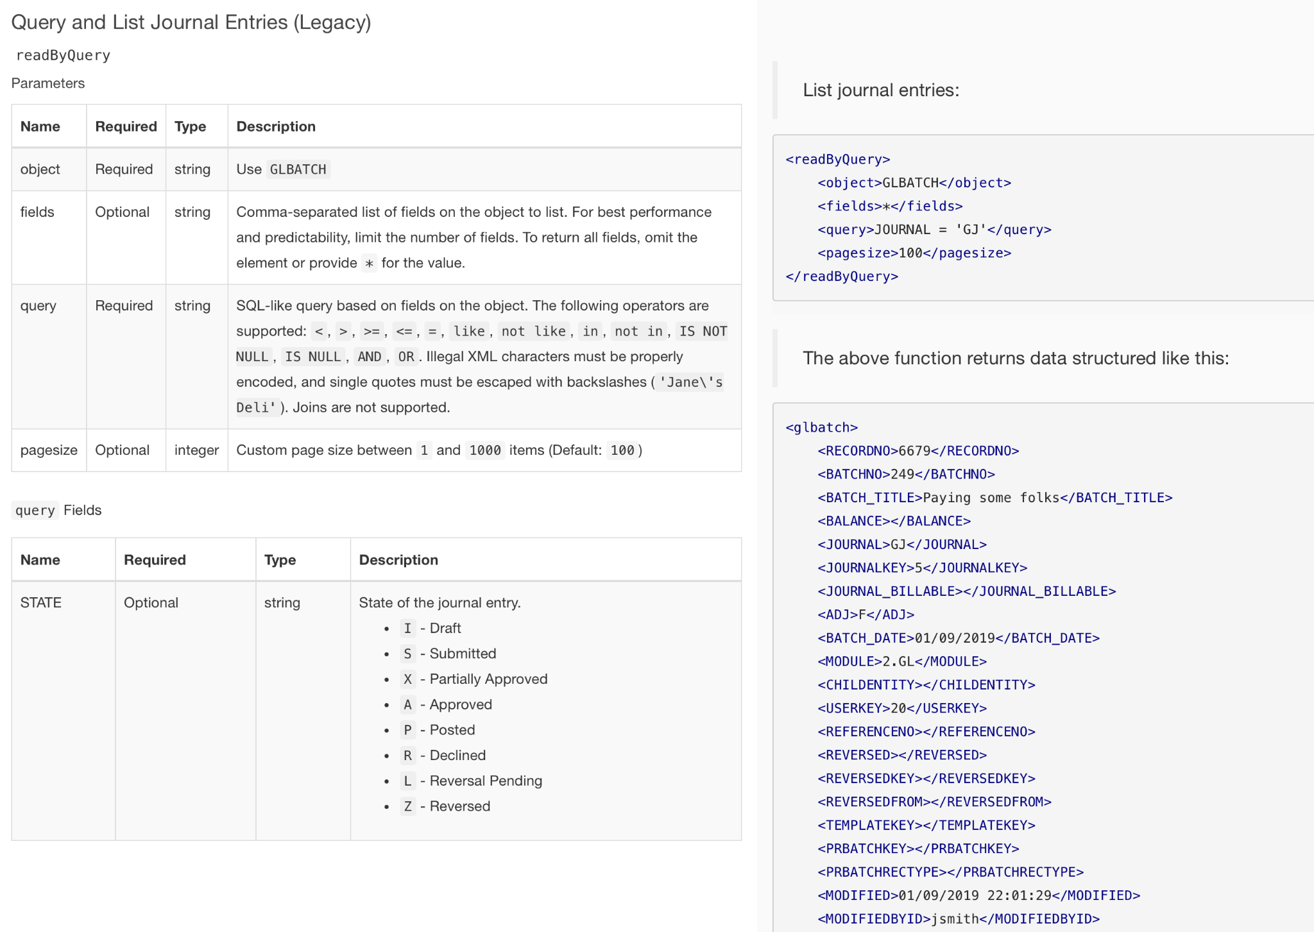
Extracts & Loads
The key is understanding the API calls or knowing what the appropriate SQL Query should be.

Slide 10
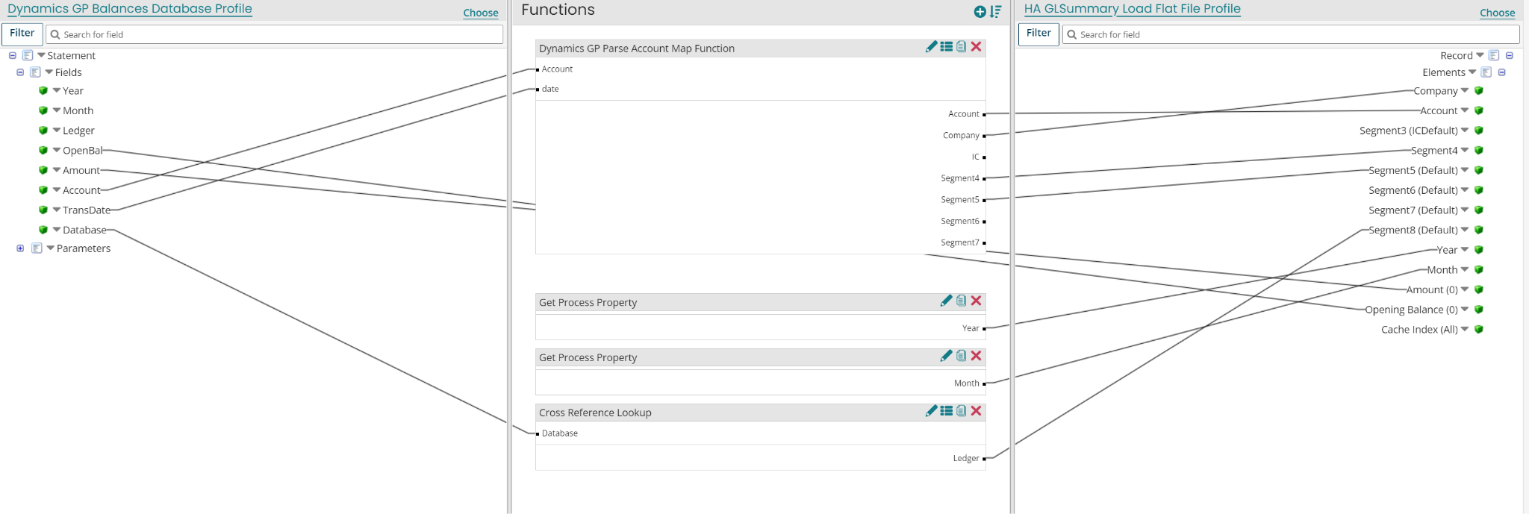
Transformations
Mapping source columns to target columns
Reformatting dates

Slide 11
Sample Translation Table
Cross reference table

Slide 12
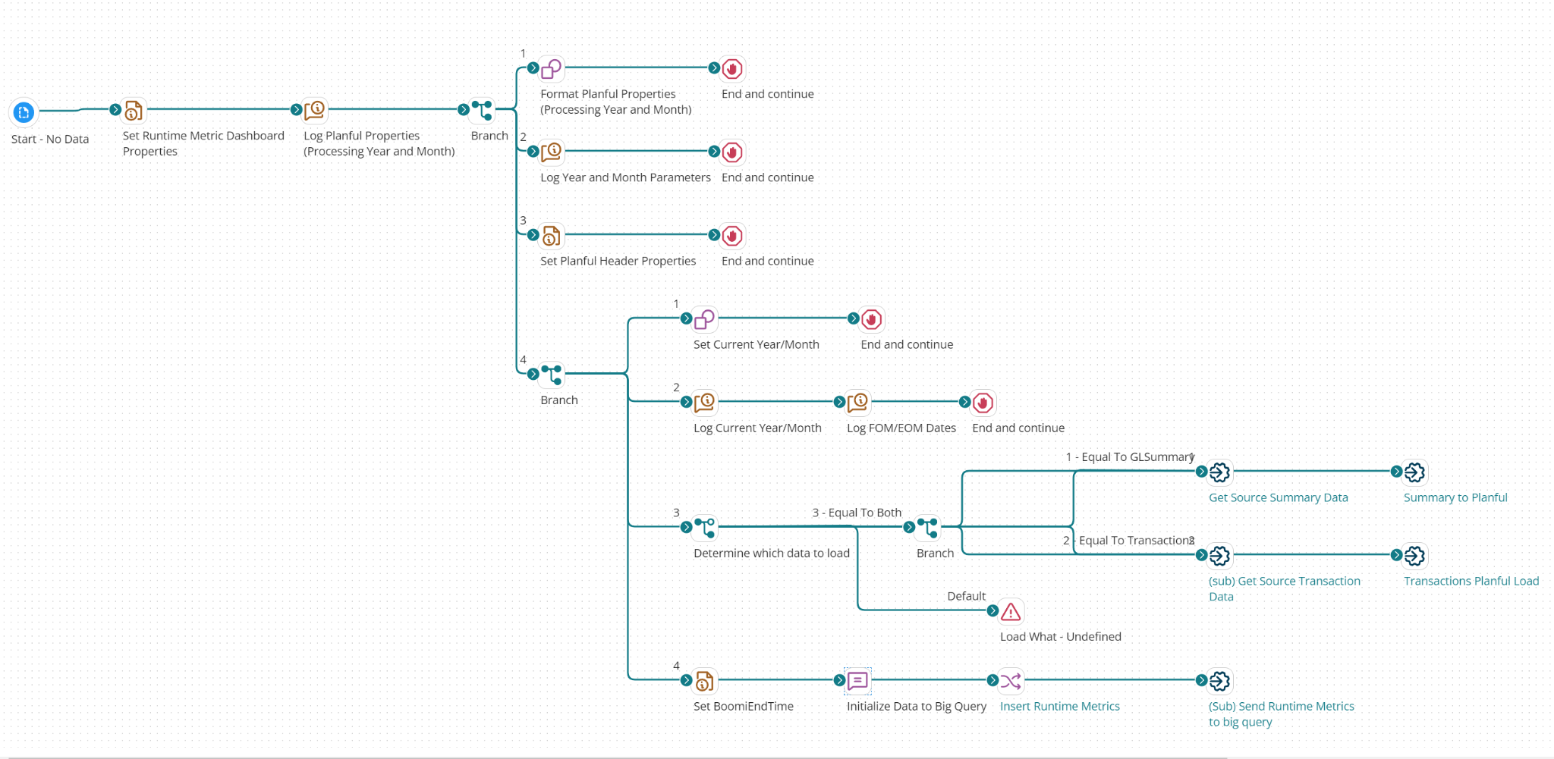
Typical Boomi Process Flow

Slide 13
System “Contract”
Changes
Timing Conflicts
Data Issues
Source of Challenges
Three Types of Issues with Boomi

Slide 14
System “Contract” Changes
Example s
Source / Target System Changes
APIs are sunset (2016 NetSuite sunset APIs)
Underlying Database Changes
Data Permission changes in Source System (overzealous admin)
Certificate / Password Expiration

Slide 15
System “Contract” Changes
Example s
Source / Target System Changes
APIs are sunset (2016 NetSuite sunset APIs)
Underlying Database Changes
Data Permission changes in Source System (overzealous admin)
Certificate / Password Expiration
Solution: Keep up with release notes & stay in touch with system administrators

Slide 16
Timing Conflicts
Other Processes / Extracts or Network Issues cause extract routine to time-out

Slide 17
Timing Conflicts
Other Processes / Extracts or Network Issues cause extract routine to time-out
Solution: Stay in touch with system administrators

Slide 18
Data Issues
Examples
Unaccounted Special Characters (ex. Comma in description field or strange keyboard characters causing timeout)
Missing Values (new transaction type not being picked up or a new transaction type that shouldn’t be picked up)
Unmapped Meta-Data (legal entity, department, project, SKU)

Slide 19
Data Issues
Examples
Unaccounted Special Characters (ex. Comma in description field or strange keyboard characters causing timeout)
Missing Values (new transaction type not being picked up or a new transaction type that shouldn’t be picked up)
Unmapped Meta-Data (legal entity, department, project, SKU)
Solution: Administrating Out All Use Cases.. But maybe we can provide some self service…

Slide 20
How can we expose the data in Boomi?

Slide 21
Visualize Pre & Post Transformed Data
Extract from ERP / General Ledger (Intacct)
Load the extracted data to Data Warehouse (Google BigQuery)
Transform from ERP format to Planful format
Load the transformed data to the Data Warehouse (Google BigQuery)
Load the transformed data to Planful Utilize Google Sheets to see the pre and post transformed data
2
4
Leverage Google Sheets to visualize the pre- and post- transformed data
1
3 (transform)
5

Slide 22
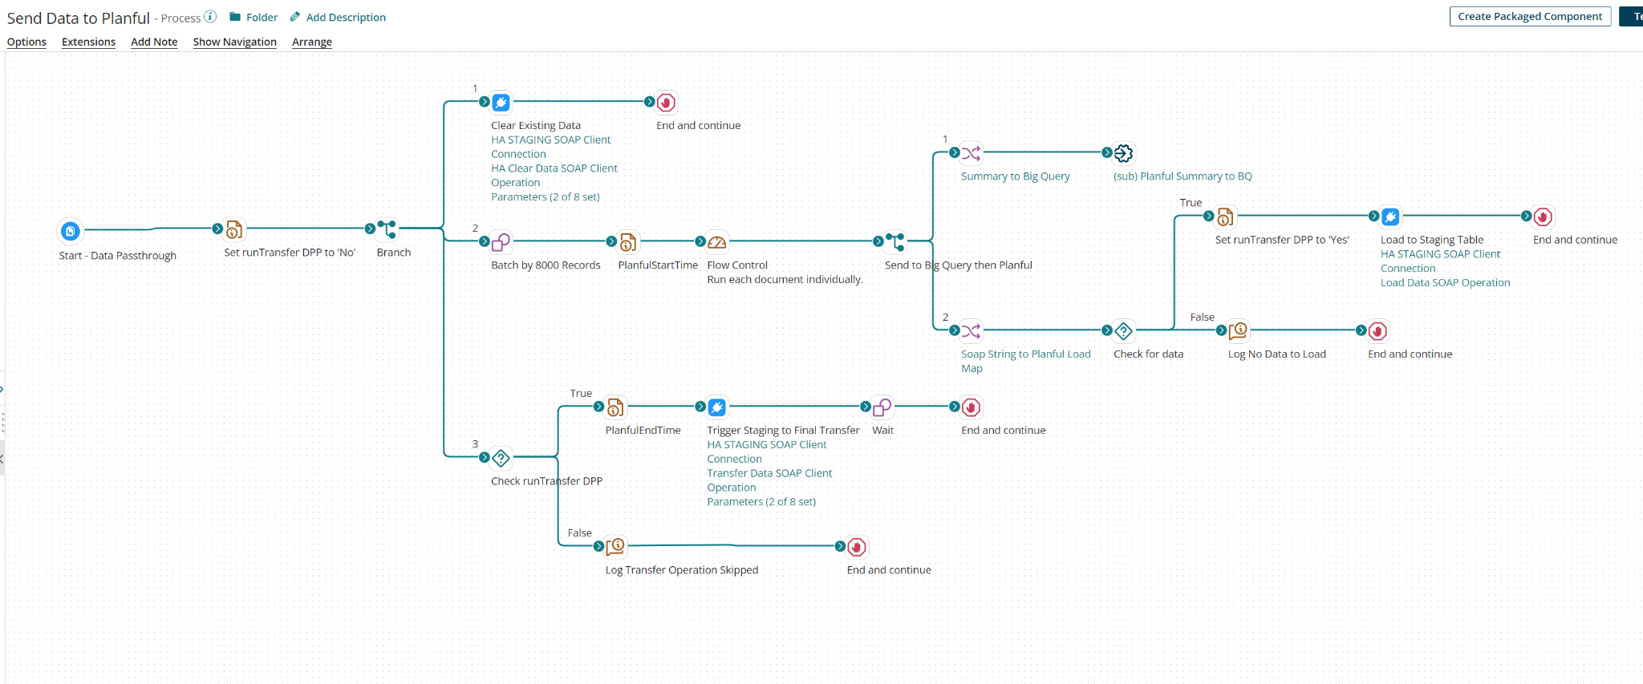
Boomi Process Flow

Slide 23
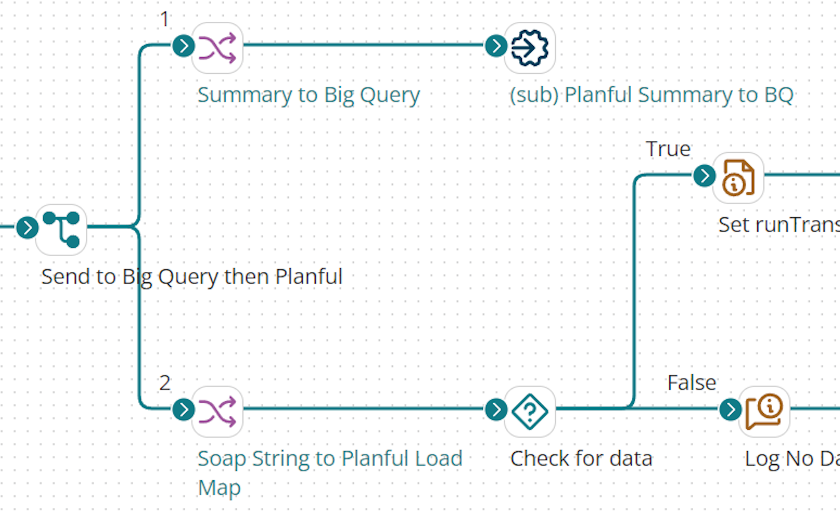
Boomi Process Flow

Slide 24
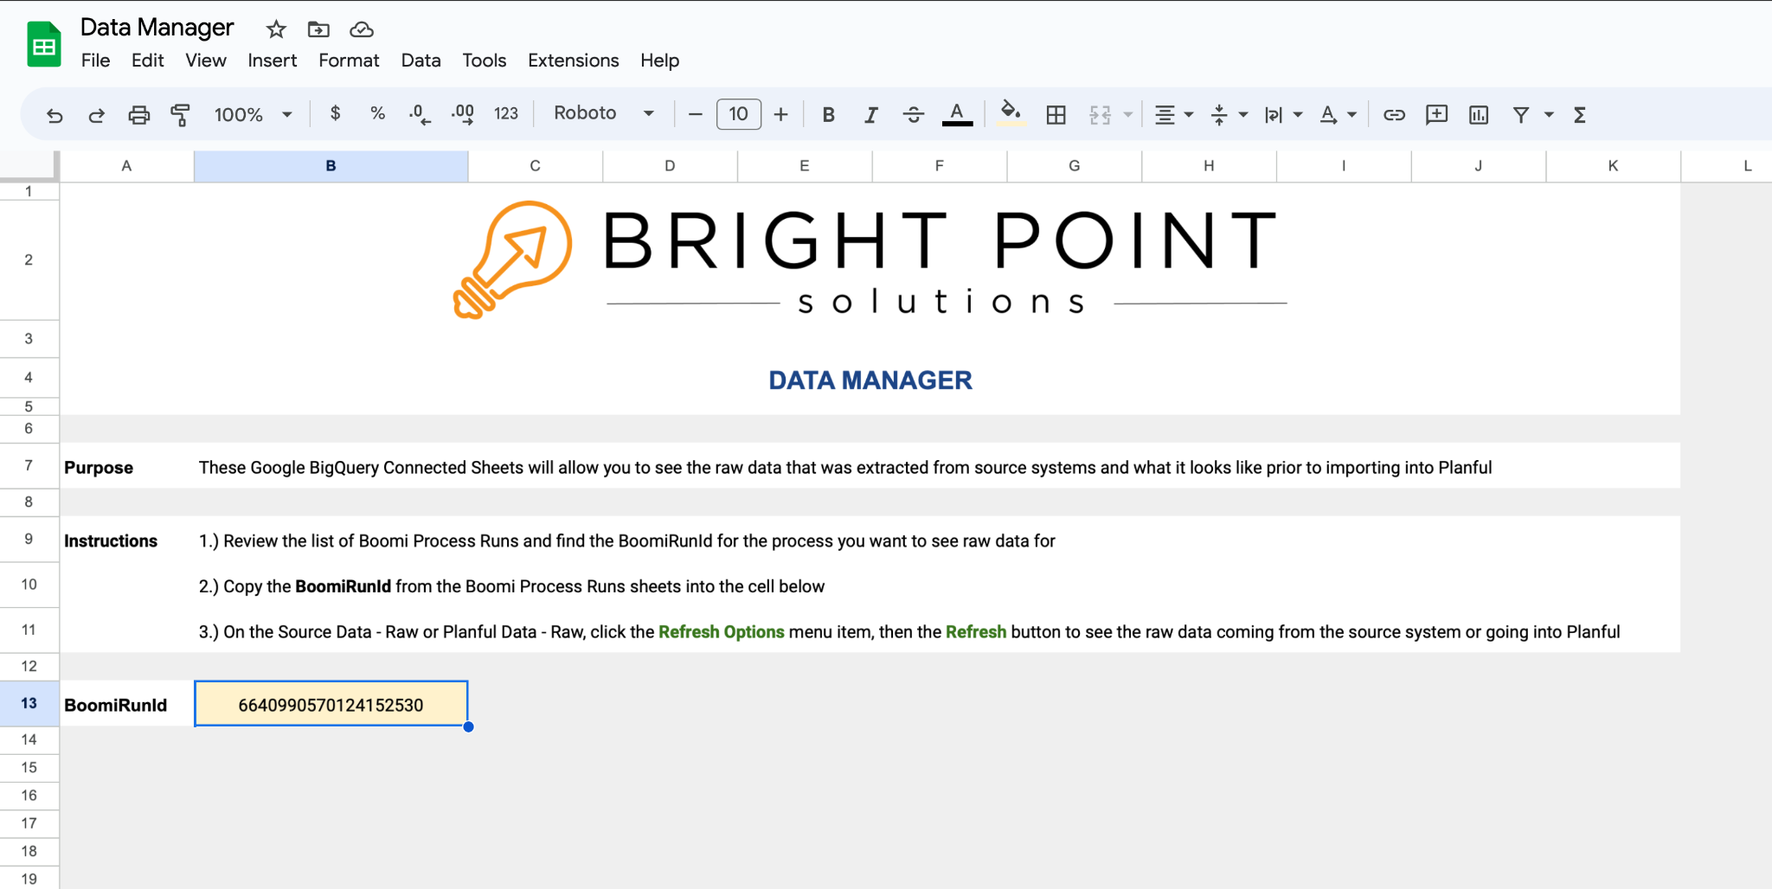

Slide 25
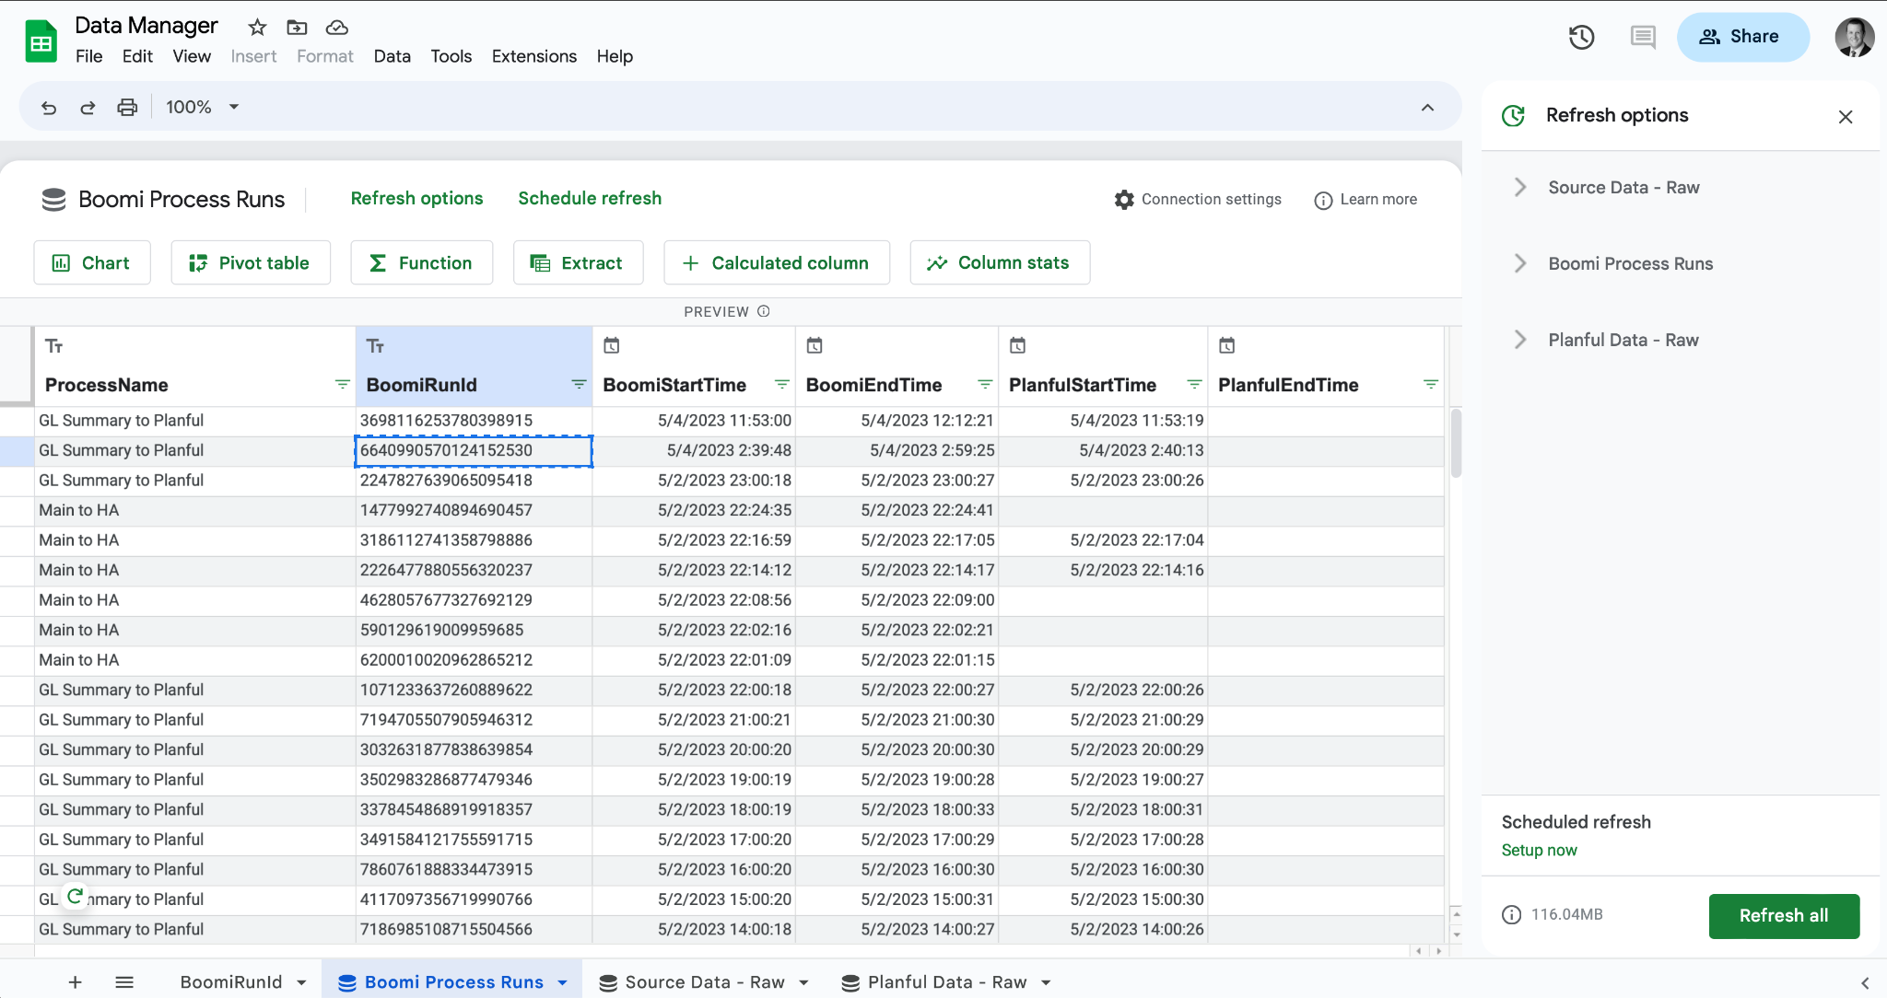

Slide 26
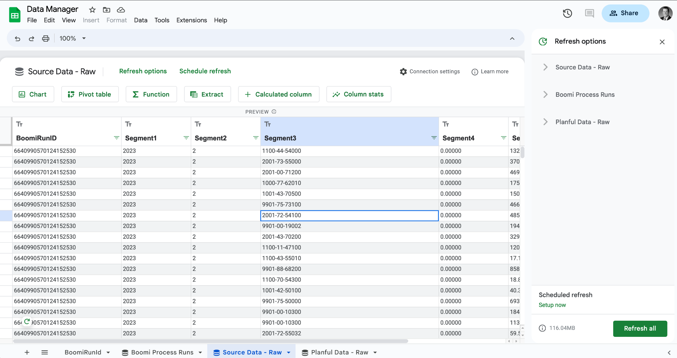

Slide 27
Geoff (customer of ours): THIS WILL SAVE ME $200+/hr!

Slide 28
Data Manager Requirements
What do you need to make this work?
Google BigQuery
very low cost <$10 per month; key is the first terabyte of data is free
An Additional Boomi Licenses
Google BigQuery
Boomi Developer
4+ hours or so, depending on experience
Plan for data retention
We used BigQuery because of the Google Sheets Data Connection Option to visualize the data. If you’ve got platforms for that (ex. Microsoft AzureDB and PowerBI) you can use those instead.

Slide 29
How can we take this idea to the next level!
Establish data quality metrics over the data and run trend analysis to ensure your not missing anomalies.

Slide 30
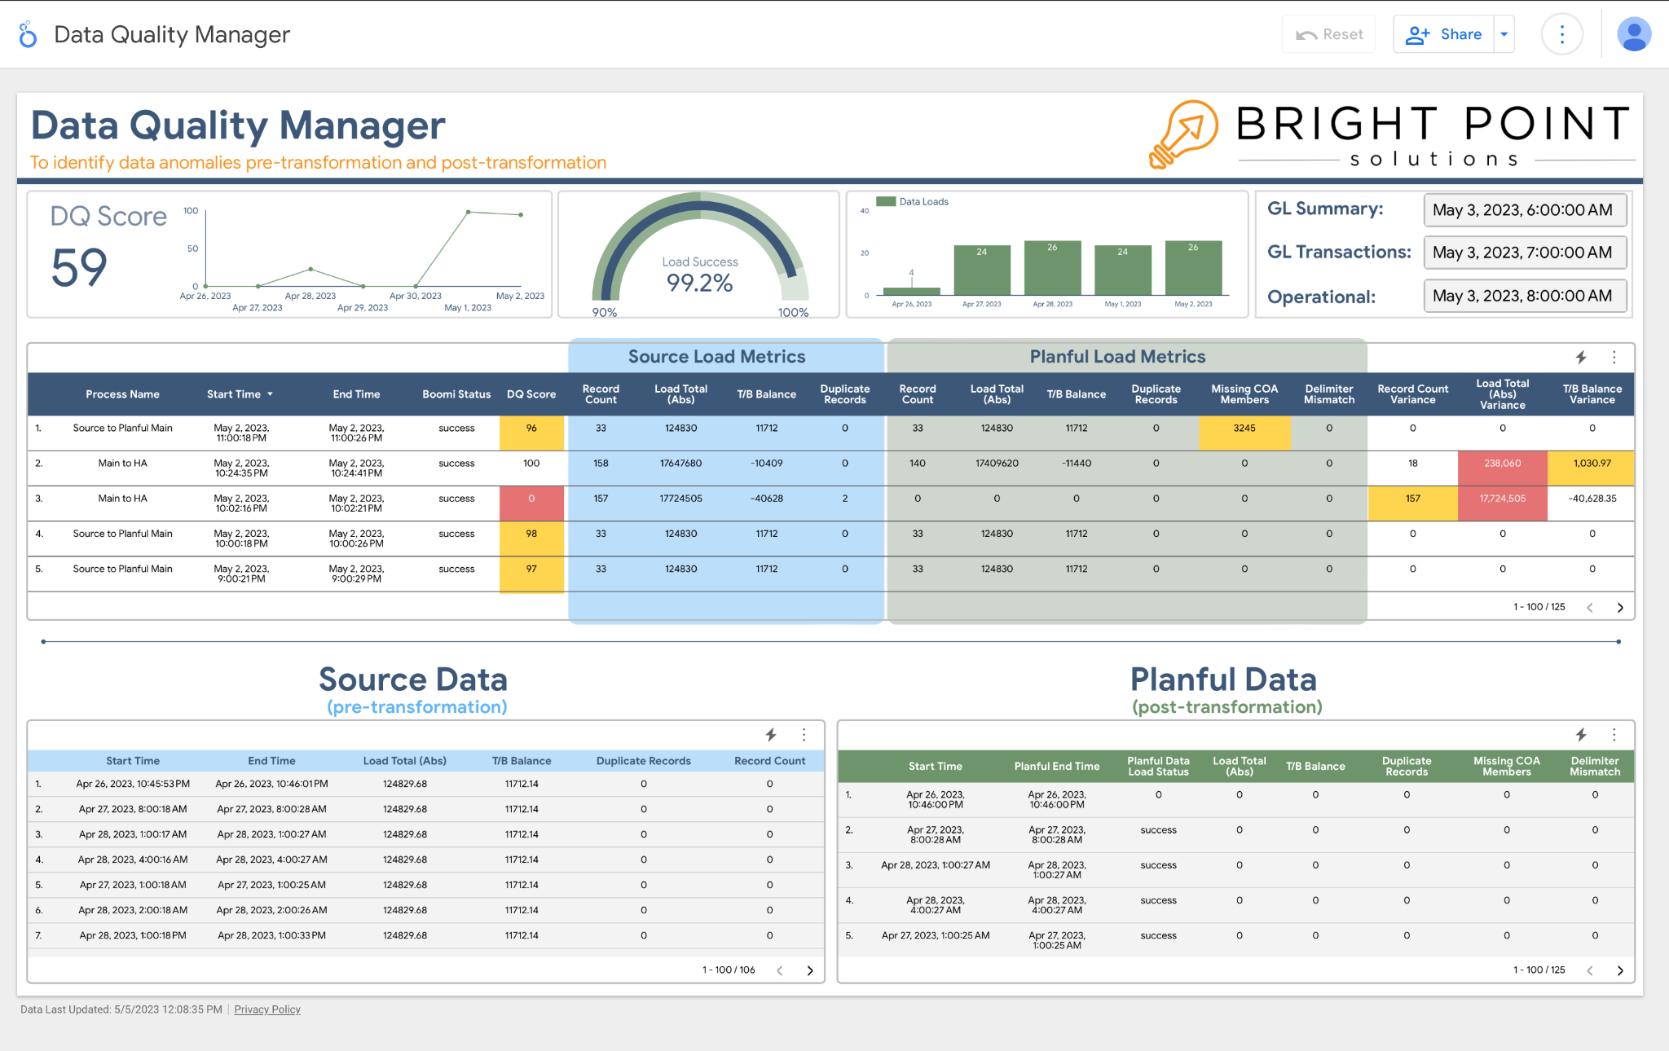

Slide 31
So far, we’ve helped with troubleshooting, but what about eliminating those meta-data errors?

Slide 32
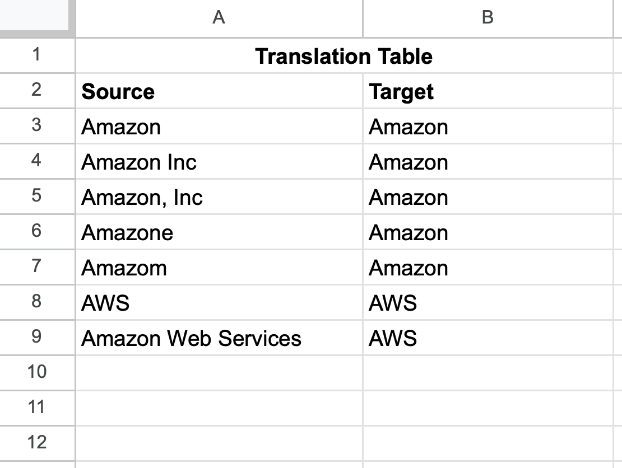
The Problem: Messy Meta-Data
Client, Vendor, Product lists
Someone has to manage these translation tables.

Slide 33
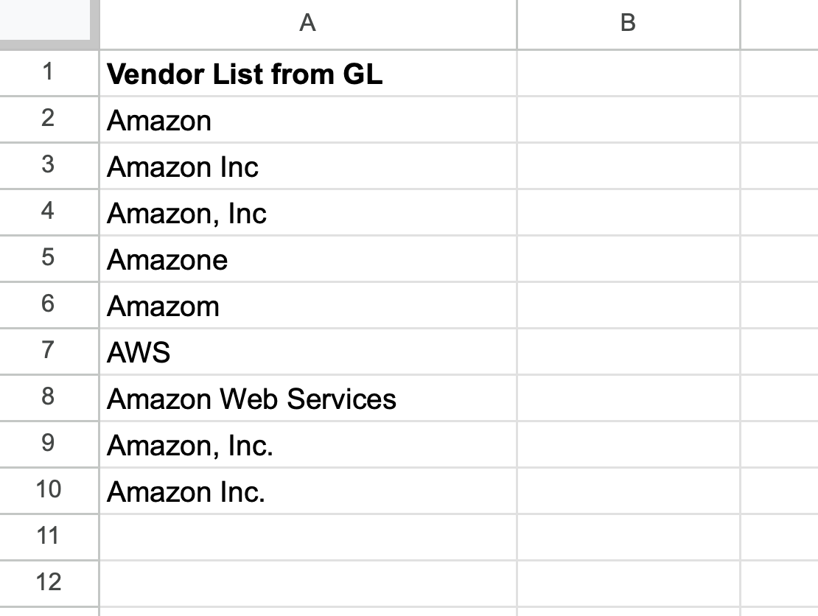
Messy Source Data
The next load from the GL has 2 new Amazons; someone has to manually add them to the translation table

Slide 34
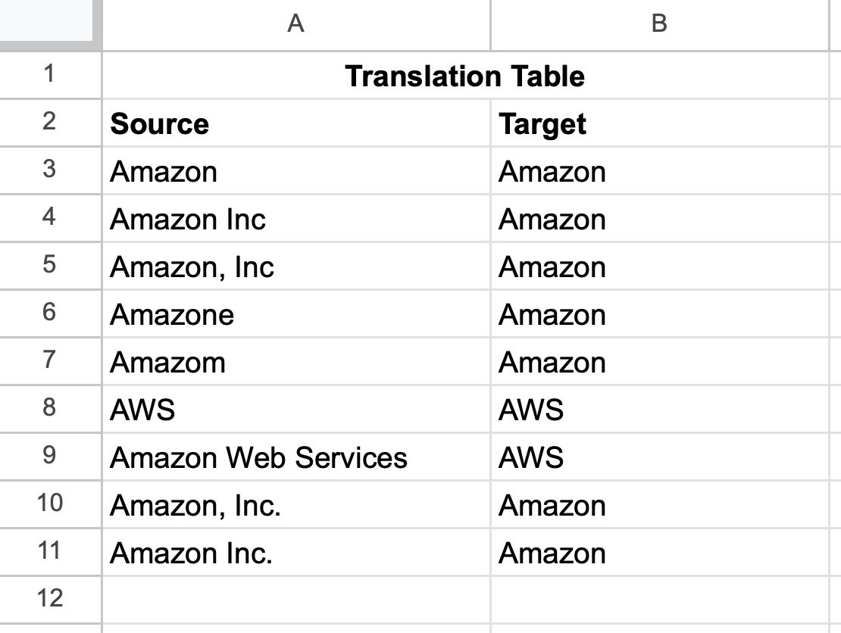
Messy Source Data
The next load from the GL has 2 new Amazons; someone has to manually add them to the translation table

Slide 35
Can we use ChatGPT to automate translation table maintenance?

Slide 36
These are our instructions to ChatGPT to udpate our vendor list translation table

Slide 37
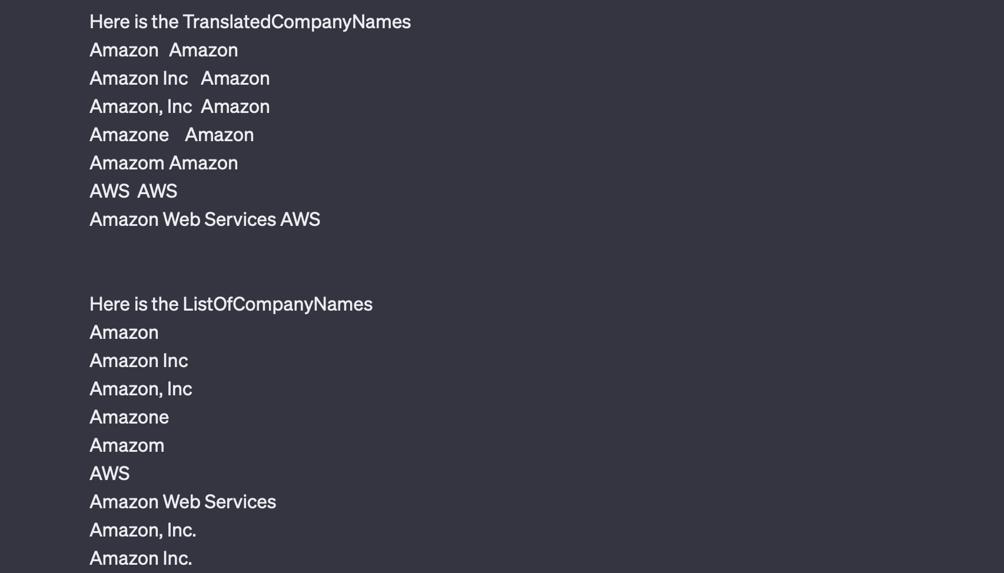
The top list has our original translation table.
The second list is the unique set of values from the latest pull from our source system.
Looks like we have two new Amazons; one with , Inc. and the other with Inc.

Slide 38
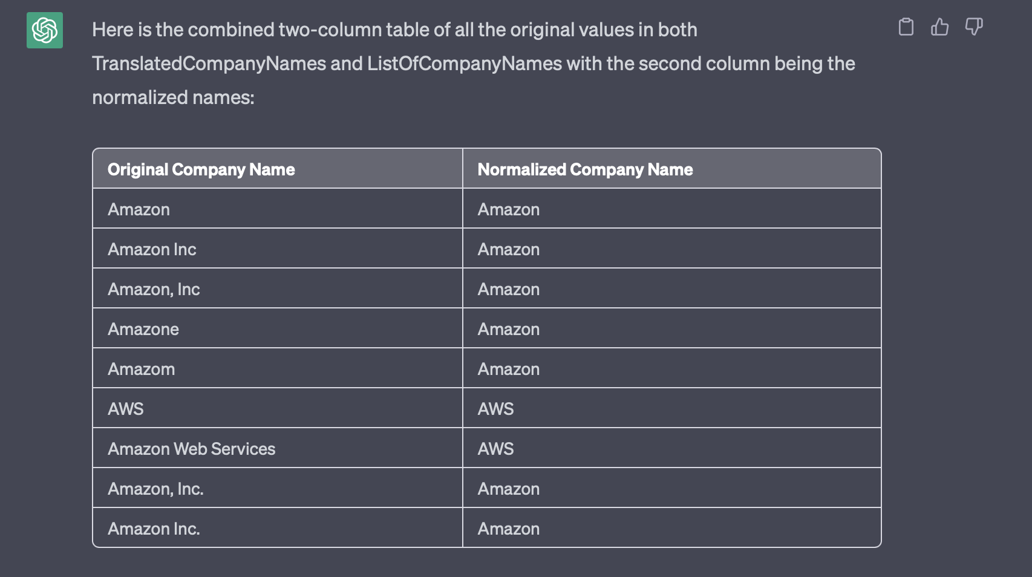
Note how ChatGPT automatically figured out the new Amazon Inc. should map to Amazon!

Slide 39
Can we use ChatGPT with Boomi?

Slide 40
ChatGPT with Boomi - Our Setup
Clean up vendors before it hits Planful
Assumptions
Transactions with Vendor from NetSuite (could be trial balance)
Vendor Translation Table in Google Sheets
We want to be able to override ChatGPT results

Slide 41
ChatGPT with Boomi - Flow
Clean up vendors before it hits Planful
Extract Transactions from NetSuite
Get Unique List of Vendors from Transactions from NetSuite
Extract Translation Table from Sheets
Send Translation Table, New Vendor List and Instructions to ChatGPT
Get new translation table from ChatGPT
Load Updated Translation Table to Google Sheets
Using updated translation table, map old vendors to new in the Transactions from NetSuite
Load to Planful
3
6
2
7
1
8
4
5

Slide 42
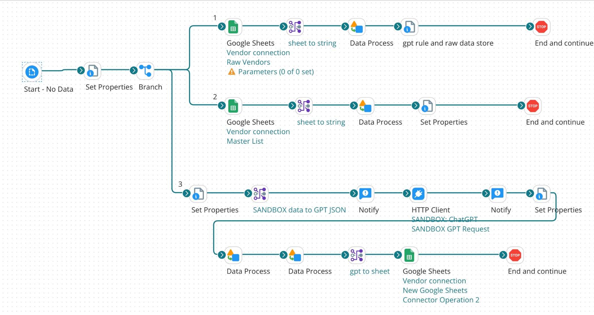

Slide 43
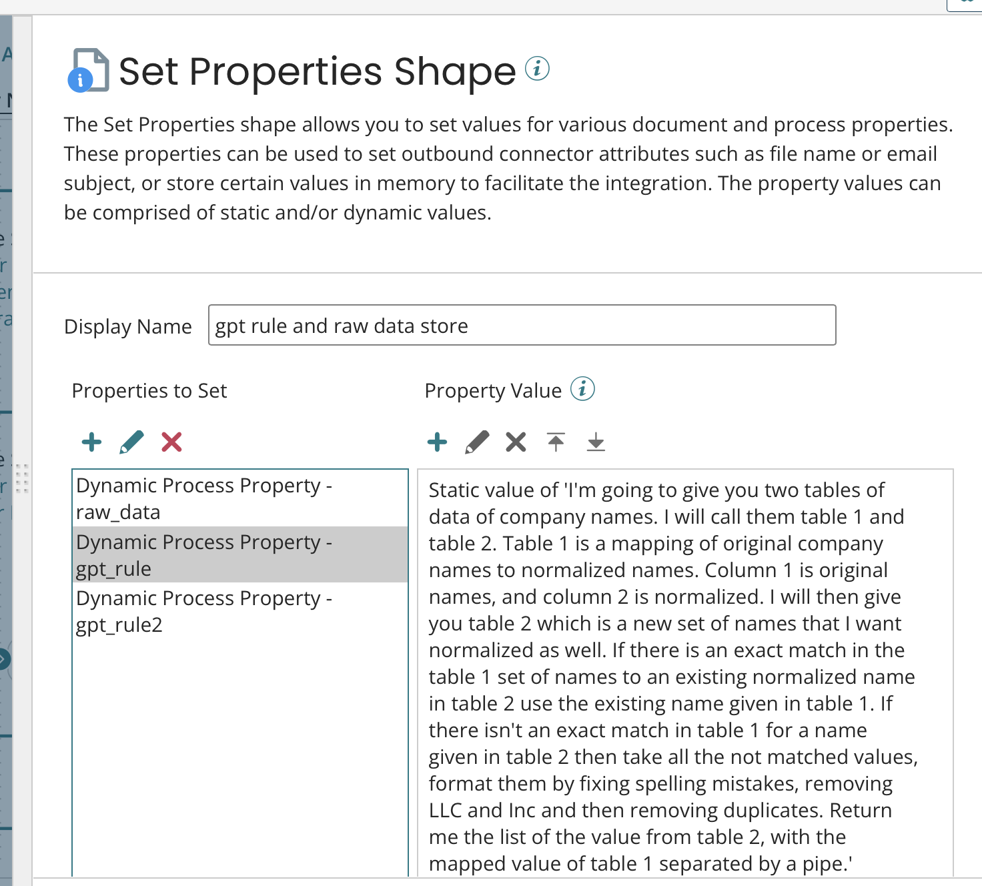

Slide 44
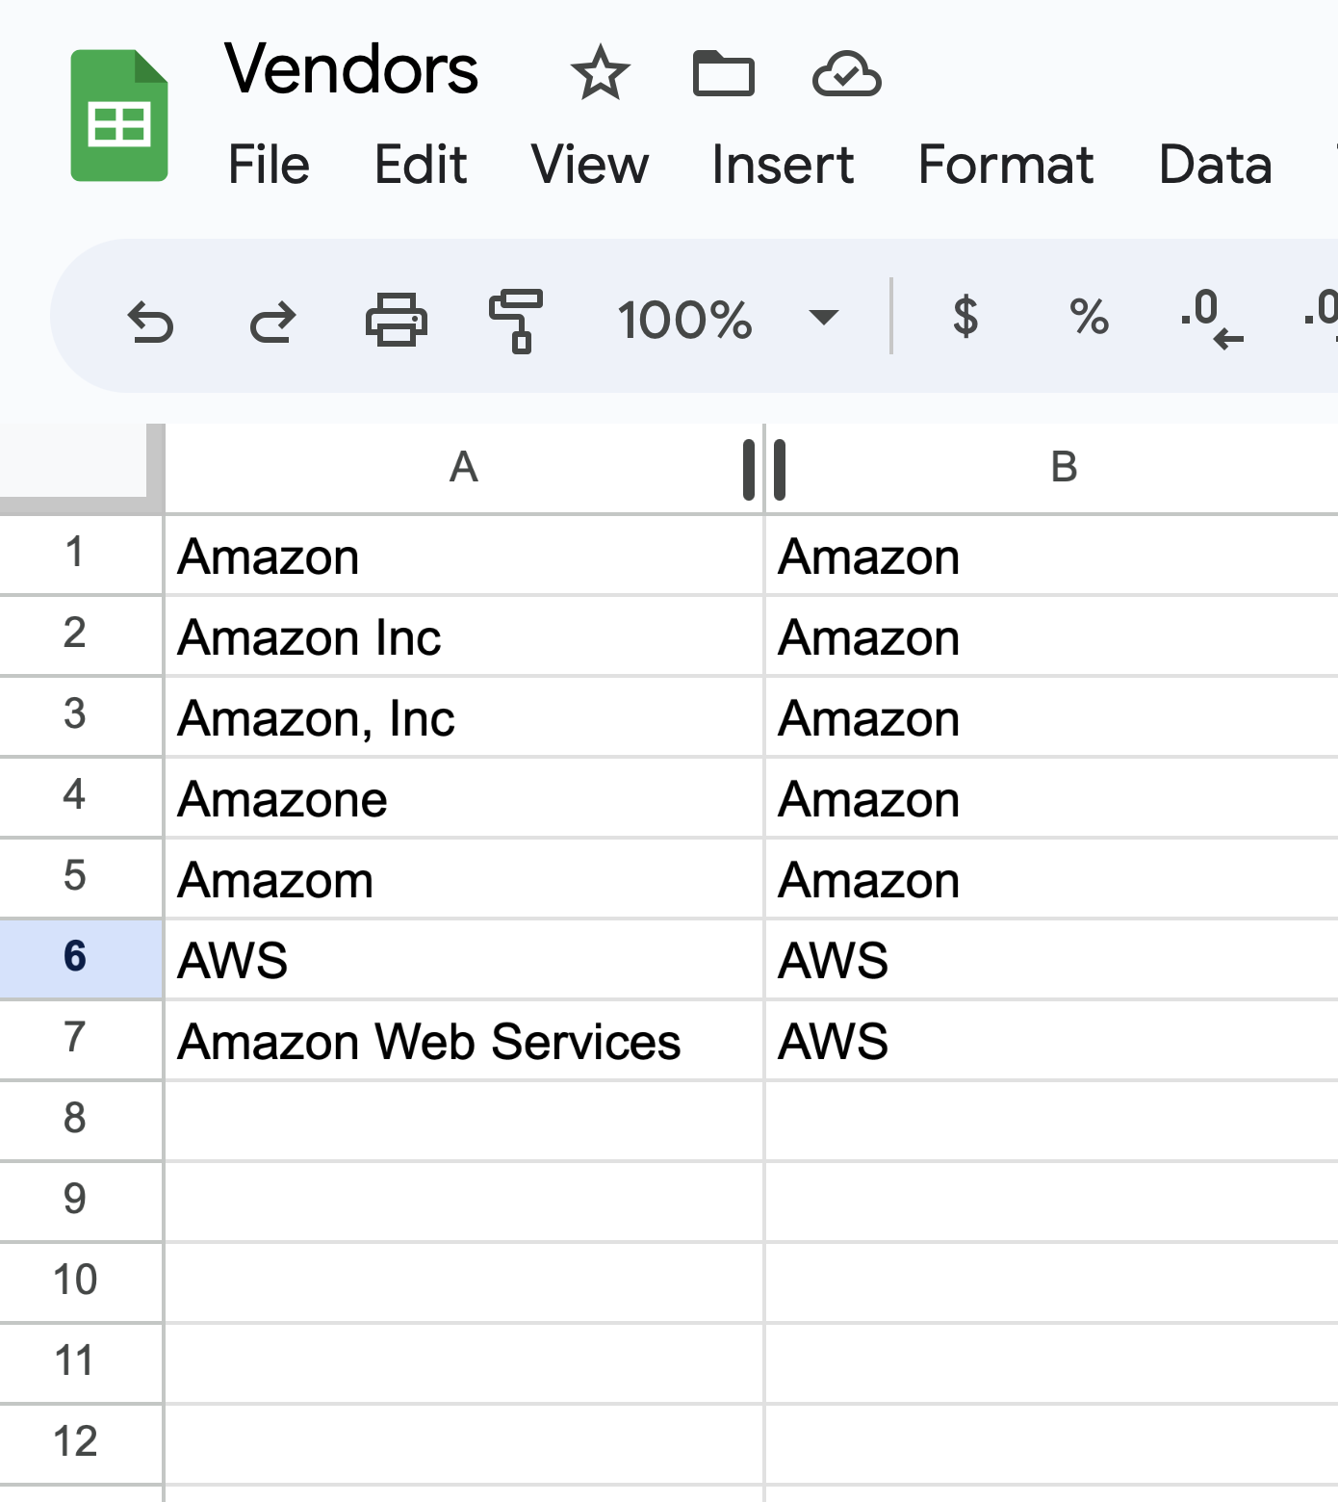
This is our existing translation table.

Slide 45
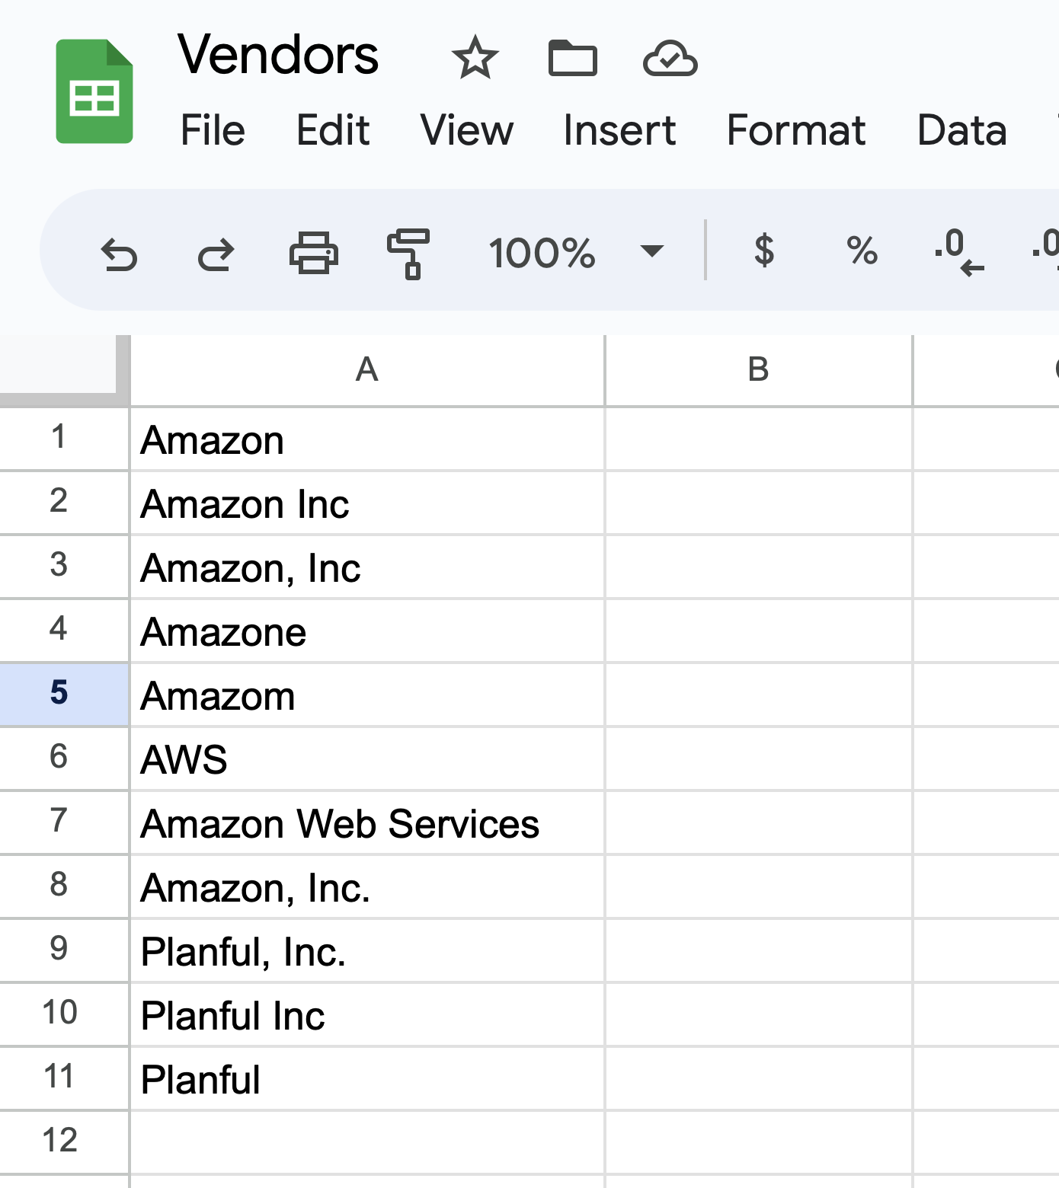
This is the list of unique vendors from my extract from the ERP (or Salesforce or whatever).
One new Amazon and a few new Planfuls

Slide 46
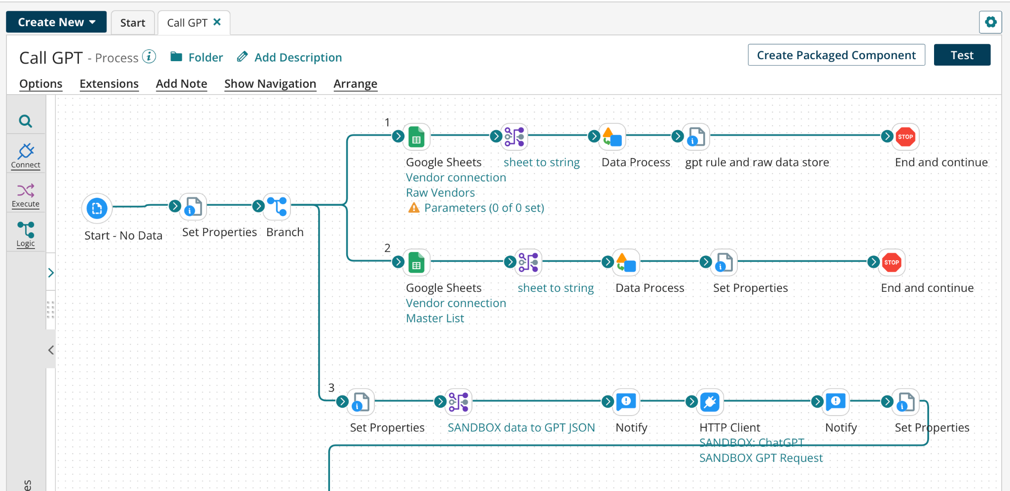
This is the actual Boomi flow. It normally is on a schedule, but I’ll run it manually here.

Slide 47
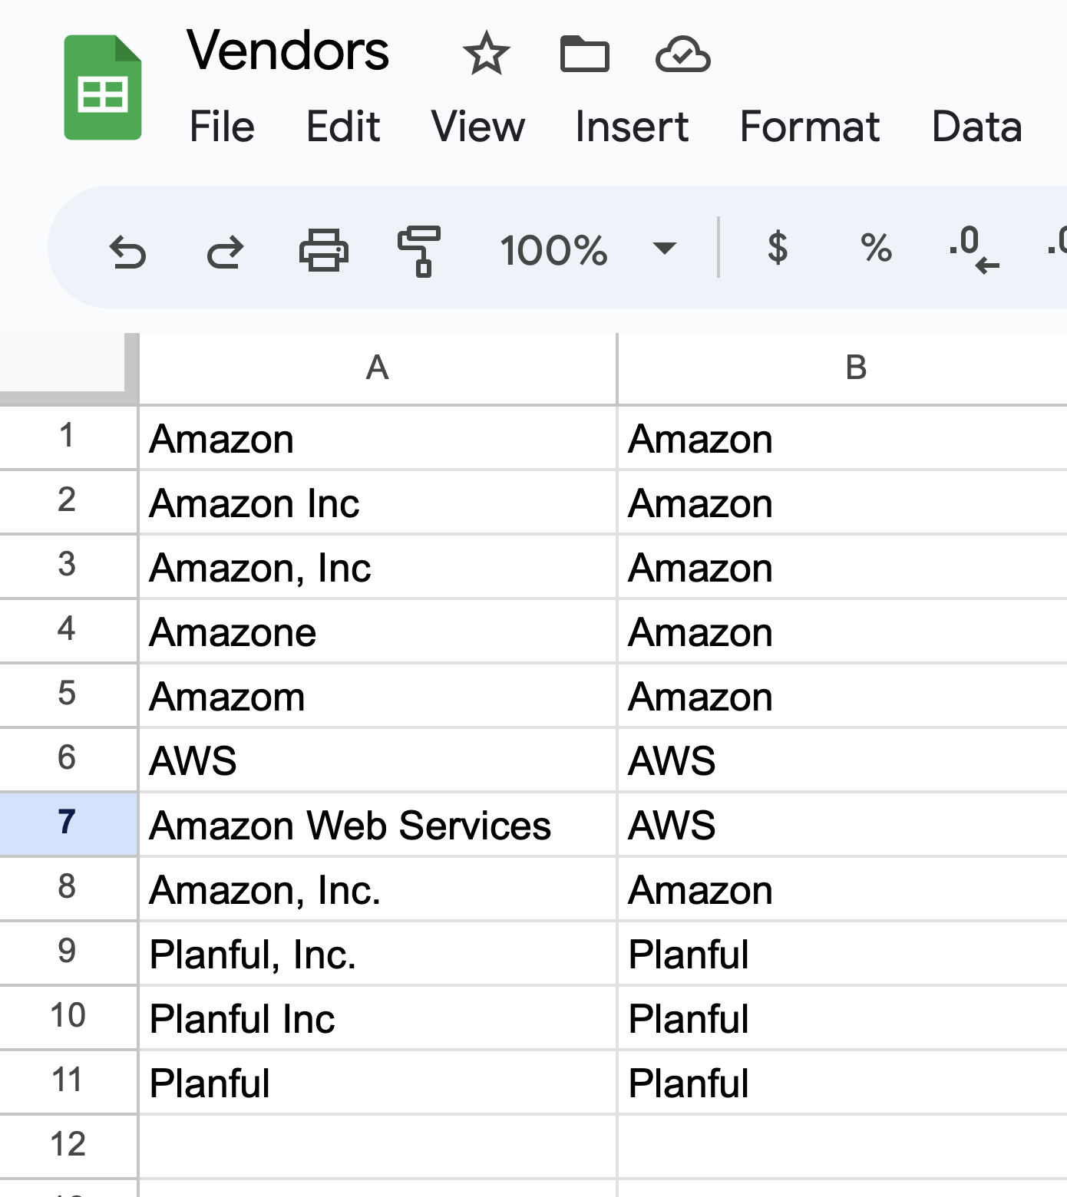
This is the new translation table.
Notice how ChatGPT automatically created the new translations.

Slide 48
ChatGPT and Boomi Requirements
What you need to make this work
ChatGPT API “License”
Two Additional Boomi Licenses
Google Sheets
ChatGPT
ChatGPT Instructions to use Translation Tables
Boomi Developer
8+ hours or so, depending on experience with ChatGPT and Google Sheets connectivity
Nothing special about ChatGPT or Boomi here, it’s just the tools we had on hand. We could just as easily used Google Bard and any other data integration platform.

Slide 49
Questions?

Slide 50
Up Next
Increasing User Adoption Through Advanced Reporting
Thank you!
Michael Zambetti National DCP

