Slide 1
Last Mile FP&A: Success Beyond the Systems
Bobby Odior, First Water & Nick Araco, The CFO Alliance

Slide 2
Bobby Odior
Vice President, Finance First Water Finance
Nick Araco
CEO and Founder of The CFO Alliance

Slide 3
About First Water Finance
First Water Finance is the finance advancement platform, serving finance professionals, management teams, and capital partners. We provide FP&A and Corporate Finance solutions through business process outsourcing (First Water Managed FP&A SolutionsSM), project consulting, and transaction advisory. Alongside The CFO Alliance, First Water also supports talent acquisition within the office of the CFO and leads community content and learning programs for finance leaders worldwide.
About The CFO Alliance
Like no other community, The CFO Alliance precisely understands the aspirations, needs, complexities, and ever-expanding demands placed on the CFO role. Ten years of collaboration and attentive listening involving thousands of interactions and over 500 peer group roundtables have inspired us to find new ways to create value that’s relevant, actionable, and measurable.

Slide 4
Agenda
Last Mile FP&A Defined
Pain Points
Skills That Matter
Key Takeaways

Slide 5
Question
Poll time!
Has your company implemented new software or technology within the last 2 years?
YES
NO

Slide 6
The Why
Systems and software continue to rise in value and accessibility, though they cannot take on the responsibility of the entire FP&A function. How do we best work alongside technology?

Slide 7
“The purpose of data is dialogue. Finance is and will remain a people-driven function.”
–Ben Lehrer, First Water Finance CEO

Slide 8
Where We’ve Come From
1985
2010
2013
2013-2019*
2014-2021**
Spreadsheets (Excel Invented)
Power Pivot / Power Query (Connect / Transform)
Power BI (Connect / Transform / Visualize)
Boomi / Alteryx, etc. (Advancements to Connect & Transform)
Planful (Dynamic Planning / FP&A Tools)
* Boomi and Alteryx founded in 2000 and 2010, respectively; timeline represents launch of critical features for how tools are primarily utilized today.
** Planful (previously Host Analytics) originally founded in 2000, timeline represents launch of HA MyPlan and onward; rebranded to Planful in 2018
…and lots of ERPs along the way

Slide 9
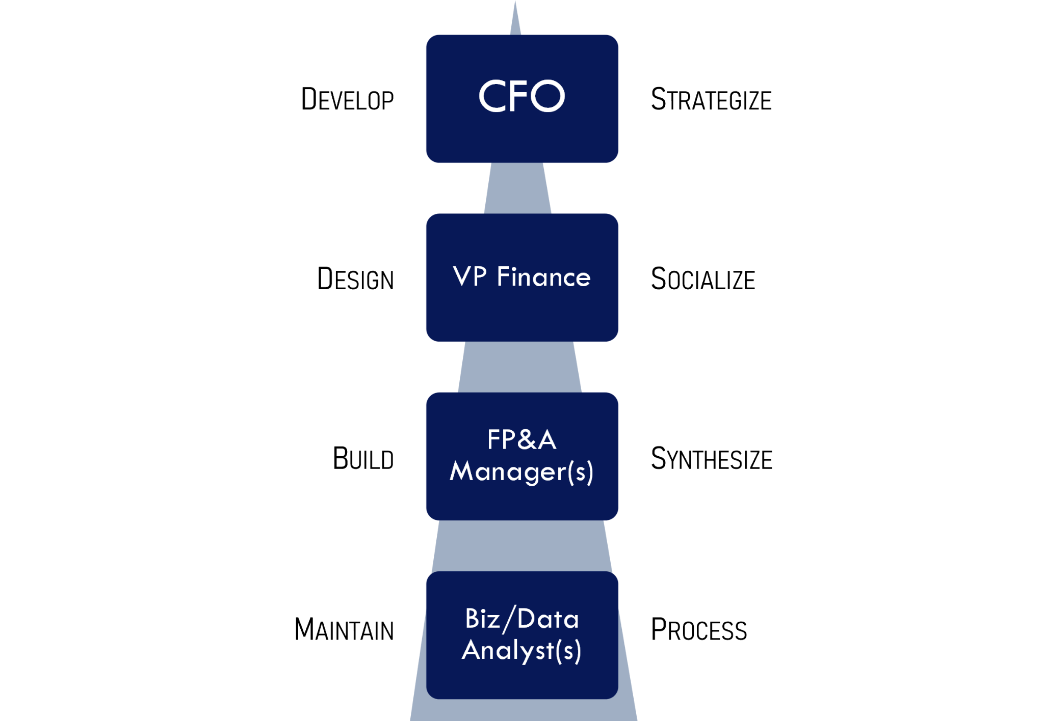
Last Mile FP&A
Working “off system”
FP&A responsibilities / processes
Beware of Frankenstein

Slide 10
Question
Poll time!
Are you too busy to learn new skills / platforms?
YES
NO

Slide 11
Sources of Pain
…holding us back from
Traditional FP&A track
Fire drills / the “finance life”
Processes built on sand
Traveling the FP&A world
Learning new skills
Scaling the pyramid

Slide 12
Question
Poll time!
Do you believe your company’s system environment and/or existing processes are holding you back in your role?
YES
NO
Sometimes

Slide 13
Question
Poll time!
What tools are you personally aware of tools that would help you, your tea,m, and your company that are not being utilized?
Yes
No

Slide 14
The #1 Skill needed to run the last mile:
What does Data Management require?
Data Collection
Data Extraction
Data Transformation
(Beyond Excel and analysis)
Process Building
People Management
Data Management

Slide 15
What Should You Do About It?
Design your own advancement roadmap (not where, but what)
Express your current process and flex your process building muscles!
Advocate for access to tools that help you scale the pyramid
Use efficiency gains for incremental learning

Slide 16
Question
Poll time!
What’s more important to you, new business experience or new technical/technology experience?
New Business Experience
New Technology

Slide 17
Questions?
Q&A with your speaker

Slide 18
DRINKS!
Thank you!

