Slide 1
Building flexibility into your workforce:
How to adapt to changing business needs beyond the annual plan
Melissa Dreuth & Justin Merritt
Notes:
People costs make up 80% of your organizations cost on average, but is that really it? Think about all the other costs that are truly driven by people, either indirectly or directly…things like software license costs, travel costs, internet, cell phone, etc…how can we automate this and give our decision makers the power to manage what they’re actually in control of…
And…what’s new? Times are changing…wage disclosures, more transient workforce, higher attrition rates, skill gaps and skill changes, etc. How can we use WFP to relieve the burden on the organization and be better at planning, running scenarios and adjusting when needed.
Data integration as third theme? Difficult, confidential, how frequently does the data change, how do we connect everything, what about actuals?
Will be after Ammesh’s session, so can reference back to what he showed.
Do we do interview type format? Have Gen facilitate or do Mel and I just chat or do we do more preso format?

Slide 2
Melissa Dreuth
Chief of Staff to CEO and Chief People Officer
Justin Merritt
Vice President of Solutions Consulting, Planful
Genevieve D’Souza
Product Marketing Manager, Planful

Slide 3
Agenda
PEOPLE
WORKFORCE
DATA

Slide 4
Why People?

Slide 5
80%
Of organizational costs are on people

Slide 6
Is that accurate?

Slide 7
90%+

Slide 8
What’s Changing?

Slide 9
60%
of companies made changes
to market data sources
to account for rapidly
changing markets
Payscale 2023 Compensation
Best Practices Report

Slide 10
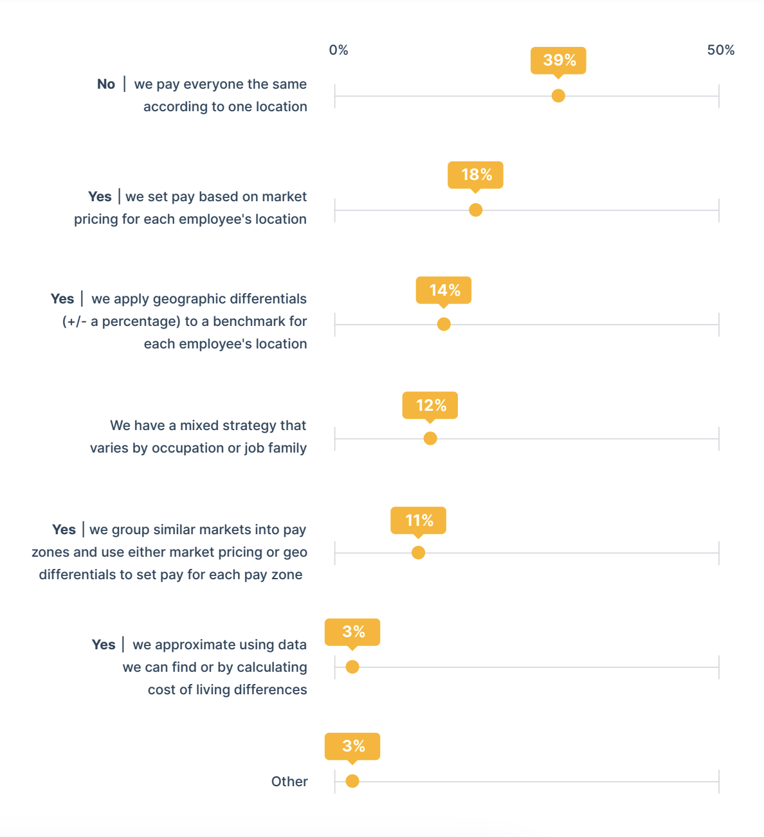
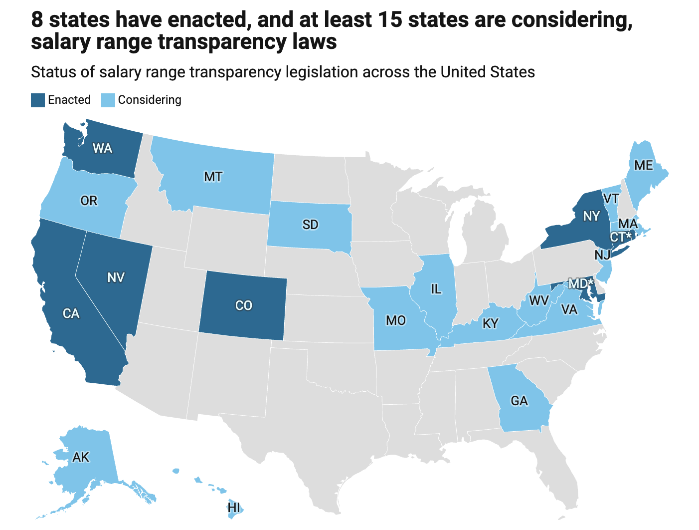
What’s changing in compensation
Compensation Strategy
Pay Transparency

Slide 11
Closing the Loop

Slide 12
Why Close the Loop?
Always Safe, Secure, Controlled
Budgeted Headcount
Modeling Compensation
Recruiting Adjustments
Employee Actuals Analysis

Slide 13
Final Thoughts

Slide 14
Questions?

