Slide 1
Building a Best-in-Class FP&A Organization and Using Empathy to Build Partnerships
Glenn Snyder

Slide 2
Glenn Snyder
Finance Executive
Glenn Snyder has over 20 years of FP&A experience and eight years of corporate strategy experience at public firms such as Franklin Templeton, Visa, Charles Schwab, and Digital Realty, as well as private companies like Zazzle and Mobileum. In addition to his work experience, Mr. Snyder has taught both Managerial Finance and International Trade & Finance at San Francisco State University, published a novel, One Moment in Time,
published a supplement to Principles of Corporate Finance through McGraw-Hill, presented at several FP&A and leadership conferences, and been a regular on the FP&A Friday’s podcast. Mr. Snyder has a bachelor’s degree from U.C.L.A. in International Economics and an M.B.A. from the University of San Francisco with a double emphasis in International Business and Finance.

Slide 3
“Imagination is more important than knowledge”
̶ Albert Einstein

Slide 4
Contents
The Role of FP&A
FP&A Evolution
FP&A Core Functions
FP&A Structure
People vs. Technology
What is Empathy?
The Value of Empathy
Analyzing with Empathy
Setting Agendas with Empathy
Partnership vs. Support
Continuing to Make an Impact

Slide 5
The Role of FP&A
FP&A is a centralized analysis and reporting team that works as a liaison between the business units and finance to provide insights and understanding that enhances decision making across the organization

Slide 6
FP&A Evolution
Thought Partnership
Metrics / Drivers / Storytelling
Reporting / Budgeting

Slide 7
Core FP&A Functions
Finance Business Partners
Monthly budget variance reports
Ad-hoc analysis
Budgeting / Forecasting
Project analysis
Business knowledge and partnerships
Consolidation / Revenue
Company level reporting
Revenue forecasting and budgeting
Calendar management and communication
Consolidation and coordination for FP&A team
FP&A Systems
Hierarchy management
Template management
Data connections with accounting and HR
Model design

Slide 8
People vs. Technology
Headcount Growth
Technology
Only when high-touch is needed
Analysis over Production
Not project based – must be ongoing demand
Promote from within, backfill lower roles
Focus on innate skills, not things that can be taught
Automate the production side as much as possible
Leverage technology to build scale
Don’t just solve for the immediate need, have a long-term vision
Technology takes time, start before the demand peaks

Slide 9
What is Empathy?
Defined by Merriam-Webster
The action of understanding, being aware of, being sensitive to, and vicariously experiencing the feelings, thoughts, and experiences of another either the past or present without having the feelings, thoughts, and experience fully communicated in an objectively explicit manner.
Sympathy vs. Empathy
Sympathy implies sharing (or the capacity to share) feelings of another
Empathy implies imagining (or the capacity to imagine) feelings that one does not actually have

Slide 10
The Value of Empathy
Situation: Barney (a new, junior employee) asks Fred what Gross Profit means.
No Empathy Answer: Gross Profit is Revenues minus COGS Expenses
If Fred uses Empathy, he may imagine that Barney doesn’t know much about accounting and would answer:
Gross Profit is Net Revenues minus COGS Expenses. Net Revenues are sales we made less returns and allowances, then backing out the cost required to make and sell the goods that were sold. COGS are generally looked at as variable costs, so Gross Profit shows how much money is left over after direct costs to cover other corporate and non-direct expenses.
Why is Empathy important?
The ability to “see through another’s eyes” will allow you to not only connect with the other person, but make them feel like you understand their needs.
Although the Empathy answer is longer, it results in a higher likelihood that Barney will understand the answer.

Slide 11
Analysis with Empathy
Communication is as much about speaking or writing as it is about listening and reading.
I could say the most profound thing, but if you don’t understand what I’m saying, my profoundness is the same as gibberish.
Why do we write analysis?
To explain what has happened or why an outcome is shown?
To tell a story?
To provide additional information to increase understanding and usage?
All of the above?
En iyi iliskiler empati ile kuruludur
What does this mean to you?
Notes:
The best relationships are built with empathy

Slide 12
Analysis with Empathy
Does your analysis fully explain the situation?
Are you using acronyms that the reader will understand?
Can the reader see what you’re referring to on the page?
Can the reader find what you’re referring to on the page?
Is your analysis your opinion or fact? Analysis should be neutral and unbiased.
Will the reader be able to come to the same conclusion?
Are there immediate follow-up questions the reader will ask? If so, are you answering them?
Did you provide enough context to ensure successful interpretation by the reader?
Could you have written the same analysis in a simpler, more concise way?
Analysis should be written to drive the desired outcome in the reader, not the writer
Writing a bit more, putting in a little more effort, increases the probability of success
Notes:
The best relationships are built with empathy

Slide 13
Setting Agendas with Empathy
Best Practice: Devote half of the meeting to your needs, and half to your business partner’s needs
Best Practice: Send an agenda in advance to allow your business partner to be prepared.
Best Practice: Think about what your business partner might need before the meeting and try to put it together before the meeting.
When you meet with a business partner what are the outcomes of the meeting?
Are the outcomes what you want or what both of you want?
Are there other outcomes that your business partner wants?
“The key to a woman’s heart is an unexpected gift at an unexpected time.”
̶ Sean Connery as William Forrester in Finding Forrester
Notes:
The best relationships are built with empathy

Slide 14
Partnering with Empathy
Partnering is a two way street. Empathy helps strengthen the partnership.
TWO
WAY
What I need
You have to do this
I need you to do this in the next 24 hours
How can I help?
Is there something I can do to make this easier?
Thank you email to partner and his/her boss

Slide 15
Partnership vs. Support
Partnership
Support
Vested interest in the other’s success
Going the extra mile
Proactively helping / volunteering
Looks out for each other
Shared investment & mutual interest
Builds trust & credibility
Collaborative
Doing what is asked of you
Delivering to defined specifications
Reactive / waiting for the request
Transactional relationship
Process oriented, tells you the situation vs. asking questions to learn of your needs

Slide 16
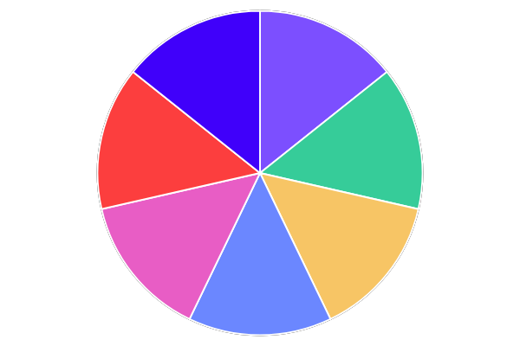
External
Market
Product
Don’t Just Bake a Piece of the Pie,
Bake the Whole Pie
Revenues
Sales
Expenses
Clients
Personnel

Slide 17
Continuing to Make an Impact
FP&A must constantly be evolving and adapting to an ever-changing business environment
Over communicate, rather than under communicate
Success is only achieved through teamwork, but failure can be done solo
Solve the questions that are not being asked, but validate they are worth solving
Develop the solutions for tomorrow, not yesterday
Don’t be afraid to invite others in – The more people involved the more uses and demand that typically comes out
Notes:
The best relationships are built with empathy

Slide 18
“I want my FP&A partner at the table with me when making decisions”
̶ Lisa Hunt, EVP International Charles Schwab

Slide 19
Questions?
Q&A with your speaker

