Slide 1
Intelligent Planning: Increasing FP&A Maturity
Glen Greer, Kin+Carta

Slide 2
Contents
Kin + Carta
Why did we start using Planful?
How we planned to use Planful to increase our FP&A maturity
How we empowered operational budget holders to own their own budget
How we built a scalable revenue model suitable for business growth
What’s the “near” and “next” for K+C
3 things to remember
Q&A
Notes:
It wasn’t long ago that I was a TITLE, trying to figure out how to build an effective partnership with other department leaders that would take our business from X to Y

Slide 3
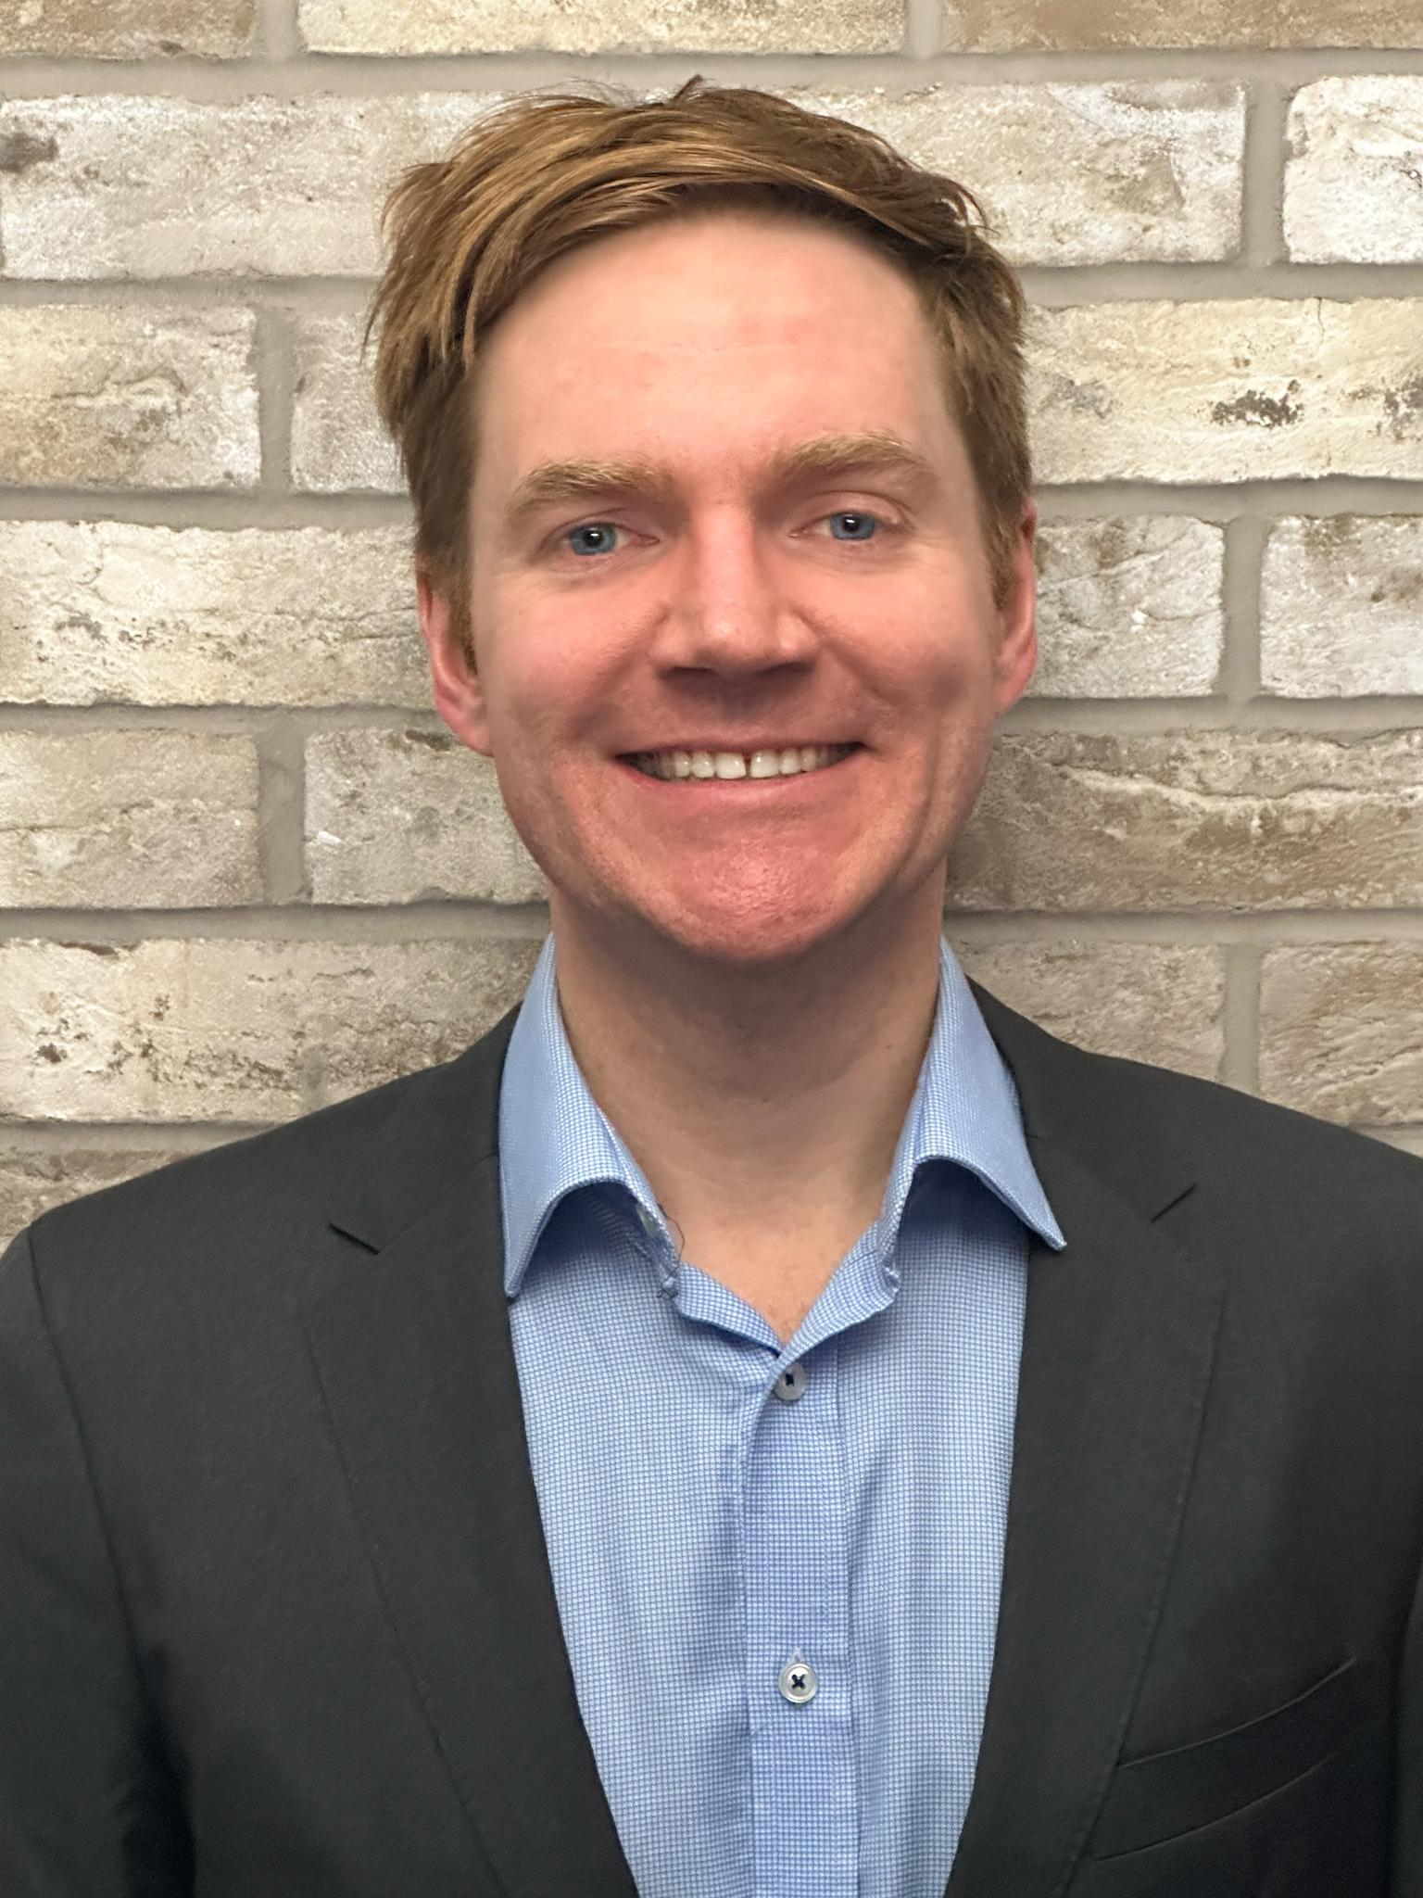
Glen Greer
Head of Finance Transformation, Kin+Carta
About Kin+Carta
Kin + Carta is a pure-play digital transformation consultancy

Slide 4
Kin + Carta is a Pure-play Digital Transformation Consultancy
Why we exist
What we do
How we grow
We exist to
build a world
that works better for everyone
Business-critical technology and data solutions
for Enterprise clients
Services
Sectors
Partners
Territories
Services
Data & AI
Experience & Product
Cloud & Platforms
Strategy & Innovation Managed Services
Sectors
Financial Services
Public Sector
Retail & Distribution
Agriculture
Manufacturing
Partners
Google
Microsoft
Amazon
Contentful
CommerceTools

Slide 5
The Why
Why did we start using Planful?
Notes:
Let’s start at the beginning of the journey

Slide 6
Why Planful?
Our previous consolidation and budgeting solution was antiquated causing more manual effort and time spent completing routine financial close tasks.
Notes:
Problem statement
On prem solution
Series of manual input schedules that required a lot of manual work

Slide 7
We Set Out to:
Reduce time and effort it takes to plan, report and close our books
Increase the reliability and ease of use of our data
Enhance the finance user experience
Digitise the budget and forecast process
Notes:
Our initial North Star for the project
Last one there being “digitise” the budget and forecast process
This was phase 1
Uploading forecasts via DLR

Slide 8
FP&A Maturity Model
Developing
Digitise
Automate
Predict
No defined process
Manual data entry
Short term
Limited technology & collaboration
Integrations with other business functions via ERP
Basic analytical reporting
Minimal collaboration
Multi-dimensional driver based models
Easy scenario analysis
Collaborative planning
Self-service planning tools
Real-time insights
Predictive & prescriptive modeling
Integrated, self-service systems
Notes:
Phase 2 set out to push FP&A further - we wanted to “automate”
Maturity is a journey - we set out to digitise in phase 1
The journey is important because you have to take users with you along the way
Get them comfortable with the system: how it works, how data is captured and stored, used to doing things a different way etc
Maturity is more detailed than this and would have a lot more on people & process but wanted to share technology
Kin and Carta has always been a listed company on the London Stock Exchange and has had a responsibility to keep the market informed
Therefore it has always had a robust forecasting process with regular cycles
However, the previous structure was more like an investment company with a portfolio of businesses which had more independent management
Our approach to maturing the organisation has been a journey: it is difficult to take users from basic to automate or Digitise to Predict
We have staged our roll-out to bring our users through the stages with a goal of hitting “automate” by the end of the initial Planful programme

Slide 9
Increasing FP&A maturity - “Automate”
System
Transparency & consistency on drivers of financial forecasts
A common language
Processes
Synchronised with reporting of actual results
Easier updates based on key input drivers
Analysis
More automated scenario modelling
People
Enable FP&A professional so they can more easily support the organisation & make better decisions
Notes:
I wanted to drill in to that automate a little bit further
How did it impact People & Process

Slide 10
Planful Journey (so far…)
2022
2023-H1
“Phase 1:” Consolidation & “as is” reporting
“Phase 2:” Forecasting by supplier & by tool
“Phase 2:” Overhead workforce planning
“Phase 2:” Driver based bottom-up gross margin
“Phase 2:” Top down Dynamic Planning
Notes:
The journey over a timeline
Phase 1 was by far the smallest phase
Break for year end (summer)
Slowed down coming in to phase 2
Bringing incremental value as we go getting users more used to the tool
1st part of phase 2 saw us have users use templates to capture forecast information

Slide 11
Problem 1
It was difficult to empower operational budget holders to own their own budget
Notes:
We had to solve this with phase 2
We needed to increase maturity to solve it

Slide 12
Empowering Budget Holders
Leverage Structured Planning
Spend by supplier
Spend by IT tool
Workforce Planning
Our current headcount
Track new hires
Notes:
Rolling forward the forecast - used to be a manual process for reforecasts

Slide 13
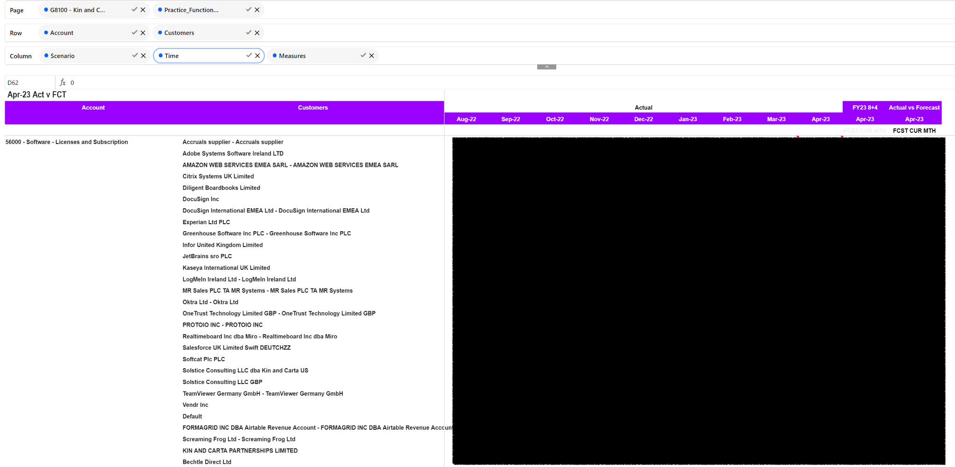
Forecast VS Actuals by Supplier
Show me my suppliers forecasted costs vs actuals?
Show me my new tools budget for Marketing?
Notes:
Restricted it to specific general ledger accounts
Don’t need to see rent by supplier as an example
The supplier names pull from our ERP so they are available to forecast against
We came up with this idea of “Planful only suppliers”
Marketing wants to buy something in December but they don’t know from who - so use a Planful only supplier

Slide 14
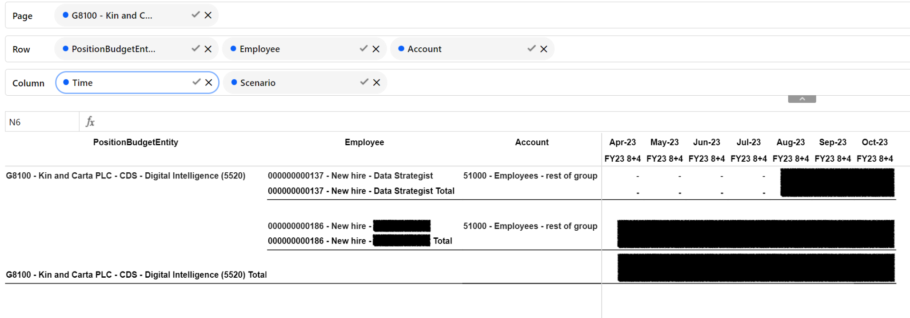
Workforce Planning
Can I see my budgeted new hires?
Can I afford to bring this new hire forward by 3 months?
Notes:
We just started with opex staff spend - most of our business is delivery people
VP of IT to show him how many new hires he has in the budget
Link it to real world scenarios - how much do we save if we delay this hire by 3 months

Slide 15
“Planful has enabled us to contribute the right insights, through the right channels to the right people at the right time”
– Dominic Hawkes, Global FP&A Manager

Slide 16
Problem 2
Regional Excel models were not scalable to support business growth and were difficult to maintain
Notes:
We had to solve this with phase 2
We needed to increase maturity to solve it
Top down pipeline view of revenue coupled with a bottom up gross margin model

Slide 17
Establishing Drivers
Conversations with regional leaders about what drives their supply
Two way learning process between central FP&A and regional teams
A fundamental aspect of the FP&A maturity model
THE OUTPUT
An agile and intelligent way to forecast
Notes:
They were at different levels of maturity themselves with forecasting
One had a lot of detail with a full staff roster of hundred of people they would make updates to each month
The other was too zoomed out
We sat down together and established drivers - the output an agile and intelligent way to forecast

Slide 18
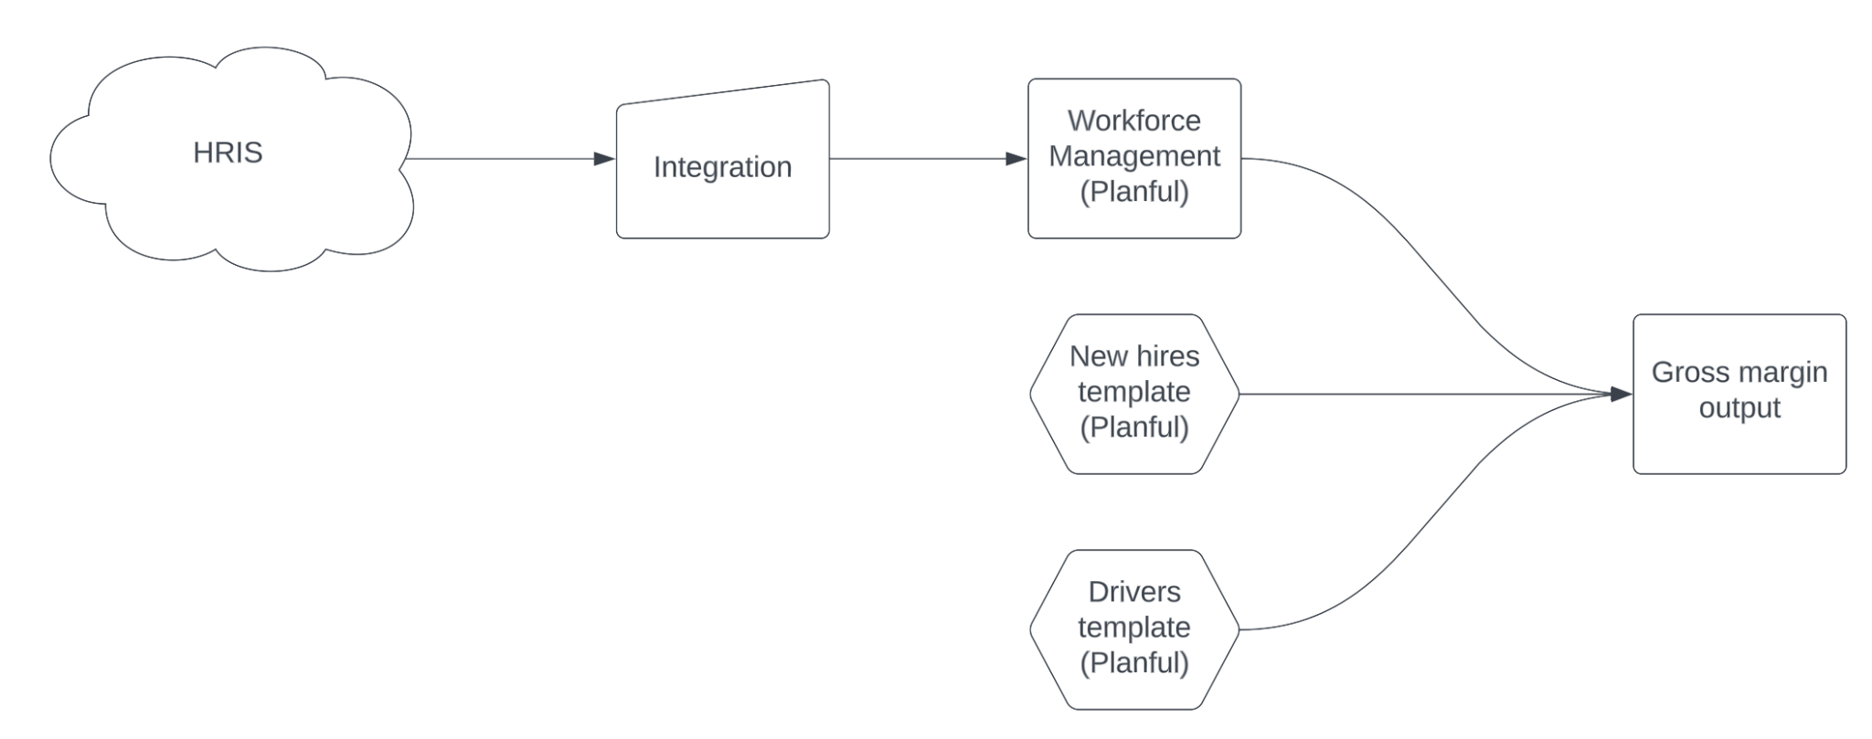
Utilising drivers
Managing supply (when and who to hire) is one of the most complicated arrears of our business
Aligned globally on drivers:
Utilisation %
Contractor mix
Nearshore mix
Level of resource
These drivers produce revenue and labour costs associated to the resource
Notes:
The hardest part of our business is balancing the supply & demand
It changes frequently and has traditionally been difficult to forecast
Different approaches regionally
Fundamental aspect of the FP&A Maturity Model
Creates an intelligent, agile process
This is our bottom up gross margin model

Slide 19
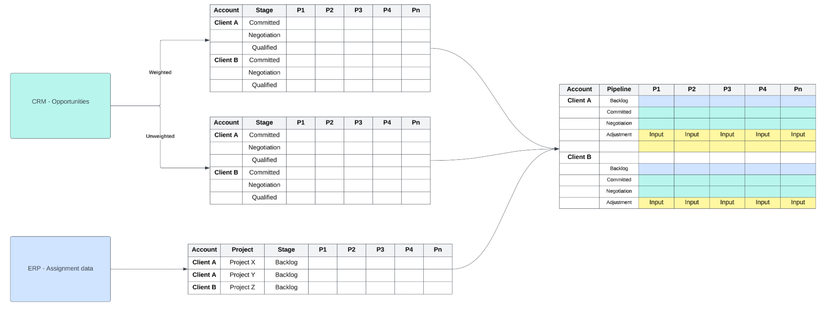
Dynamic Planning
Integrate with CRM & ERP data in Dynamic Planning to establish Analytical models
Notes:
This is our top down revenue model

Slide 20
The Future… “Near” & “Next”
Operations deep dive
Scenario modelling
Greenhouse integration (talent acquisition tool)
Predictive analysis
HRIS integration
Notes:
As we continue to present data in different ways the business continues to ask for more and more
Operations deep dive is about pushing budgets to budget holders
We want them in Planful so they can work with FP&A BPs to update new hires etc
To continue the maturity journey of our FP&A function we are continuing to invest in Planful alongside building more deep knowledge in our Global Business Services Centre in Sofia Bulgaria
Greenhouse integration
Predictive analysis - super excited to try but want to get more good data in the system first

Slide 21
3 things to remember
Maturity is a journey you have to take everybody on
Check in with Stakeholders regularly
Keep the North Star in focus

Slide 22
Questions?
Q&A with your speaker

