Slide 1
Best Practices for Integrating your Marketing Plan
5/11/23

Slide 2
Agenda
Introductions
Why?
Introducing an Automated Marketing Plan
Marketing Challenges
Automation Solutions
Q&A

Slide 3


Alex Kiritsy
Sr. Onboarding Manager, Planful for Marketing (PFM)
Currently oversees the PFM Implementation team
Has spent 3 years working with PFM and developed the PFM PS team from the ground up
Experience managing over 200+ PFM implementations
Enjoys playing pickup sports with friends, trying under-appreciated restaurants, & traveling around the world

Slide 4


Bridges Smith
VP Product, Planful for Marketing
Responsible for product management and engineering
Former CTO of Plannuh
20+ years of experience in high-tech product leadership
Enjoys running, hiking, tennis, and volunteering as firefighter/EMT for his local fire department

Slide 5
Why Integrate your Marketing Plan?
Accuracy
Timeliness
Visibility
Notes:
Marketing teams that don’t have an integrated marketing plan, and don’t leverage automation fall into the traps of the 3 items above.
Accuracy: When data is not fed from your source of truth, whether it be your CRM, ERP or other data warehouse… you ultimately end up keying in data manually to account for either your costs or your returns. This is like manually tracking your stock portfolio. Imagine how tedious that would be to purchase your investments manually, and then track whether they have gone up or down and by how much they have gone up or down. We’ll come back to this analogy later.
Timeliness: Not only is accurate data a challenge for teams, but getting data in a timely manner can be also be a major challenge. Many marketing teams will generate Impressions, Responses, Leads, & Opportunities through their investments, but they can’t point to the return on their investments (to no fault of their own) simply due to their business operating with a longer sales cycle…therefore a response or a lead may only turn into legitimate revenue 3, 6 or 9 months down the road. We’ll talk about how you can leverage automation and Planful for Marketing’s unique metric funnel capabilities to solve this problem….
But it’s not just marketing outcomes that are faced with a lack of timeliness, we also have marketing costs that tend to lack timeliness. Marketing team members often know when a vendor has been paid and the approximate cost, but when utilizing a source of truth like your ERP (to ensure accuracy), you sometimes fall prey to the practices of the accounting team. IF we put our accounting hat on for a second, the challenge is clear when you understand how the accounting team closes the books. Toward the end of the month, the accounting team will capture all of the marketing team’s costs and post them to the GL (regardless if these are individual employee expense reports, invoices, cc charges, accruals, amortizations, or the long tail of marketing expenses). Yet, this process can often take days or even weeks AFTER THE MONTH HAS ENDED to complete… ultimately leading to a lag in a major input of your marketing plan, costs… we’ll talk about how Planful for Marketing solves for this as well… :)
Agility: So we’ve talked about the challenges of accuracy and timeliness at length… let’s now get to the most important point.. Agility… and for this, i’m going to return back to our investment portfolio analogy. Imagine you have a portfolio of 15 stocks and 1 investment has outperformed to the point that you want to add to your winners. Now, there are certainly some investment practitioners that would argue that adding to your winners after they have made a major run may not be the wisest investment strategy, but we’re not here to talk investment philosophy… the point is that almost 100% of the investment world can execute this type of strategy within minutes with amazingly little effort and not have to worry about the tax implications, the effect it has on your portfolio, the underlying risk you are taking, and the and all the other points of tediousness.… it’s all AUTOMATED and the visibility is there for you at your fingertips. Yet, in the marketing world, that luxury of automation and visibility is a foreign concept to many teams.
You see, Marketing teams oftentimes don’t have the ability to pivot on a moments, notice, they don’t have the ability to respond to the market or economic pressures midway through the year, because their various data inputs are not automated into a consolidated tool. Therefore, when the CEO or the board says we’re making a strategic shift in response to market conditions and we need to go upmarket, the exercise of understanding where to reallocate investments in an efficient, data driven manner is not a viable possibility.

Slide 6
For What Purpose?
Notes:
WHY IS accuracy, timeliness, and visibility so important… because they all allow you to BE MORE AGILE!

Slide 7
Automated Marketing Plan
Definition: An automated marketing plan leverages technology to marry the marketing teams’ investments to outcomes, ultimately allowing the CMO to be more agile to respond to constantly changing market dynamics & prove the value of marketing

Slide 8
The Problem: We run our digital ad campaigns on a variety of platforms and…
The data is siloed, whether it be in Google, Linkedin, or Facebook
&
The method to account for & track payments of these investments do not align with how we allocate our budget
Running Digital Ad Campaigns

Slide 9
Example Accounting Treatments
Example 1: Accrual
Example 2: Granular CC charges
Journal Entry Memo | Timeframe | Amount | GL Code
Google Ads Feb Accrual | February | $44,000 | 65234 - Demand Generation
Journal Entry Memo | Timeframe | Amount | GL Code
Google Ads Amex Charge | February | $500 | 65234 - Demand Generation
Google Ads Amex Charge | February | $500 | 65234 - Demand Generation
Google Ads Amex Charge | February | $500 | 65234 - Demand Generation

Slide 10
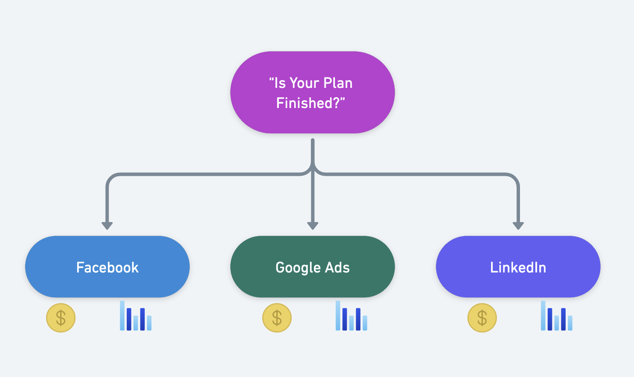
The Solution: Digital Ad Automation

Slide 11
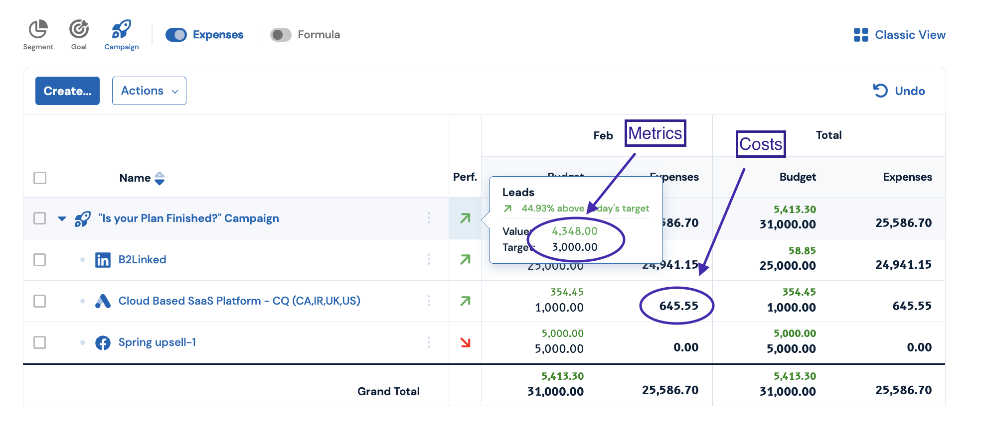
Digital Ad Vendors- An Automated Solution

Slide 12
Benefits
Marketing
Budget & reforecast campaign costs accurately
Provide enhanced visibility to campaign & channel managers
Daily sync of ad vendor data allows marketing team to optimize spend performance in real time
Finance
Accurate cost data leads to better forecasting and accruals management
Visibility into marketing budget & plan builds trust between the two teams
Timely data reduces hassle and stress of working with marketing to close the books

Slide 13
The Problem: We have our marketing plan and budget established but no insight into what is approved…
The data is siloed between PFM, Spend Approval Sys, and ERP
&
The marketing team does not have insight into what % of their plan has been approved by Finance
Providing Approval Visibility

Slide 14
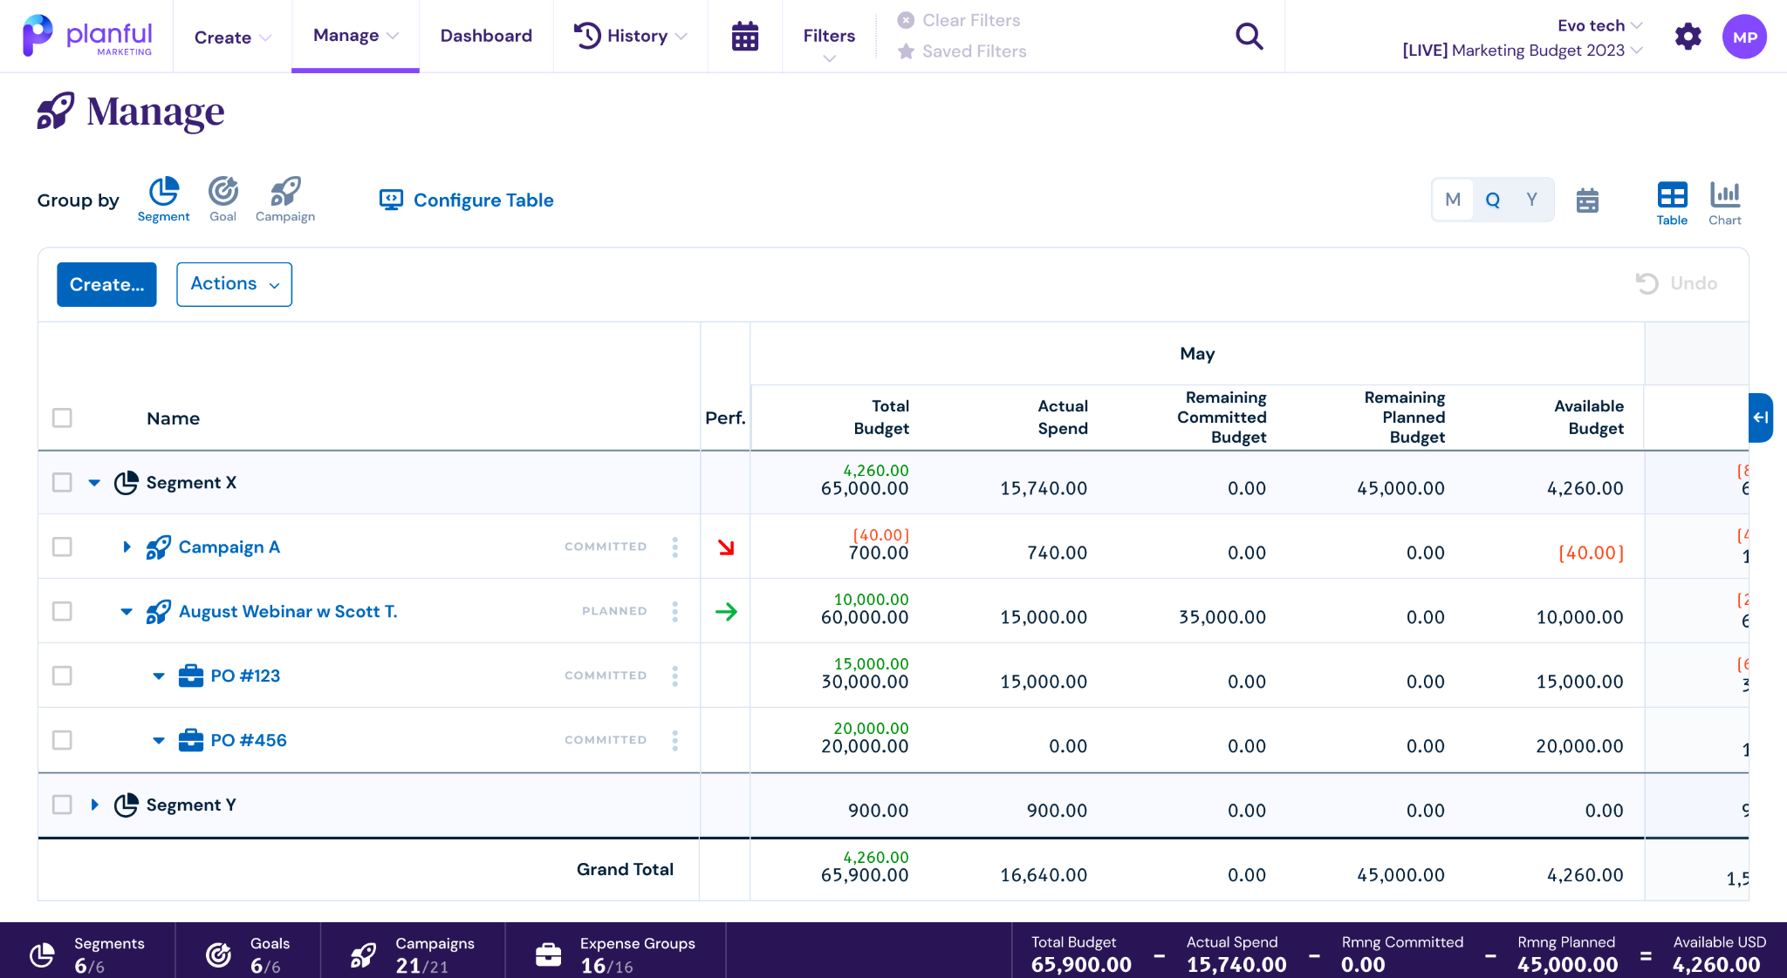
The Solution: PO Automation

Slide 15
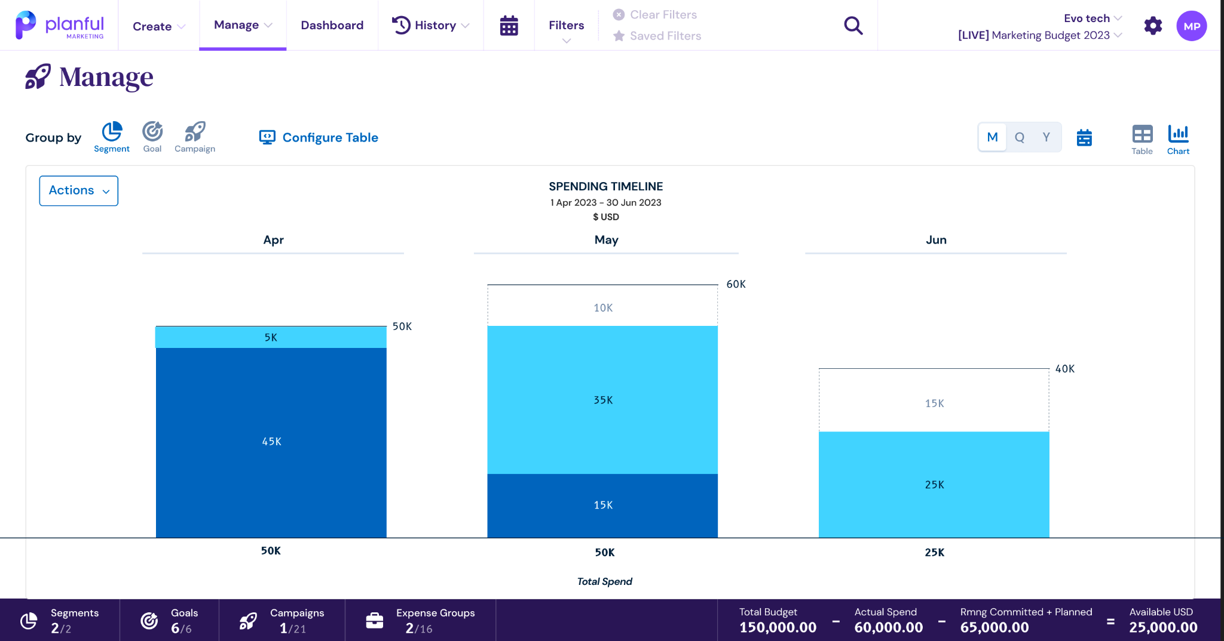
The Solution: PO Automation

Slide 16
Questions?
Q&A with your speaker

Slide 17


