Slide 1
Confronting Financial Disruption With Confident FP&A Decisions
Carl Seidman
Principal, Seidman Financial
CPA/CFF, CSP, CFE, CGMA, CIRA, AM

Slide 2
Confronting Financial Disruption With Confident FP&A Decisions
Types of financial disruption and impact we see
Preparedness and the role of FP&A
The evolution of FP&A in managing disruption
Forecasting, planning, & analysis
KPIs and collaborative performance management
Building a resilient and adaptable function
Q&A

Slide 3
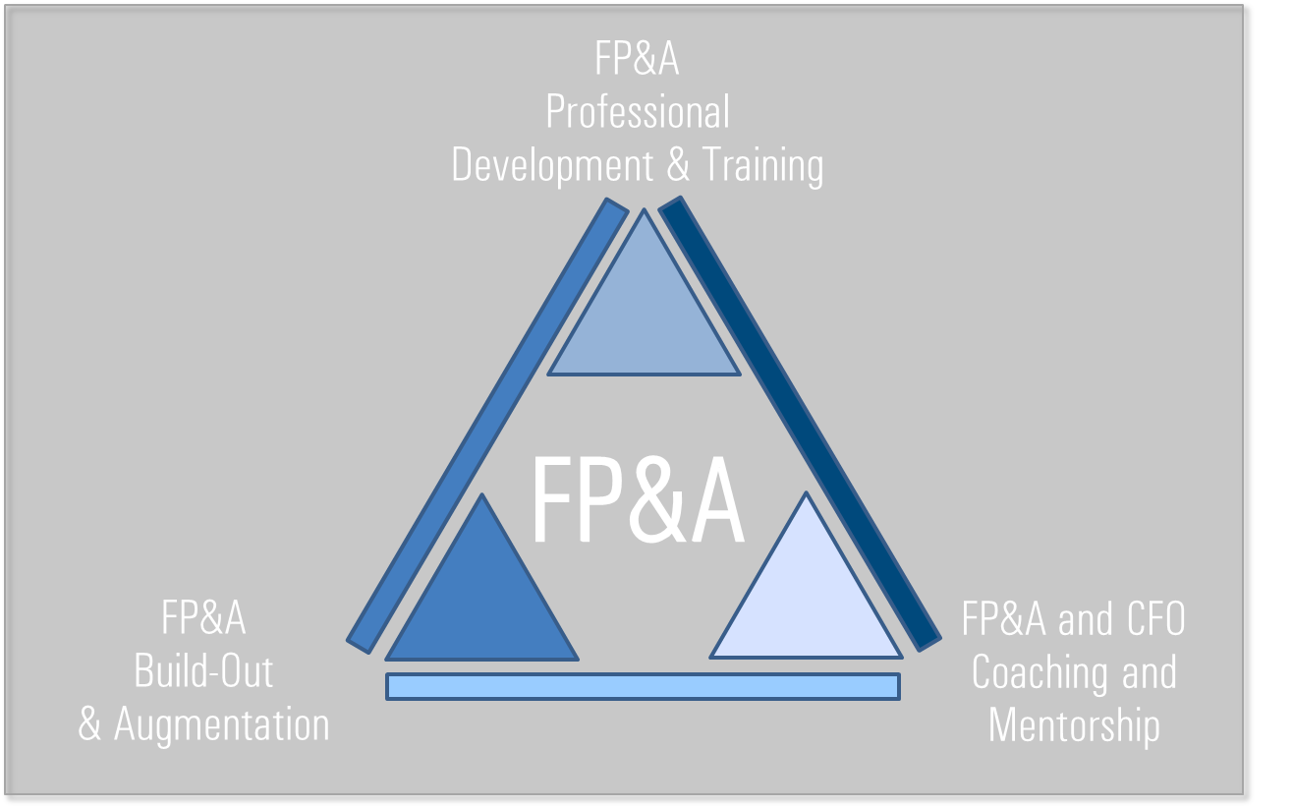
About
Carl Seidman
Principal
Seidman Financial
CPA/CFF, CSP, CFE, CGMA, CIRA, AM
carl@seidmanfinancial.com
Linkedin.com/in/carlseidman

Slide 4
POLLING QUESTION #1
❶
What have been the primary sources of disruption for your business over the last 3 years? (supply chain, technological disruption, regulatory changes, changing customer behaviour, geopolitical or environmental other)
❷
What is currently the primary source of disruption?
Notes:
Time: 1.5 mins
Carl to initiate poll and elaborate on poll responses (required for CPE)

Slide 5
Disruptions
Types and Impacts

Slide 6
Types of Financial Disruption
Disruption of the Supply Chain
Disruption from Reduction in Demand
Disruption from Rapid Growth
Disruption from Financial Distress
Disruption from Regulation
Disruption from Transactions

Slide 7
At a high level –
What events over the past 5 years have been the most disruptive in industry and companies?

Slide 8
Preparedness
And the role of FP&A

Slide 9
Types of Financial Disruption
✓
✓
Disruption of the Supply Chain
Disruption from Reduction in Demand
Disruption from Rapid Growth
Disruption from Financial Distress
Disruption from Regulation
Disruption from Transactions

Slide 10
At a high level –
How would we describe the degree of preparedness to deal with disruption?

Slide 11
99%
70%
60%
What changed?
Title
Title
Title
How would we describe the degree of preparedness?
Why do we feel companies weren’t as prepared as they would have liked?

Slide 12
Forecasting Planning & Analysis
In Times of Disruption

Slide 13
How do rolling forecasts help?
What are best practices when times are uncertain?

Slide 14
POLLING QUESTION #2
❶
How frequently are you reforecasting or updating your forecasts? (weekly, monthly, quarterly, ad-hoc)
Does this change when times are more uncertain? (yes, no)
❷
Notes:
Time: 1.5 mins
Carl to initiate poll and elaborate on poll responses (required for CPE)

Slide 15
At a high level –
How would we describe the (rolling/static) forecasting process 5+ years ago?

Slide 16
99%
70%
60%
What’s next?
Title
Title
Title
How would we describe the former process
How did the process and what they paid attention to need change

Slide 17
Forecasting, planning and analysis trends we see
Increased focus on data-driven decision making
Greater focus on business partnership
Real-time reporting and analytics
Attractiveness of scenario- and dynamic planning
Acceptance of cloud-based FP&A platforms
Intrigue around how AI can augment finance

Slide 18
KPIs and Performance Management
In Times of Disruption

Slide 19
POLLING QUESTION #3
❶
What are key performance metrics, ratios, or targets that your company monitors? (can multi-select: financial, customer KPIs, operational KPIs, not measuring)
Notes:
Time: 1.5 mins
Carl to initiate poll and elaborate on poll responses (required for CPE)

Slide 20
At a high level –
How has performance metric tracking changed over the past 3-5 years?

Slide 21
99%
70%
60%
What’s next?
Title
Title
Title
How would we describe the former process
How did the process and what they paid attention to need change

Slide 22
Building a Resiliant FP&A Function
In Times of Disruption

Slide 23
Questions?
Q&A with your Carl

Slide 24
Summary of Key Points

Slide 25
Carl Seidman
Principal
Seidman Financial
CPA/CFF, CSP, CFE, CGMA, CIRA, AM
Contact
carl@seidmanfinancial.com
Linkedin.com/in/carlseidman

