Slide 1
The AllCampus Success Story Using Planful for Marketing

Slide 2
Agenda
Introductions
AllCampus Overview
Challenges & Solution
Overview of PFM
Implementation & Bakerfield Value
Looking to the Future
Q&A

Slide 3
Mikayla Davidson
Solution Architect, PFM
Bakerfield Solutions
Alex Kiritsy
Sr. Onboarding Manager, Planful for Marketing
Ben Kuikman
Associate VP, Digital Marketing AllCampus

Slide 4
Mikayla Davidson
Solution Architect - PFM | Bakerfield Solutions
About Bakerfield Solutions
Established in 2006, Planful Partner Since 2013
Over 400+ Successful Planful Projects
A leading partner of Planful for Marketing
About Mikayla
BS in Marketing and Finance University of Pittsburgh
Experience as an FP&A Analyst (UPMC)

Slide 5
Alex Kiritsy
Sr. Onboarding Manager, PFM
Currently oversees the PFM Implementation team
Has spent 3 years working with PFM and developed the PFM PS team from the ground up
Experience managing over 200+ PFM implementations
Enjoys playing pickup sports with friends, trying under-appreciated restaurants, & traveling around the world

Slide 6
Ben Kuikman
Associate VP of Digital Marketing | AllCampus
Currently overseeing the paid search and paid social (PPC), organic search (SEO), organic social, and ad buying teams.
20 years in B2C and B2B marketing spanning brand development, growth, search, product, content and event marketing, as well as print advertising and social media.
Spent the last decade building and directing performance marketing teams overseeing seven and eight-figure marketing budgets.
After 15 years in downtown Chicago, moved to the suburbs in 2020. Father of two boys (4 and 2) and one girl (2 months).

Slide 7
AllCampus Overview
AllCampus is a leading online program management services provider for universities & academic programs
130 programs across 25+ industries
Partner with schools such as Boston University, University of Florida, University of Arizona & more
“We experienced a 900% increase in enrollment within the first year with their assistance”
-Department Chair @ UF

Slide 8
The Why

Slide 9
Looking to Solve a Problem
Limited Visibility
Manual Processes
Limited Strategic Decision-Making
Limited Collaboration with Finance
Disparate spreadsheets and tools managed across the team
Manually verifying report accuracy by investigating in various systems
Time spent keying in data prevented ability to drive strategic analysis and investment decisions with partners
Finance & Marketing operating in silos
Notes:
AllCampus faced significant challenges in managing their various marketing programs and campaigns, which resulted in fragmented data, manual processes, and limited visibility. Their Niche program alone had over 20 Media Calendar spreadsheets for campaign planning and budget management across schools, while their PPC program had expenses and metrics from multiple platforms tracked in Supermetrics which could not be automated into a consolidated report. Actuals in Quickbooks reports were delivered manually by finance, and program budget and expense management across all programs was managed in a Google Sheet. With a growing need for a ‘one source' repository for the Marketing team, AllCampus recognized the need for a comprehensive solution that could streamline their marketing efforts and provide a centralized platform for all their data and reporting needs.

Slide 10
The Solution

Slide 11
Marketing Performance Management
Operationalizing Your Marketing Plan
Goals-based planning
Apply success metrics
Allocate Budget
Build
Run campaigns
Manage expenses
Team collaboration
Execute
Plan effectiveness
Campaign success
Budget impact (ROI)
Goals · Campaigns · Budgeting · ROI
Measure
Revise goals
Modify your plan
Reallocate budget
Improve
Notes:
One Central Hub for Full View into Marketing Performance allowing you to:
Build marketing plans & activities to align with company goals for Full Visibility
Execute plans and campaigns with Agility & Collaboration
Measure CPO, ROI and LTV to get True Business value with Accuracy
Improve operations based on actionable insights with Efficiency
When changes occur manage, re-plan & execute with Agility
Marketing Planning Goals management
Campaign management Project management Content management
Full visibility into your Plan and Performance metrics against Goals and Budget
Indicators for when you are ahead or behind on your goals — for making better recommendations and decisions with agility and efficiency
Project and content management with timeline, tasks, calendar and filtering capabilities - for collaboration
Marketing Budgeting Easy budget import Customer budget allocation Budget forecasting & tracking Manage multiple Budgets
Fully Automated for efficiency
Full visibility into your Budget and Performance against Plan and Goals
Budget forecasting and reallocation for increased efficiency and accuracy in budget management
Customizable to unique budget categories for ease of use
Expense Management Automated expense import Automated reconciliation Intuitive expense tracking UI
Split costs & multi-currency
Fully Automated for budget performance accuracy
Automated expense entry and reconciliation for greater efficiency and increased productivity of the team
Split expenses, multi-currency and intuitive UI for ease of use
Business Value/ ROI Tracking True ROI Measurement
Performance management for Real-time forecasting of CPO, ROI, & LTV Spend by goals/type/function
Dashboards for metrics tracking
Dashboard for full visibility and accuracy in tracking Real-time performance metrics
Forecasting Estimated Business value of Marketing Campaigns
Calculating CPO, ROI, & LTV to prove, improve and optimize the Value of Marketing

Slide 12
Simple to Start with Planful for Marketing
Crawl, Walk, Run with Planful for Optimization
Marketing Performance Management
Calculate your business value
Calculate CPO, ROI, LTV
Performance forecasting
Scenario planning
Agile replanning
Benchmarking
Sales funnel
Marketing Plan Management
Set up and manage goals
Campaign management
Performance management
Project and content management
Team collaboration
Budget Management
Import and allocate budget
Manage expenses
Track spend
Notes:
EASY TO GET STARTED WITH *Planful for Marketing* Our Dedicated Customer Success Team will be there every step of the way
Complete Onboarding & Training
Consultative set up & organization
Implementation
Bi-weekly consultative meetings
Though Adoption of all product features suitable to your needs
Tips & tricks

Slide 13
Implementation Solutions

Slide 14
Solutions to Drive Value
Utilizing Planful for Marketing hierarchy to operationalize AllCampus marketing plan
Automating data inputs to reduce manual expense management and budget reallocations
Leveraging campaign insights to provide visibility into best performing campaigns
Utilize PFM reporting & permissioning to bridge gap between Marketing & Finance

Slide 15
The Bakerfield Value
Best Practices in Finance and Technology
Cross Department Collaboration
Increasing Efficiency, Saving Time
Configuration of Segments, Goals & Campaigns
Migration of Existing Marketing Data

Slide 16
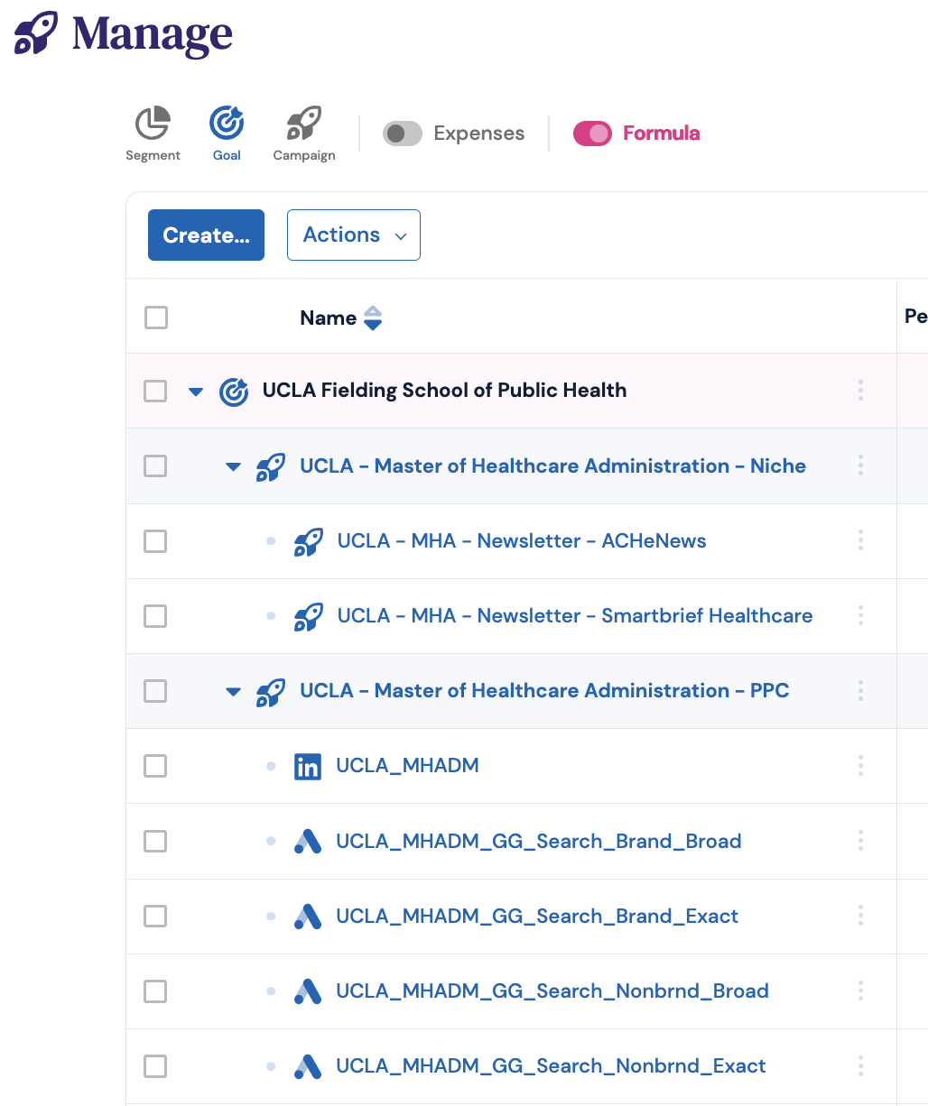
AllCampus Marketing Plan in PFM
AllCampus Budget Categories
AllCampus Partners
Partner-Specific Program
Integrated Digital Campaigns
Integrated Expenses

Slide 17
Automating Data into PFM
CAMPAIGNS:
Digital ad vendors
Campaign data connectors
Segment
Goal
Thematic Campaign
METRICS:
Digital ad vendors
Metrics data connectors
Campaign
EXPENSES:
ERP Systems
Prepaid Expenses
Credit Card Transactions
Digital ad vendors
Expenses

Slide 18
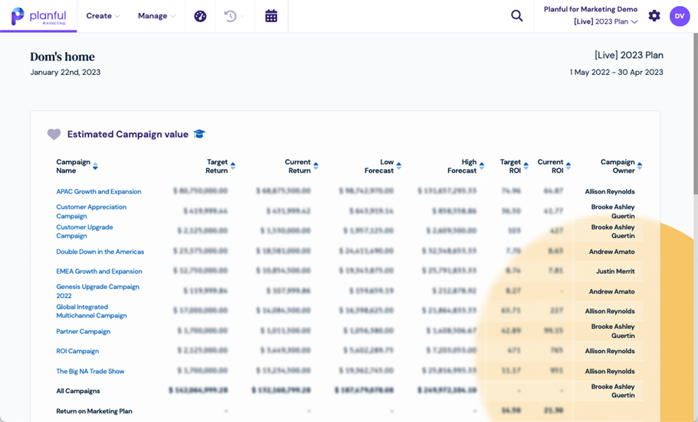
Campaign Insights
PFM Campaign Insights allows the AllCampus team to make better investment decisions on behalf of their partners

Slide 19
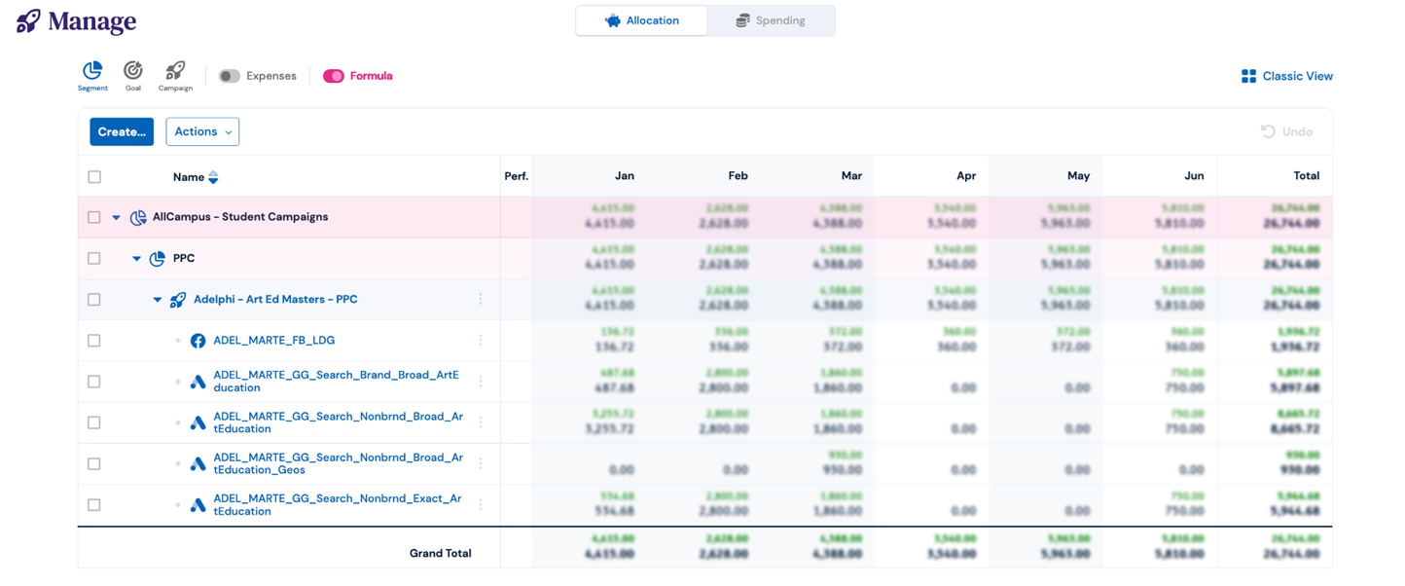
Bridging the Gap Between Finance & Marketing
Providing full visibility into anticipated spend below the GL

Slide 20
Looking to the Future

Slide 21
Leveraging Further Metric Insights

Slide 22
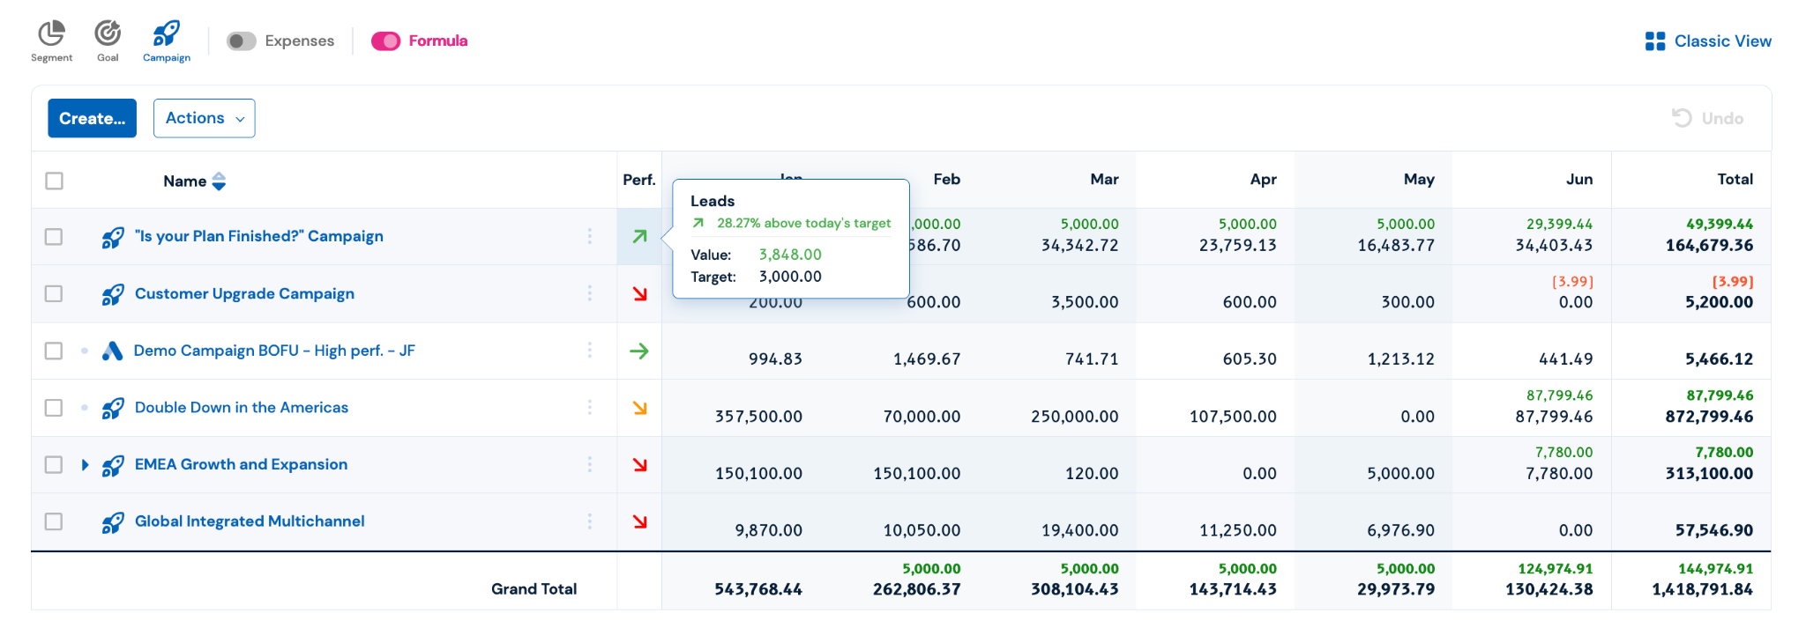
Leveraging Further Metric Insights

Slide 23
Questions?
Q&A with your speaker

